Slide 1
What is a P-value? Michael Sullivan Joliet Junior College msulliva@jjc.edu sullystats@gmail.com www.sullystats.com

Slide 2
A Small p-value suggests one of two things:
The statement in the null hypothesis is true and we observed an unusual result
The statement in the null hypothesis is not true
Notes:
In hypothesis testing, the null hypothesis is a statement of “no change” or “no effect”. The idea behind hypothesis testing is to judge whether an observed difference is unusual under the assumption the statement in the null hypothesis is reality. This is done via the P-value. The P-value is the probability of observing an effect as extreme or more extreme than that observed assuming the statement in the null hypothesis is true. A “small” P-value means one of two things:
The statement in the null is true and we observed an unusual result.
The statement in the null is not true.

Slide 3
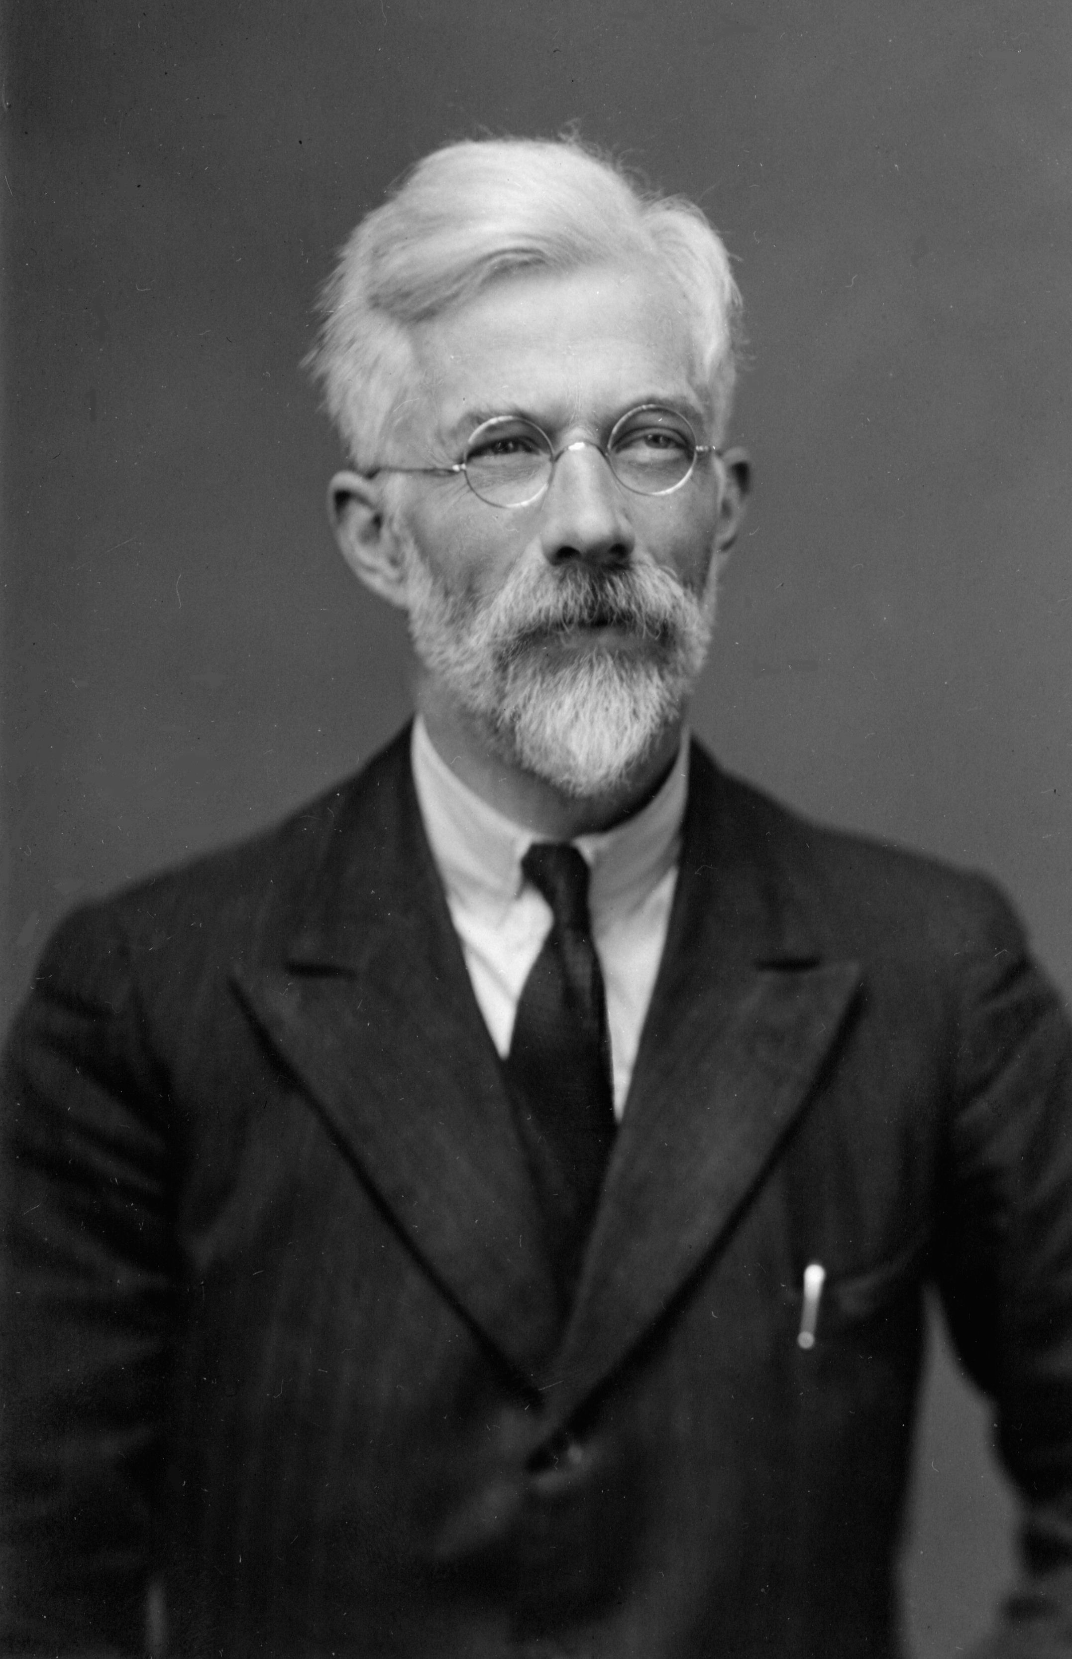
“No scientific worker has a fixed level of significance at which from year to year, and in all circumstances, he rejects (null) hypotheses; he rather gives his mind to each particular case in the light of his evidence and his ideas.”
-Ron Fisher (1956)
Notes:
According to Ron Fisher, the smaller the P-value, the stronger the evidence against the statement in the null hypothesis. How small should the P-value be to reject the statement in the null – that is up to the researcher (and should be decided prior to the data collection/data analysis phase of the study process). In 1926 Fisher suggested levels of significance of 1% or 5% depending on the goals of the research (or the consequences of making a Type I Error). The only reason the 1% or 5% level of significance is in use is because these values were printed in his book (due to constraints of the printed page). In 1956 Fisher elaborated by saying, ““no scientific worker has a fixed level of significance at which from year to year, and in all circumstances, he rejects (null) hypotheses; he rather gives his mind to each particular case in the light of his evidence and his ideas.” Fisher also indicated that a small P-value warrants further investigation – not that a small P-value means the case is closed.

Slide 4
H_{o}: Statement of no change (no wedding)
H₁: Statement looking to gather evidence in support of (wedding)
Notes:
As Ron Wassertein (former president of the American Statistical Association) so aptly put it, a small P-value is like a good first date. You are not ready for a wedding but are certainly willing to investigate the relationship further.
H0: Statement of no change (no wedding) H1: Statement looking to gather evidence in support of (wedding)
That is, more dates mean more data. Hopefully, each date leads to data that allows for rejection of the null hypothesis.

Slide 5
Do your students understand what a P-value measures?
Notes:
If you asked your students to define a P­-value, what type of response would you get? Do you believe your students have a solid grasp of what a P­-value represents? Do you believe that students truly understand what the models we use to obtain a P-value actually represent?
If the answer to your question is “no”. Don’t feel bad. Watch this.

Slide 6
FiveThirtyEight.com
Not Even Scientists Can Easily Explain P-Values
Notes:
Okay. So, is there anything we could do to increase our students' conceptual understanding of a P-value? Yes!!
Let’s go through an example where we use simulation to approximate a P-value. From this type of simulation, students will get a real sense as to what the P-value is measuring and how it can be used to judge the statements made in the null and alternative hypothesis. Finally, this approach will allow students to see why models such as the normal model might be useful in finding P-values.

Slide 7
Using an Urn
The proportion of the human population that is left-handed is 0.12. Mensa is an organization of high-IQ individuals (to qualify to be a member of Mensa one’s IQ must be at the 98th percentile). In a random sample of 20 members of Mensa, it was found that 4 were left-handed. Does this result suggest that a higher proportion of Mensa members are left-handed that the general population?
What is the variable of interest in this study? Is it qualitative or quantitative?
What are the null and alternative hypotheses?
Build a null model that could be used to simulate the outcomes of the study. Hint: There are approximately 120,000 members of Mensa worldwide. Under the assumption the null hypothesis from part (b) is true, how many of the 120,000 Mensa members would be left-handed? How many would not be left-handed?
Simulate 5000 repetitions of this study. What does the result suggest?
Use the binomial probability distribution function to find P(X > 4) where n = 20 and p = 0.12.
Notes:
For part (c). In StatCrunch, select Applets > Simulation > Urn sampling.
For part (d), click 1 Run.

Slide 8
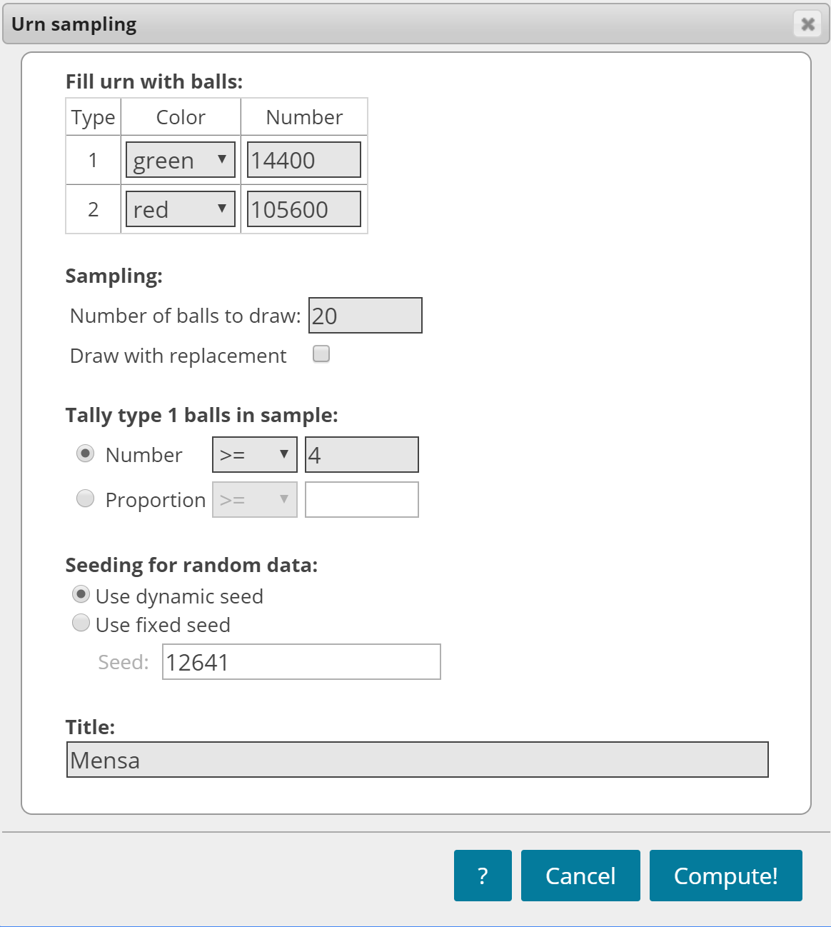
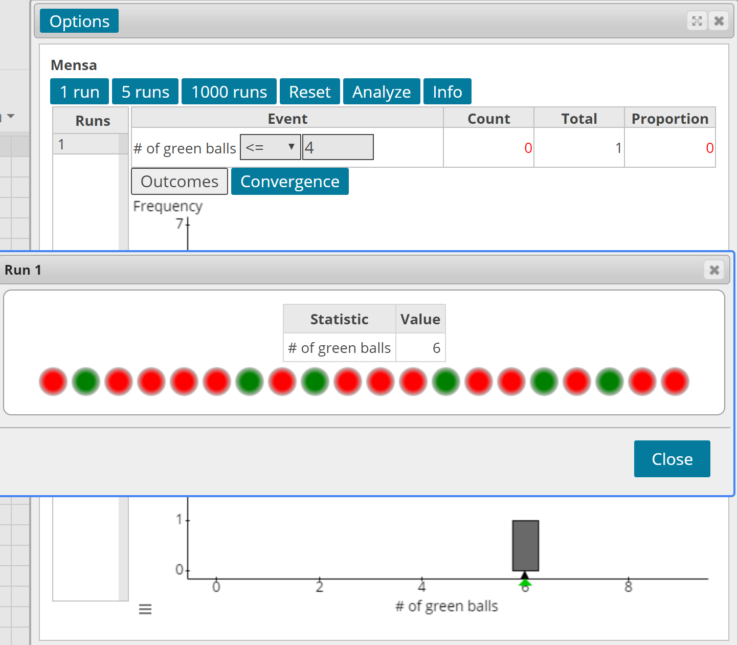

Slide 9
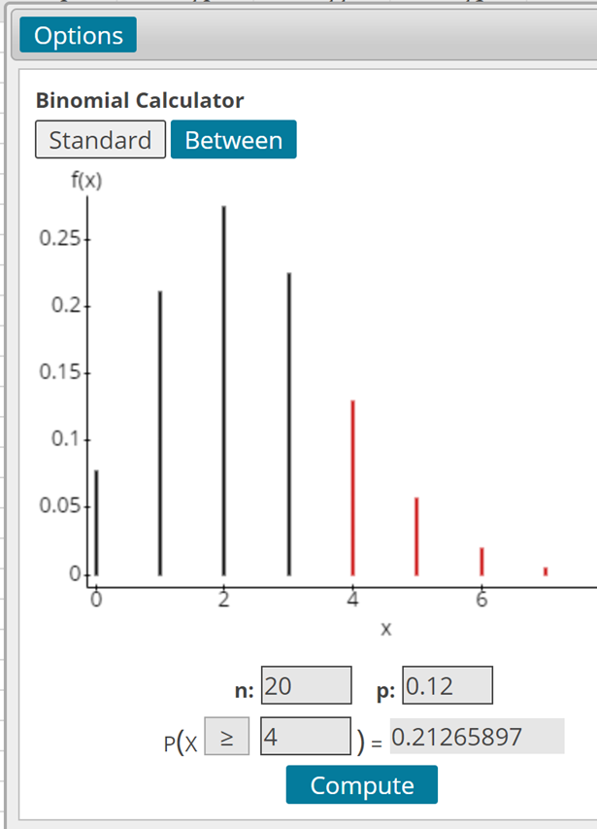
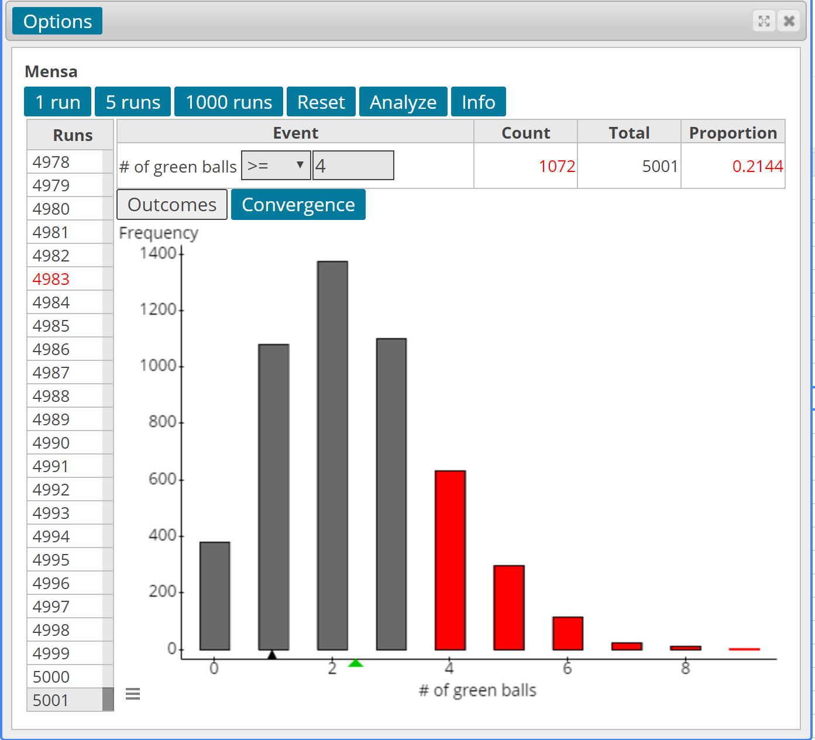
Notes:
For the binomial probability, select Stat > Calculators > Binomial
The “absolute effect size” is the difference between the mean outcomes in two different groups. In the single sample case for a proportion, the absolute effect size is the difference between the population proportion stated in the null hypothesis and the sample proportion. The absolute effect size in the two scenarios presented is the same.
Absolute Effect Size = 0.2 – 0.12 = 0.08
It is very difficult to reject the statement in the null hypothesis (even for large absolute effect sizes) when the sample size is small. Put another way, a small sample size leads to studies with weak power – the ability to correctly identify an effect (that is, correctly reject the statement in the null hypothesis).
Encourage you to have students do this and share their estimate of the P-value.

Slide 10
Approximate P-value
= 0.135 + 0.057 + 0.015 + 0.006 + 0.001 = 0.214

Slide 11
Visit https://www.sullystats.com/statistics-6e/r-guidebook/ To Learn some R Code

Slide 12
The Role of Sample Size
The proportion of the human population that is left-handed is 0.12. Mensa is an organization of high-IQ individuals (to qualify to be a member of Mensa one’s IQ must be at the 98th percentile). In a random sample of 120 members of Mensa, it was found that 24 were left-handed. Does this result suggest that a higher proportion of Mensa members are left-handed that the general population?
Build the Urn applet again and run 5000 simulations. Be sure to select proportions.
Click Analyze. Find the mean and standard deviation of the 5000 sample proportions.
Determine the mean and standard deviation of the sample proportion assuming p = 0.12. Compare to part (b).
Use the normal model to find the probability of observing 24 or more left-handers from a population whose proportion is 0.12.
Notes:
For part (c), select Stat > Summary Stats > Highlight the mean and standard deviation.
For part (d), the theoretical mean is 0.12 and the theoretical standard error is sqrt(0.12*0.88/120) = 0.0297.

Slide 13
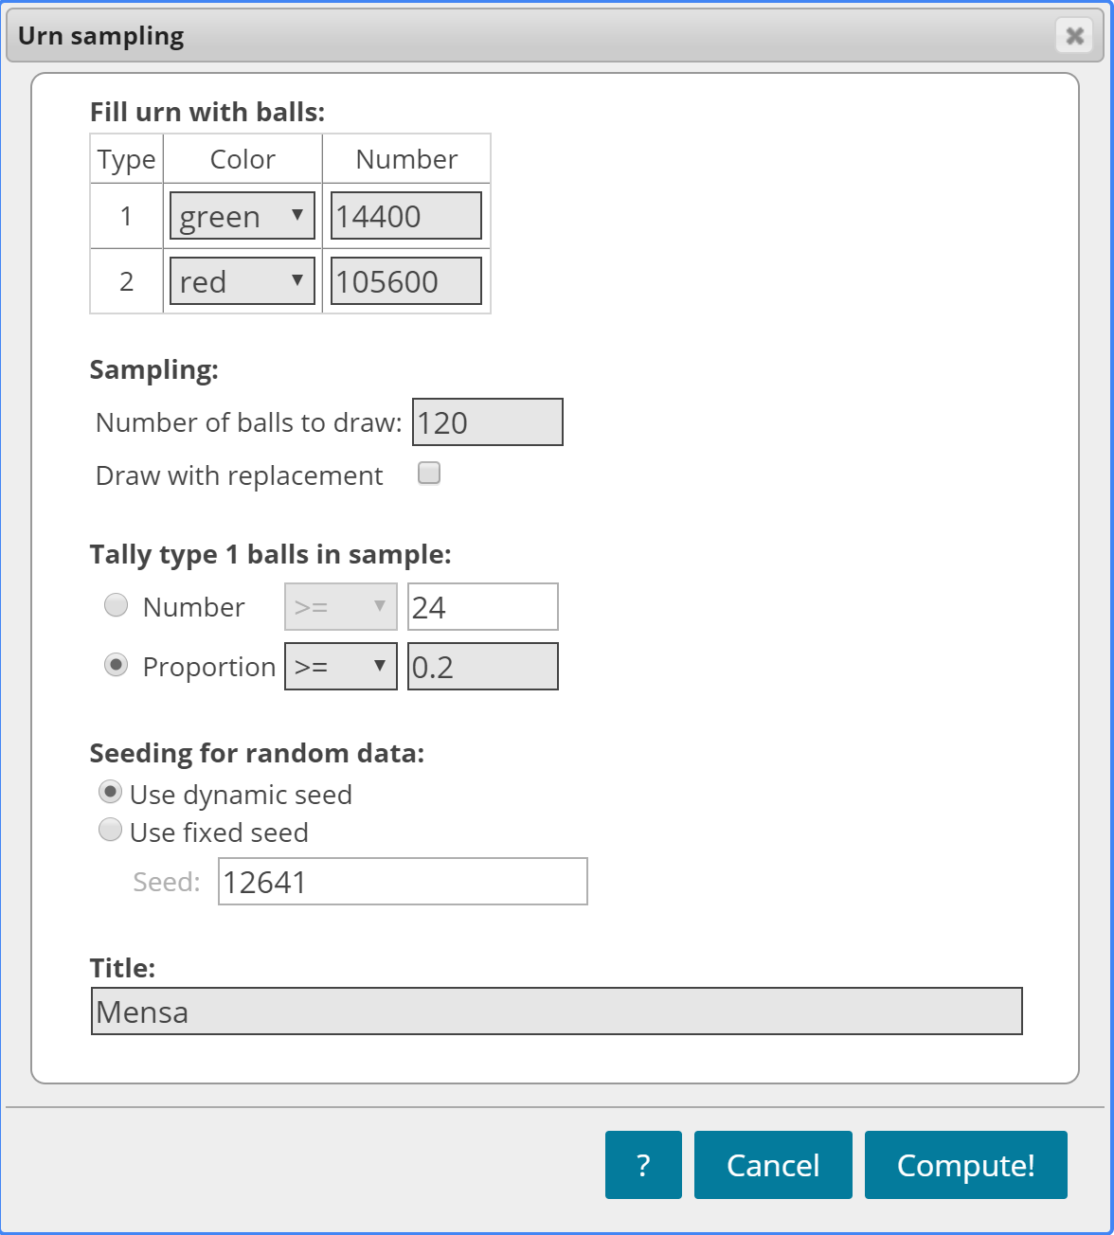
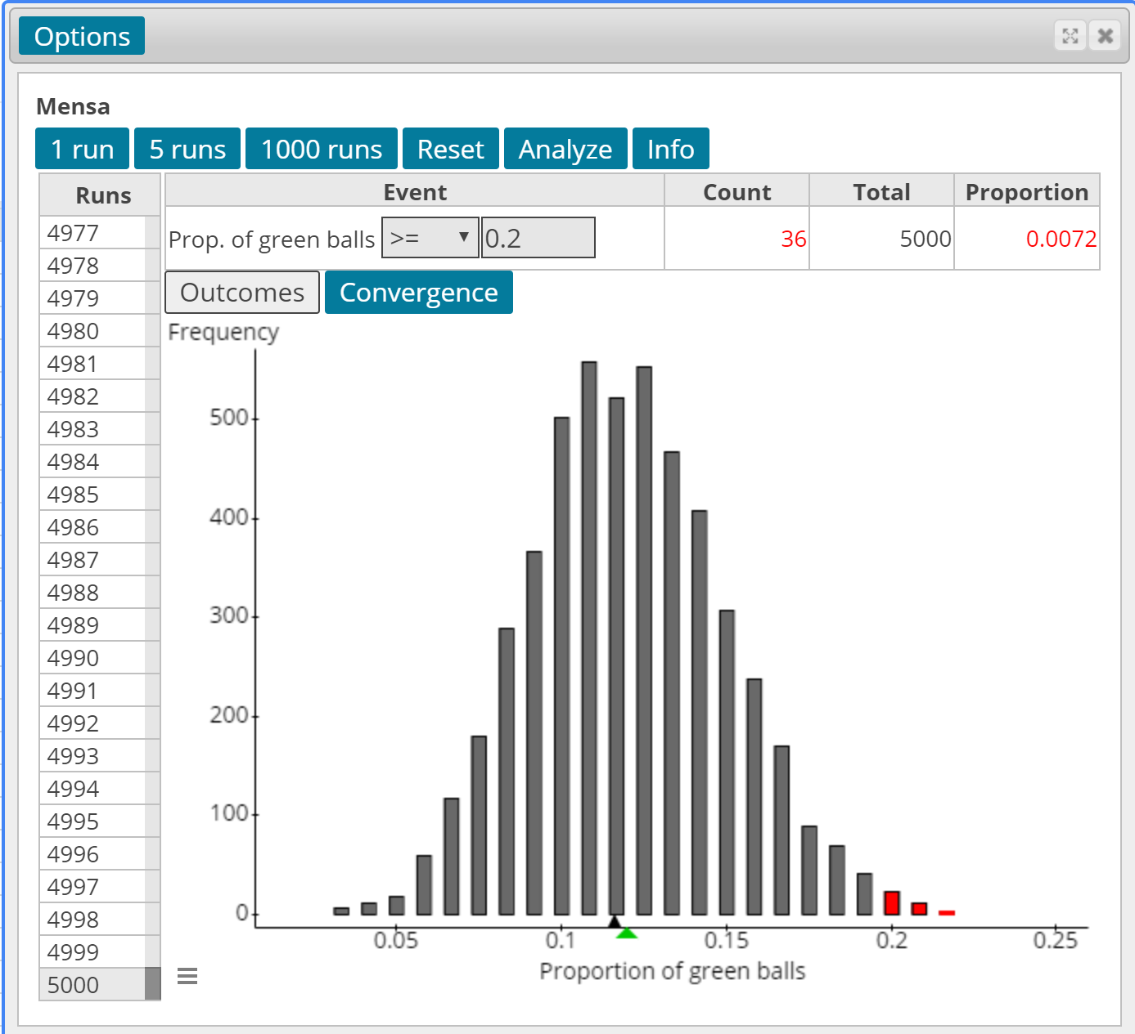
Notes:
For the same effect size as the example with a sample of size n = 20, the P-value is much smaller.

Slide 15
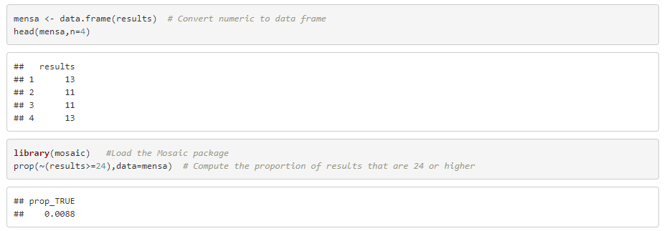

Slide 16
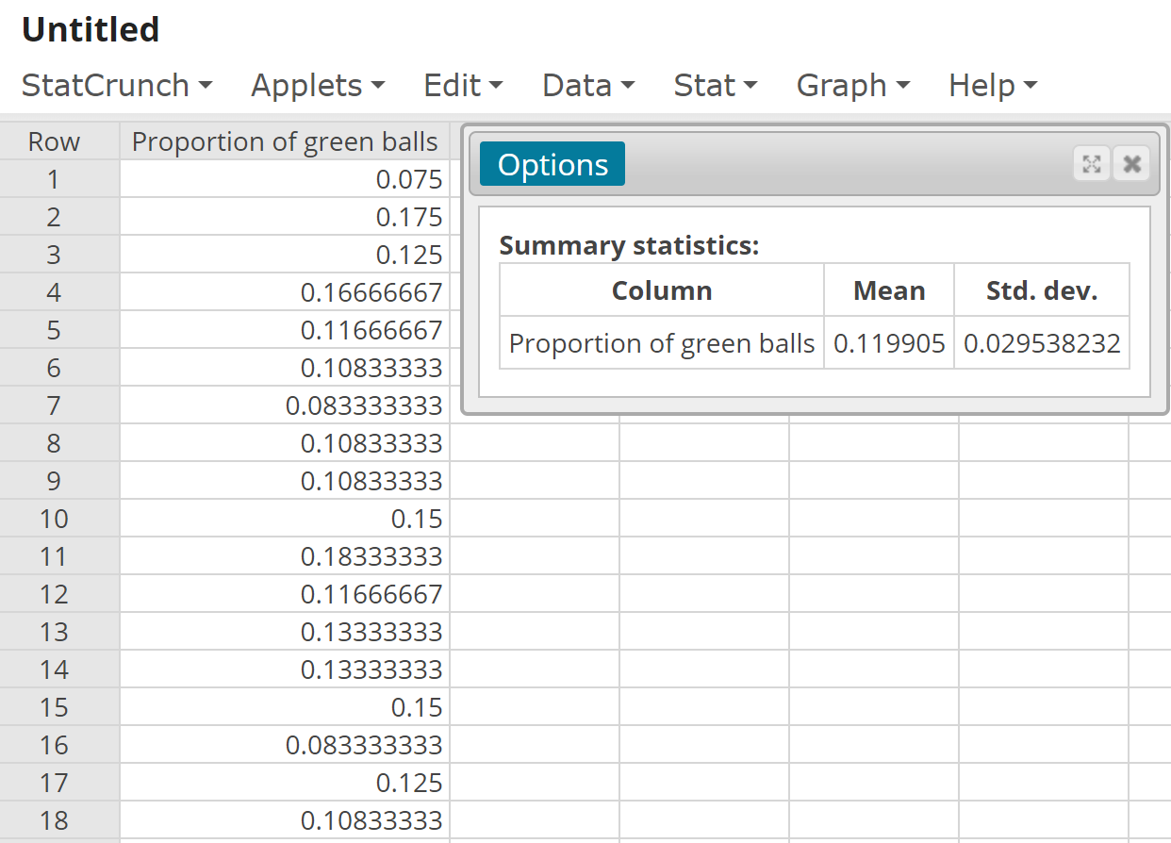
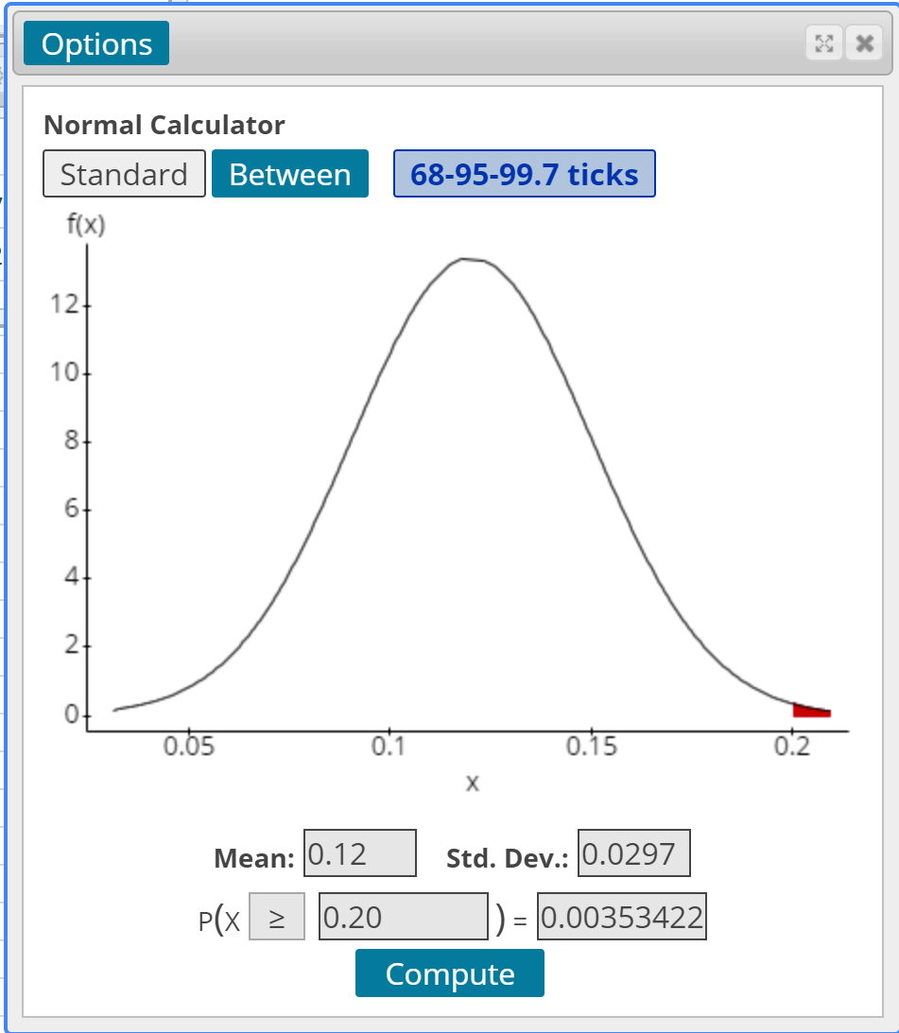
Notes:
For part (c), select Stat > Summary Stats > Highlight the mean and standard deviation.
For part (d), the theoretical mean is 0.12 and the theoretical standard error is sqrt(0.12*0.88/120) = 0.0297.

Slide 17
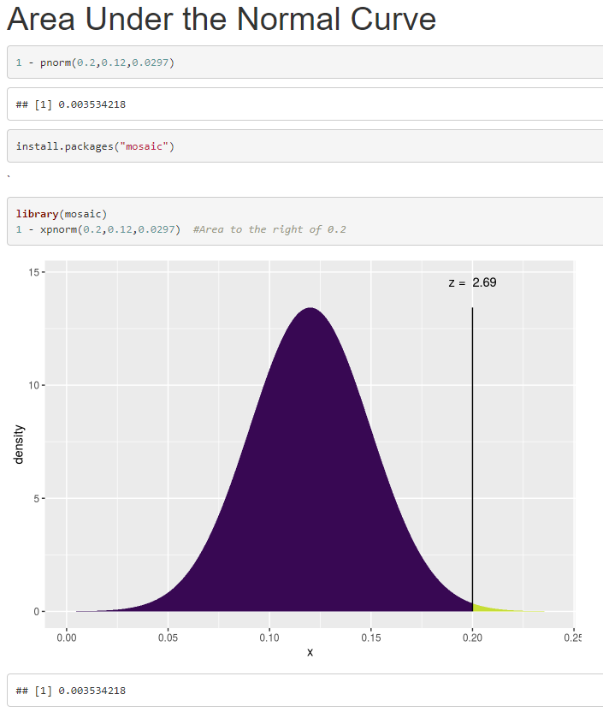

Slide 18
Besides using an Urn to simulate for proportions, a coin may be used. The coin need not be fair.
Go to YouTube to see an example of this. I also have R code for simulating using a coin.
When does each make sense?
Is the scenario a sequence of events? Use the coin-flipping approach
Is it easy to build a population? Use the urn approach.

Slide 19
Do baseballs travel farther in Colorado?
https://baseballsavant.mlb.com/statcast_search
Notes:
Coor’s Field is home to the Colorado Rockies. It is consider to be the most “hitter-friendly” ballpark in Major League Baseball. One reason, of course, is the altitude. So, do baseballs travel farther in Colorado? Let’s see.

Slide 20
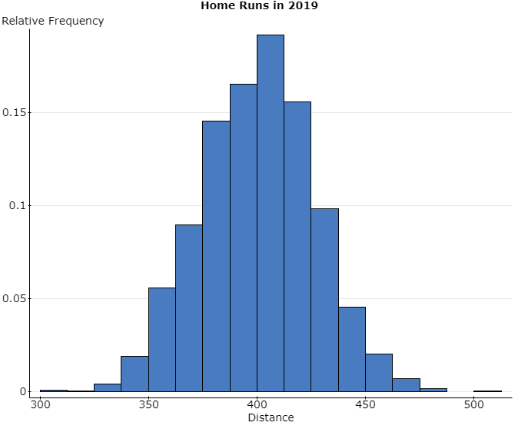
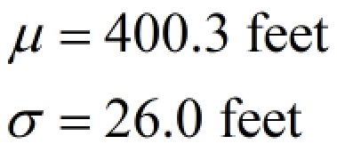
Notes:
This data represents the distance all “traditional” home runs hit during the 2019 Major League Baseball season. Note the shape of the distribution. The mean distance is 400.3 feet.
Our research question is “Do baseballs travel farther in Coor’s Field?”

Slide 21
In Words:
H_{o}: baseballs do not travel farther in Coor’s Field
H₁: baseballs travel farther in Coor’s Field
Symbolically:
H_{o}: µ = 400.3 feet
H₁: µ > 400.3 feet

Slide 22
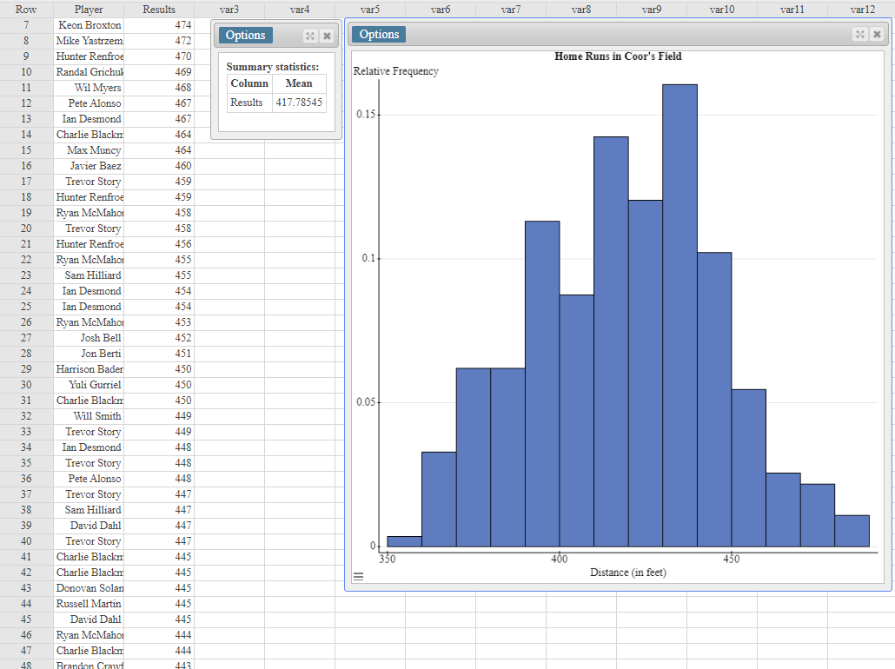
Notes:
This is the data from Coor’s Field only. Notice the effect size is 417.8 – 400.3 = 17.5 feet.

Slide 23
Have each of your students obtain a SRS of size n = 10 from this data. Compute the P-value for the data where
H_{o}: µ = 400.3 feet
H₁: µ > 400.3 feet
Ask the students to share their P-values.
Notes:
Why do the students get different P-values? The P-value is a random variable whose value is dependent upon the sample obtained. Therefore, P-values vary from sample to sample.

Slide 24
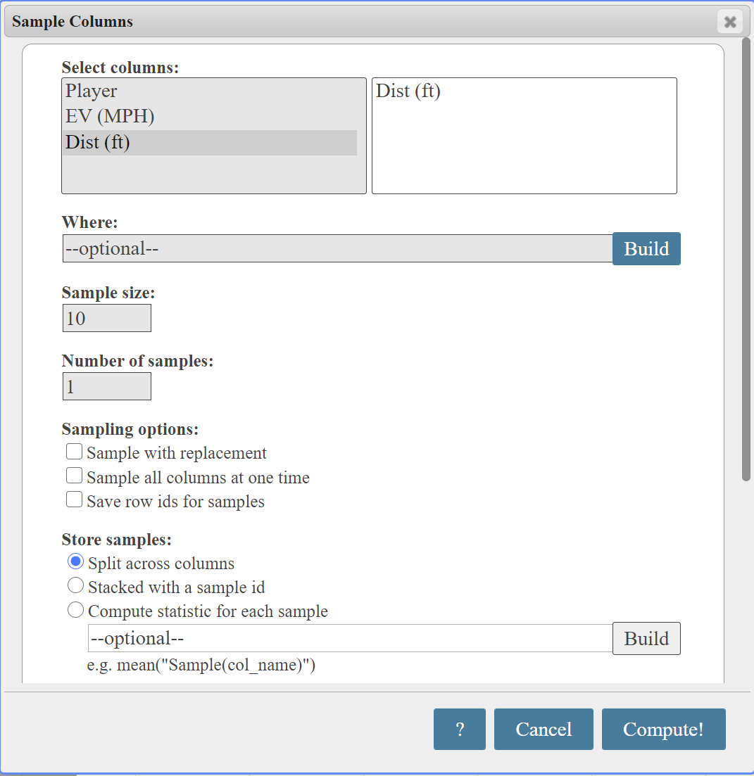
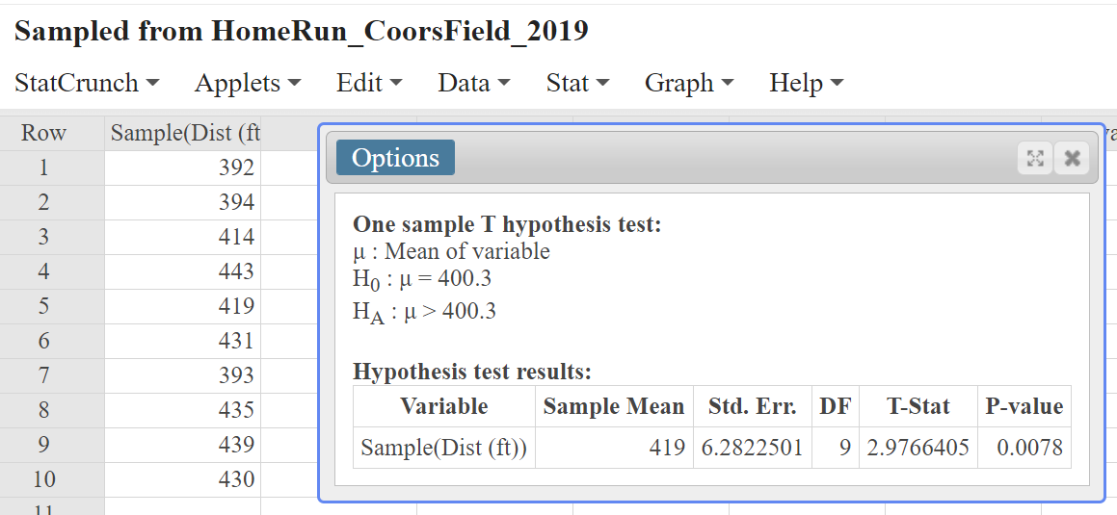
Notes:
In StatCrunch, select Data > Sample

Slide 25
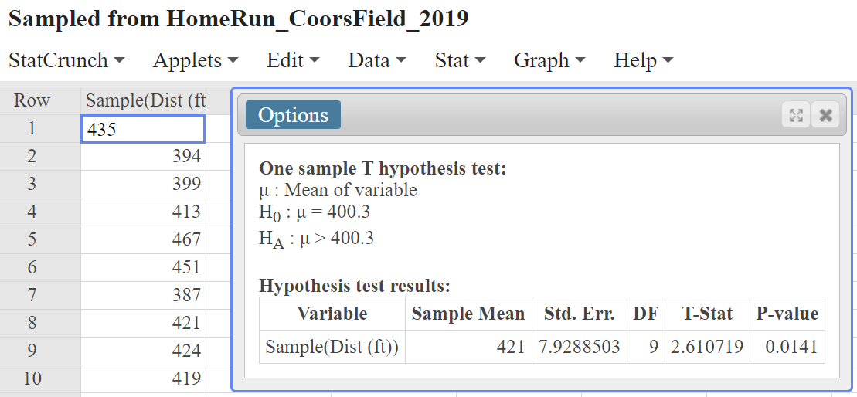
Notes:
Here is a second SRS of n = 10

Slide 26
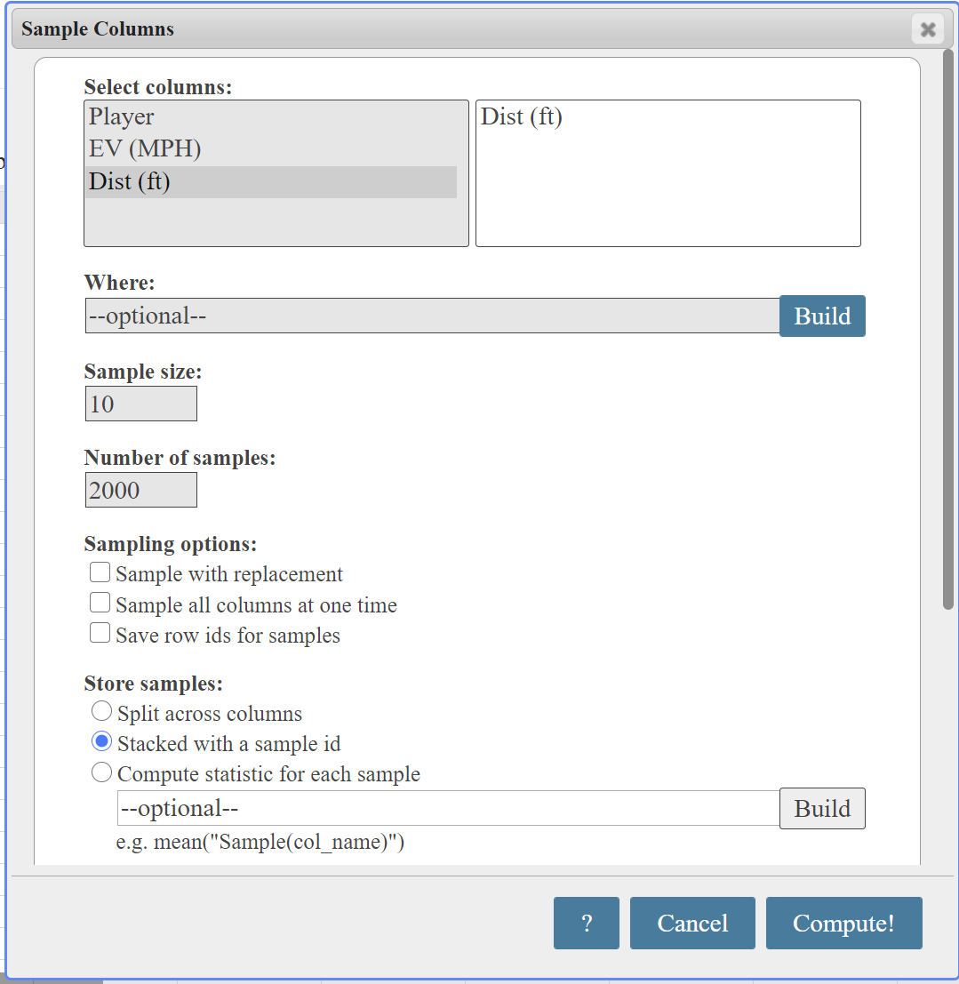
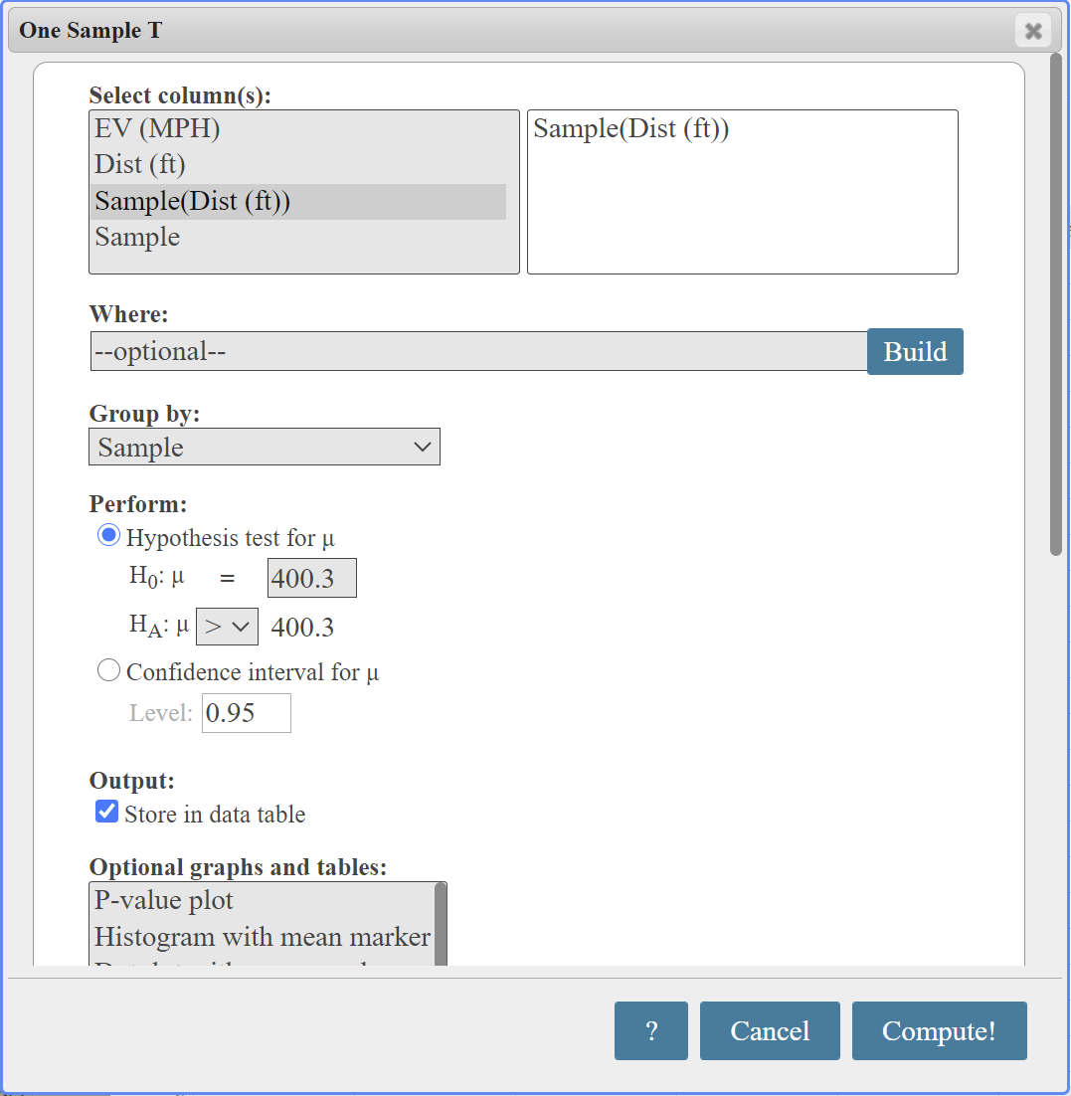
Notes:
Now, let’s find 2000 independent SRS of n = 10. For each sample, run a T-Test. Save the P-values. Draw a histogram of the P-values.

Slide 27
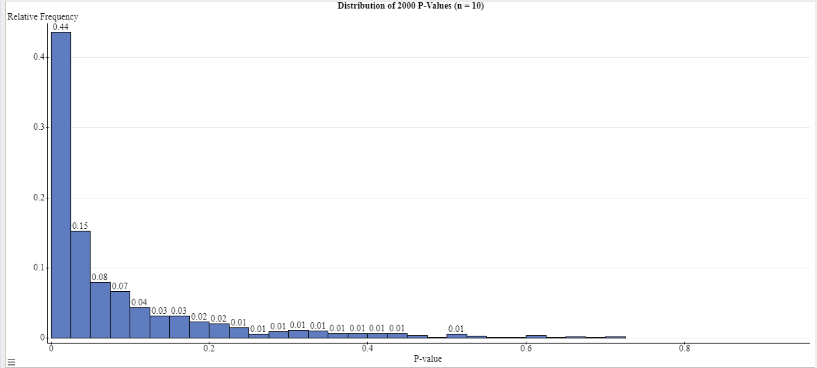
Notes:
Notice that 0.44 + 0.15 = 0.59 or 59% of samples led to a P-value < 0.05. That is, 59% of samples lead to the conclusion that the mean distance of a home run in Coor’s Field is greater than 400.3 feet.

Slide 28
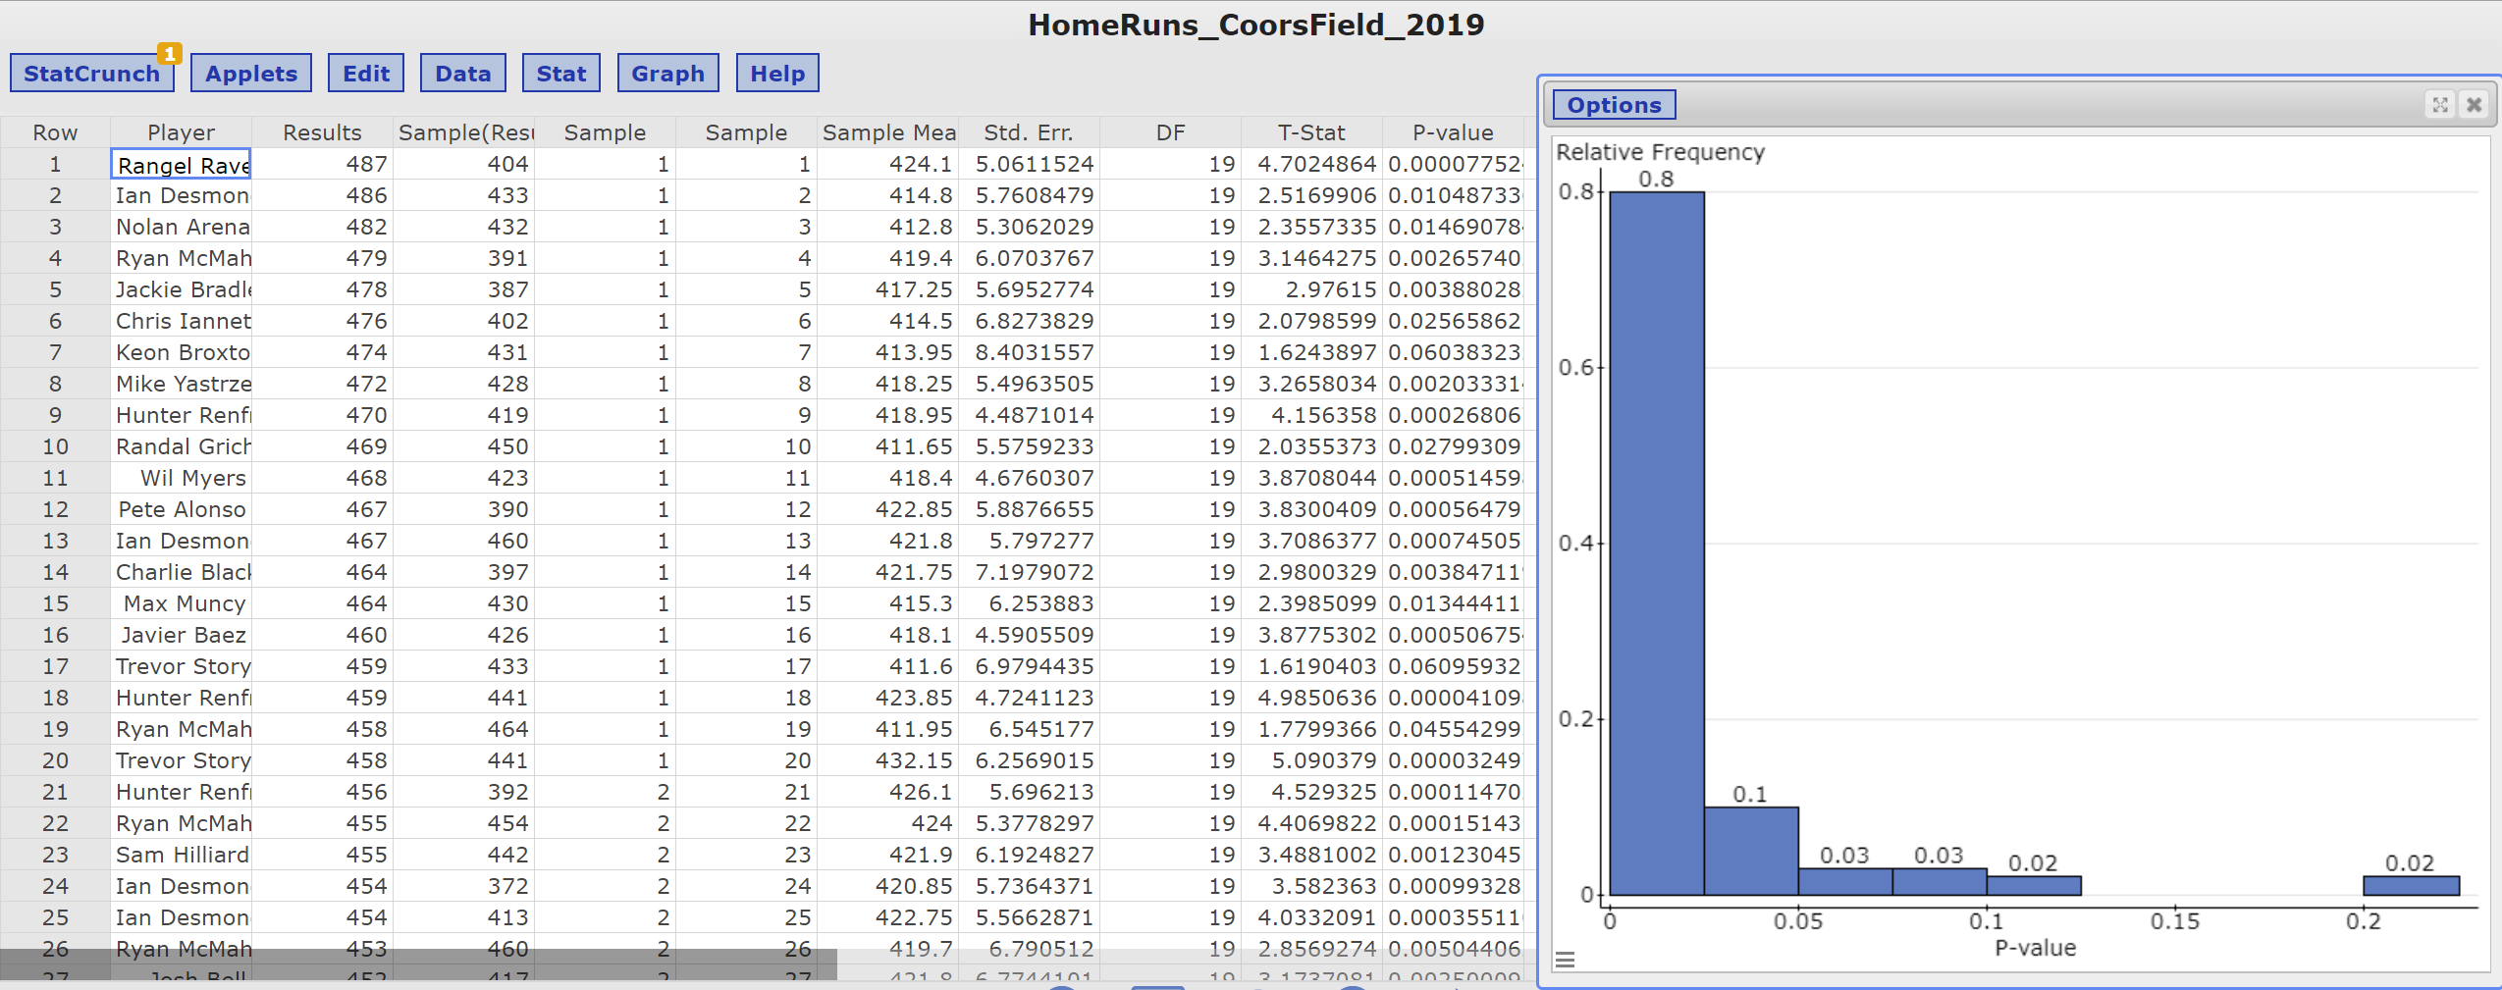
Notes:
If we repeat this exercises for a sample of size n = 20, fully 90% of the SRS result in a P-value < 0.05. Why does this happen? It is due to the fact that the standard error has decreased. Therefore, a higher proportion of sample means are going to fall into the “rejection region”. Very, very important to emphasize to your students that “all other things equal”, a higher sample size results in a higher proportion of samples that lead to rejection.
Distributions of P-values tend to be right skewed. The results of the last activity tell us that distribution of P-values depend upon the sample size. The distribution also depends on the effect size. If you want to explore this, work with a different stadium where the effect size is much smaller. No time for that today.
For example, for sigma = 26 feet, the standard error with n = 10 is 26/sqrt(10) = 8.2 feet. So, any sample mean that is about 16.4 feet from 400.3 will lead to rejection of the statement in the null. However, for n = 20, the standard error is 26/sqrt(20) = 5.8 feet, so any sample mean that is about 11.6 feet from 400.3 feet will lead to rejection. The moral of the story – watch out for studies with large samples sizes.

Slide 30
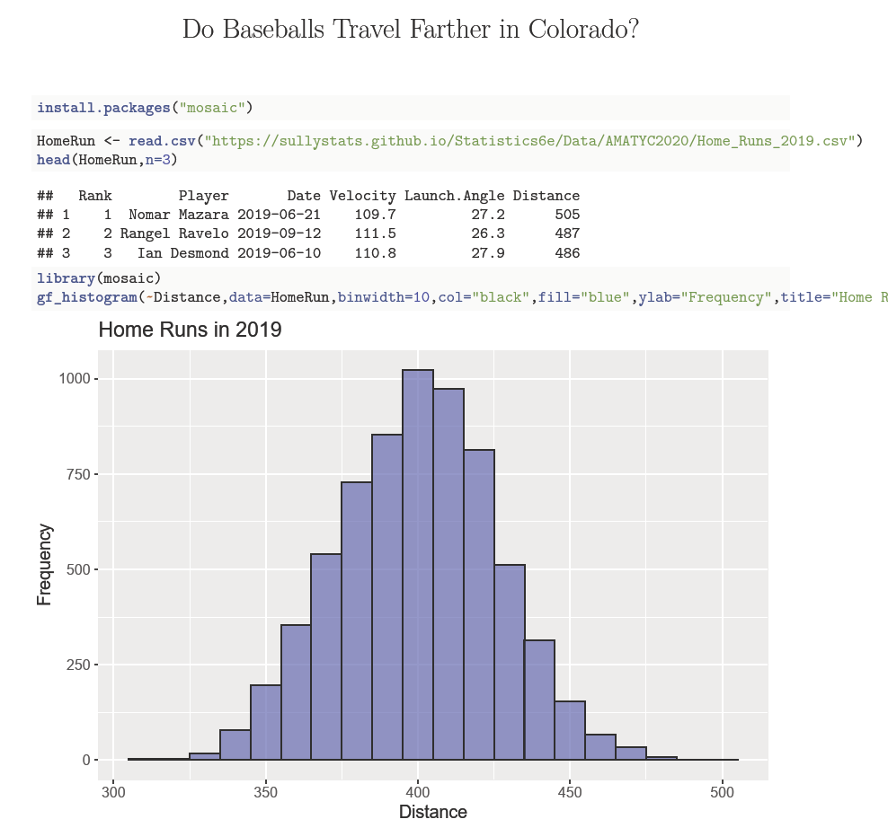

Slide 31
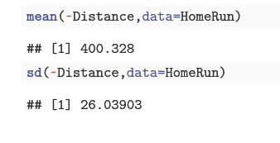

Slide 32
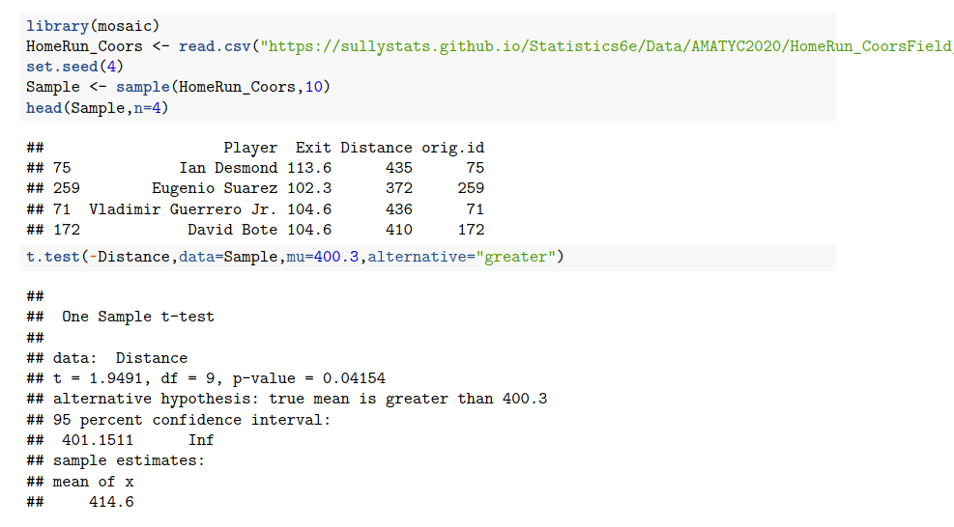

Slide 33
THE ROLE OF SAMPLE SIZE
A real-life example of this was the Physician’s Health Study in which 22,000 subjects were followed over 5 years. The question – does an aspirin a day prevent myocardial infarction. P-value < 0.00001. Led to recommendation of aspirin use for general prevention. The effect size showed a risk difference of 0.77%. Aspirin no longer recommended. Source: Bartolucci, AA, Tendera M, Howard G “Meta-analysis of multiple primary prevention trials of cardiovascular events using aspirin Am J Cardiol 2011; 107(12); 1796-801
See Ioannidis – The opposite of the study above is true as well – the smaller the effect size, the less likely the research findings are to be true. So, identifying a “true finding” in diseases with small relative risks is very difficult.

Slide 34
KEY TAKE-AWAYS
1. It is not THE P-Value. Rather, it is the P-Value for this particular set of data.
2. A P-value < 0.05 does not guarantee “statistical significance”. It is a first step. Replication of results is vital to validating a claim of association. Researchers and the media are motivated by small P-values. This allows for “ground-breaking” headlines like “Science Says a Glass of Red Wine Can Replace One Hour of Exercising”.
Notes:
2. In 2015, the Open Science Collaboration repeated 100 experiments take from the psychology literature. Of the 100, only 39 produced results that replicated the original findings. https://ink.library.smu.edu.sg/cgi/viewcontent.cgi?article=6256&context=lkcsb_research

Slide 35
3. Beware of “p-hacking”. From the urban dictionary, p-hacking is “exploiting – perhaps unconsciously – researcher degrees of freedom until p < 0.05. Some examples of p-hacking include
the treatment of outliers
Collecting data until a significant result is found
Selectively choosing explanatory variables.
Elimination of observations
4. Consider the sample size in the study.
Small sample sizes means small power – the likelihood of correctly identifying an effect.
Large sample sizes do not require a large effect size to identify an effect.

Slide 36
Sources/Additional Reading
Moving to a World Beyond P-values
The Role of p-Values in Judging the Strength of Evidence and Realistic Replication Expectations
Why Most Published Research Findings Are False
Notes:
The second article is extremely interesting

