Slide 1
Advancing Equity in Mathematics Pathways in the Era of the Pandemic
October 21, 2020

Slide 2
Welcome! Let’s get to know each other while we wait to start the webinar
Please answer the questions below in the “Chat,” located at the bottom of you screen.
switch from panelists to all panelists and attendees
Where are you from?
What attracted you to enroll in this webinar?

Slide 3
Connie Richardson, The Charles A. Dana Center
Ann Edwards, Carnegie Math Pathways, WestEd
Helen Burn, Highline College
Presenters
Sponsored by the National Math Summit

Slide 4
Webinar Recording Policy
AMATYC is recording the webinar
AMATYC retains the right to show it again and to distribute it.
By participating, you are agreeing that your contributions become part of the recording

Slide 5
Housekeeping
Please make sure that you are muted.
Open the chat by clicking on chat at the bottom of your screen
Click on the arrow to switch from panelists to all panelists and attendees so that everyone will be able to view your comments
We will have limited time to address questions. Type your question in the chat. We will save the chat and be able to address questions not answered during the webinar at a later date.
Be open to new ideas and kind in comments to others.

Slide 6
Advancing Equity in Mathematics Pathways in the Era of the Pandemic
October 21, 2020

Slide 7
Math Course Enrollments at Two-Year Institutions
Course | 2000 | 2005 | 2010 | 2015
CA | 173,000 | 206,000 | 230,000 | 292,000
Stat | 71,000 | 111,000 | 134,000 | 251,000
MLA | 43,000 | 59,000 | 91,000 | 97,000
Calc I | 53,000 | 51,000 | 65,000 | 66,000
Still working on text here...
Compiled from Conference Board of Mathematical Sciences 2000-2015 Surveys

Slide 8
Math Course Enrollments at Two-Year Institutions
Course | 2000 | 2005 | 2010 | 2015
CA | 173 (51%) | 206 (48%) | 230 (44%) | 292 (41%)
Stat | 71 (21%) | 111 (26%) | 134 (26%) | 251 (36%)
MLA | 43 (13%) | 59 (14%) | 91 (18%) | 97 (14%)
Calc I | 53 (16%) | 51 (12%) | 65 (13%) | 66 (9%)
Still working on text here...
Compiled from Conference Board of Mathematical Sciences 2000-2015 Surveys

Slide 9
Math Course Enrollments at Two-Year Institutions
Course | 2000 | 2005 | 2010 | 2015
CA | 173,000 | 206,000 | 230,000 | 292,000
Stat | 71,000 | 111,000 | 134,000 | 251,000
MLA | 43,000 | 59,000 | 91,000 | 97,000
Calc I | 53,000 | 51,000 | 65,000 | 66,000
Still working on text here...
Compiled from Conference Board of Mathematical Sciences 2000-2015 surveys

Slide 10
Mathematics Pathways should...
Provide students with math content that aligns with their academic and professional goals;
Accelerate students who have been underserved in the past;
Provide learning environments that:
support students’ identities as math learners and
invite and engage students in the development of skills and dispositions that serve them broadly to achieve their academic and career aspirations

Slide 11
Equitable Mathematics Pathways
K12 foundation:
Detracking, improved instruction and supports, pathways
Just Equations (2019)
Postsecondary math pathways
High-quality options
Transparency and awareness
Student-centered teaching
Rich content
Evidence-based assessments

Slide 12
Are your math pathways...
Serving the right students (i.e., are your students in the right math pathway)?
Serving students equitably?
Providing the supports needed, even when virtual?
Contributing to a strong STEM pipeline?

Slide 13
Recent Research
Program analysis tools for equitable access
The relationship between math pathways and corequisites
What we know about corequisites: effectiveness, implementation, and design
Transitioning Learners to Calculus in Community Colleges

Slide 14
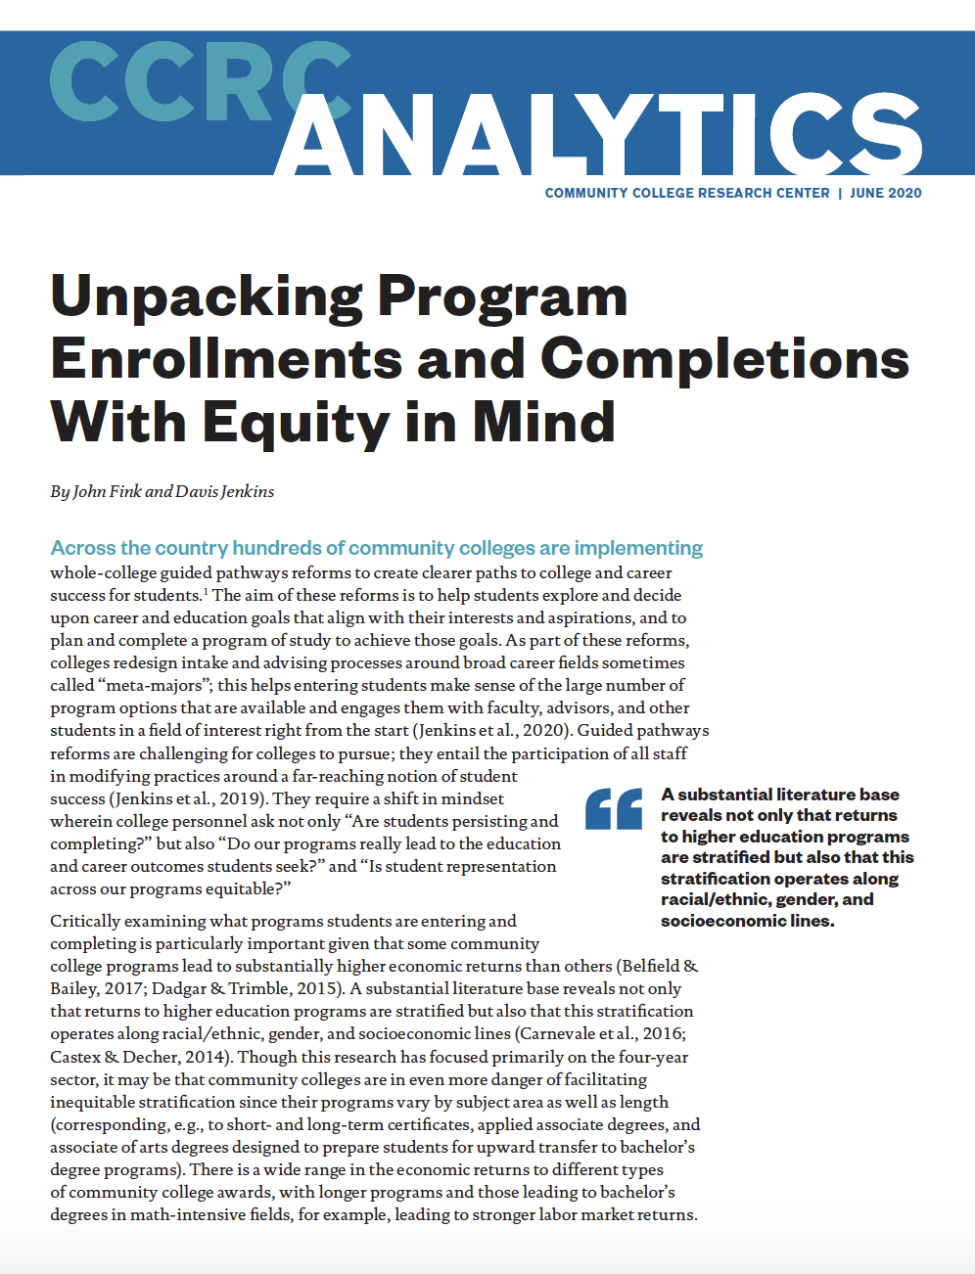
Equity View of Program Enrollments
What programs are our students currently enrolled in?
What opportunity does each program lead to in terms of further education (e.g., transfer to bachelor’s programs or bridges into more advanced workforce credentials) and/or immediate job prospects and earnings. Which programs lead to greater or lesser opportunity?
Is student representation across programs proportionate? Which subgroups of students (by race/ethnicity, gender, socioeconomic status, and age) are underrepresented in higher-opportunity programs?
.
https://ccrc.tc.columbia.edu/publications/unpacking-program-enrollments-completion-equity.html
Notes:
https://ccrc.tc.columbia.edu/publications/unpacking-program-enrollments-completion-equity.html

Slide 15
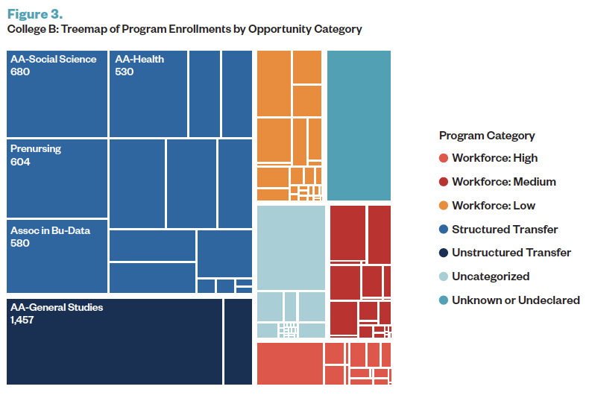
Program Enrollments and Opportunity Categories
Are most of your students preparing for high-wage or low wage jobs?
Which students are preparing for high-wage jobs?
https://ccrc.tc.columbia.edu/publications/unpacking-program-enrollments-completion-equity.html

Slide 16
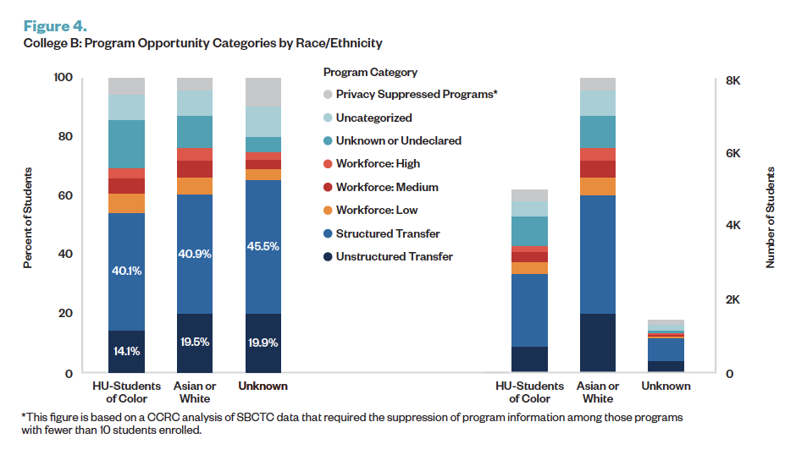
Program Enrollments and Opportunity Categories

Slide 17
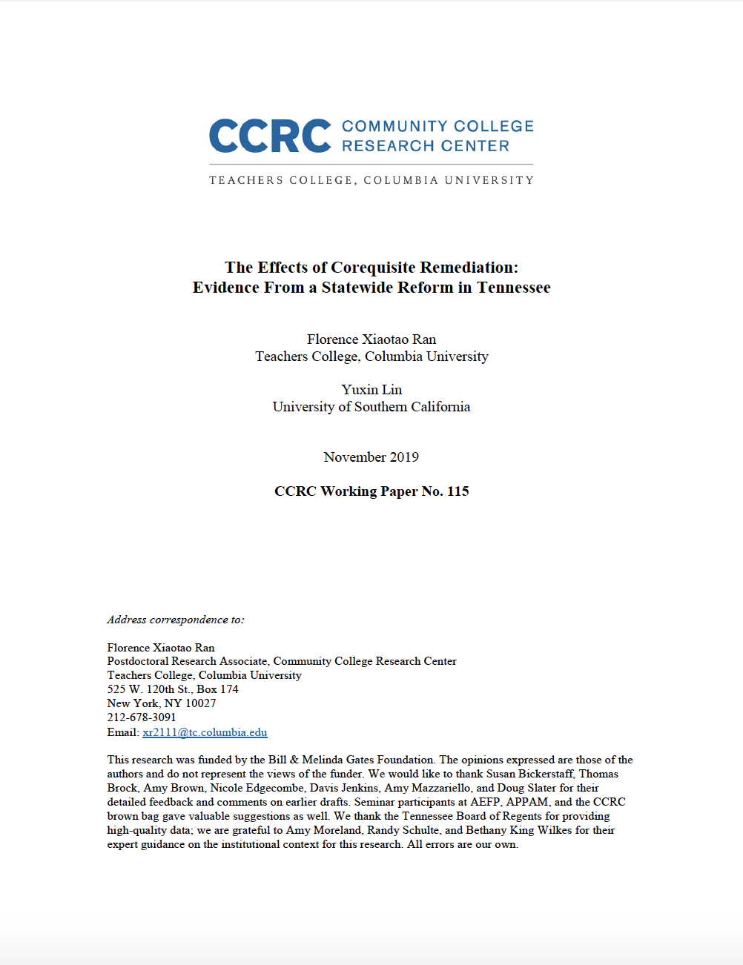
Math pathways and corequisites
The study found that enrolling students in corequisite courses resulted in large positive effects, and attributes these effects to state-wide efforts to enroll students in math courses aligned with the requirements of their program, i.e., enrolling more students in Statistics rather than placing them into algebra by default. …[M]ath students placed into corequisite courses were 8 percentage points more likely to enroll in and pass an additional college-level math course compared with students placed into college-level directly.
Summary approved by lead researcher Florence Xiaotao Ran
Personal communication April 27, 2020
Notes:
The messaging here and on the next slide is about ensuring that institutions and departments continue to attend to getting students into the appropriate math pathway that aligns with their aspirations. We can’t underestimate the importance of purpose and relevance in engaging students in their mathematical education rather than just “checking the box” of a math requirement.

Slide 18
Math pathways and corequisites
A significant takeaway from this study is that math pathways and corequisite courses should not be viewed as competing reform efforts, but rather, as complementary system-wide strategies that lead to student success in gateway level math courses. In fact, …, offering viable math pathways is essential to maximizing the benefits of corequisite remediation.
Summary approved by lead researcher Florence Xiaotao Ran
Personal communication April 27, 2020
Notes:
It is important to note that this study was about “bubble” students - students very near the cut score. The importance of corequisites for students lower in the placement bands can be seen in the CUNY study by Logue and Watanabe-Rose.

Slide 19
References
Conference Board of the Mathematical Sciences.. (2000-2015). Statistical Abstract of Undergraduate Programs in the Mathematical Sciences in the United State.https://www.cbmsweb.org. 2015 Survey available at: http://www.ams.org/profession/data/cbms-survey/cbms2015-Report.pdf
Fink, J., & Jenkins, D. (2020). Unpacking Program Enrollments and Completion with Equity in MInd.
Just Equations. (2019). Redesigning the Mathematics of Opportunity: Principles for Equitable Math Pathways To and Through College.https://justequations.org/resource/redesigning-the-mathematics-of-opportunity-principles-for-equitable-math-pathways-to-and-through-college/
Ran, F., & Lin, Y. (2019). The Effects of Corequisite Remediation: Evidence From a Statewide Reform in Tennessee. CCRC Working Paper No. 115. https://ccrc.tc.columbia.edu/publications/effects-corequisite-remediation-tennessee.html

Slide 20
What is Corequisite Remediation?
Direct enrollment into a college level course alongside additional academic support in the same term
Many different implementation models
Alignment of content and pedagogy
Delivery mode
Cohort

Slide 21
Why Corequisites?
Inaccuracy of placement mechanisms
Reduce course sequence (eliminating potential exit points) and increase student “momentum” in earning college credits
Reduce potential stigma and aversion; improve motivation
In some implementations, content is more closely aligned to student interest and is less abstract

Slide 22
Do corequisites “work”?
Outcomes
Passing college-level course within one year
Subsequent course-taking and credit accumulation (GE, math)
Graduation and transfer

Slide 23
Do corequisites “work”?
Primary Studies
Tennessee
System-wide implementation in the 13 colleges in TBR (2015)
Regression discontinuity analysis incl longer term outcomes
CUNY
RCT with 3 colleges implementing Stat Coreq incl longer-term outcomes (2013)
Additional PSM study of pass rates with 4 colleges (2013 - 2015)
Texas
Regression discontinuity analysis in math incl longer term outcomes (2014 - 2016)
RCT with 5 colleges in English (2016 - 2017)

Slide 24
Do corequisites “work”?
Passing college-level course within one year
TN, CUNY, TX: More likely to pass gateway math than prereq remediation
Subsequent course-taking and credit accumulation (GE, math)
TN, CUNY: More likely to enroll in and pass subsequent math course
CUNY: More likely to have passed GE reqs
TX: No significant impact on credit accumulation, progress to degree
Graduation and transfer
TN & TX: No significant impacts on graduation and transfer
CUNY: More likely to graduate

Slide 25
Do corequisites “work”?
What can we take away?
Corequisite remediation gets students through gateway math faster and just as well.
Implementation with math pathways reforms may support longer-term effects.
Improvements in transfer and completion depend on much more than just gateway course completion. Additional supports are needed.

Slide 26
Corequisite Design & Implementation
Growing consensus on principles of design and implementation:
Alignment with math pathways
Same college content and outcomes
Alignment of instructional approach in college and corequisite components
Corequisite support tailored for the college level course
Attention to mindset, sense of belonging, relevance and other SEL factors
Explicit attention to equitable participation and outcomes

Slide 27
Carnegie Math Pathways Corequisite Design
Active, collaborative learning
Productive struggle
Rich authentic contexts
Explicit connections to concepts
Deliberate practice
Social-emotional learning supports
Language and literacy supports
Flexibility of implementation
Guides for recommended use of materials
Notes:
Tie into PROWESS

Slide 28
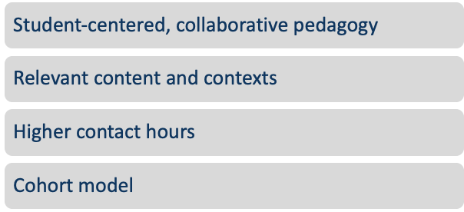
Elements of Effective Design
Notes:
Weekly contact hours | Coreq success rate
4 | 39%
5 | 61%
6 | 67%

Slide 29
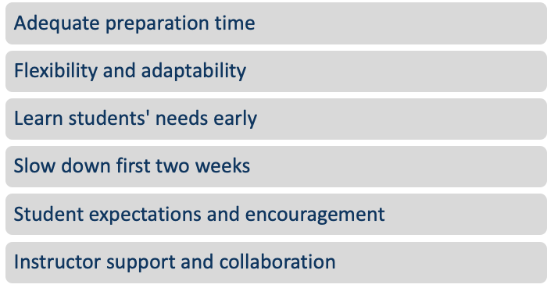
Suggestions for Implementation

Slide 30
What we still need to learn
What works for whom under what conditions?
For what students are corequisites less effective? What do we know about the students who are not succeeding with corequisites? How can corequisites better serve those students?
How can corequisites be designed for equity?
What other reforms are complementary with and amplify the effectiveness of corequisites?
What data should institutions be looking at to know whether their corequisite is “working” and for whom?

Slide 31
References
Denley, T. (2016). Co-requisite remediation full implementation 2015–16. Tennessee Board of Regents Technical Brief No. 3. Retrieved July 19, 2020, from https://www.tbr.edu/sites/tbr.edu/files/media/2016/12/TBRCoRequisiteStudy-FullImplementation2015-2016.pdf
Logue, A. W., Douglas, D., & Watanabe-Rose, M. (2019). Corequisite mathematics remediation: Results over time and in different contexts. Educational Evaluation and Policy Analysis, 41, 294–315. Retrieved December 31, 2019, from http://journals.sagepub.com/doi/10.3102/0162373719848777
Logue, A. W., Watanabe-Rose, M., & Douglas, D. (2016). Should students assessed as needing remedial mathematics take college-level quantitative courses instead? A randomized controlled trial. Educational Evaluation and Policy Analysis, 38, 578–598. Retrieved December 31, 2019, from http://journals.sagepub.com/doi/10.3102/0162373716649056
Meiselman, A., & Schudde, L. (2020). The Impact of Corequisite Math on Community College Student Outcomes: Evidence from Texas. Working Paper, University of Texas at Austin. Retrieved, October 16, 2020, from http://dx.doi.org/10.26153/tsw/9560
Ran, F. X., & Lin, Y. (2019). The effects of corequisite remediation: Evidence from a statewide reform in Tennessee. CCRC Working Paper number 115. Retrieved July 1, 2020, from https://academiccommons.columbia.edu/doi/10.7916/d8-46wx-k824
Strother, S., & Klipple, K. (2019). Corequisite remediation in math: A review of first-year implementation and outcomes of Quantway and Statway. San Francisco, CA: WestEd.

Slide 32
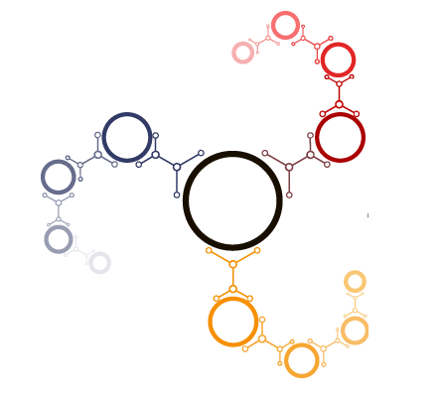
Racial Equity in the STEM Math Pathway
Transitioning Learners to Calculus in Community Colleges https://occrl.illinois.edu/tlc3
Helen Burn, Highline College
Vilma Mesa, University of Michigan-Ann Arbor
J. Luke Wood, San Diego State University Chauntee Thrill, Appalachian State University
Eboni Zamani-Gallaher, University of Illinois at Urbana-Champaign
Support for this work is provided by the National Science Foundation's Improving Undergraduate STEM Education (IUSE) program under Awards 1625918, 1625387, 1625946,1625891. Any opinions, findings, and conclusions or recommendations expressed in this material are those of the author(s) and do not necessarily reflect the views of the National Science Foundation.
Notes:
Helen Burn is chair of AMATYC’s Pathways Joint Subcommittee. Describe Highline and your work there.
ANNETTE, please post: https://occrl.illinois.edu/tlc3

Slide 33
Transitioning Learners to Calculus in Community College (TLC3)
Project Goals
Research Approach
Identify practices to enhance the success of racially minoritized students in the STEM math pathway
Create an Institutional Self-Assessment tool to transform how colleges identify and remove barriers for racially minoritized students
Race-conscious, interdisciplinary
National Survey of Community College Mathematics Chairs
Case studies of minority-serving institutions (PBI, HSI, AANAPISI, Tribal College)
Content validation by TLC3 Advisory Board
Notes:
How to take action based on disaggregated data

Slide 34
Racial Equity in the STEM Math Pathway
Multiple Domains
Multiple Challenges
Math Placement
STEM Math Courses
Instruction
Student support
Institutional responsibility
Receives less attention than other pathways
Course sequence is long and may include developmental courses
Underrepresentation of racially minoritized students and faculty
Notes:
“You can’t do everything; but you can’t just do one thing.”
What racially minoritized student groups are you focusing on at your college?
https://documents.highline.edu/math/Mathematics-Curricular-Flowchart.pdf

Slide 35
Accessing TLC3 Tools
Pandemic opportunity to do planning and to build infrastructure, develop action plans.
Single-page infographic with domains and practices
https://drive.google.com/file/d/1-JzK07Klh1ZQAhMxVFQuS2W9j1PRjE0U/view?usp=sharing
Notes:
ANNETTE, please post in chat: https://drive.google.com/file/d/1-JzK07Klh1ZQAhMxVFQuS2W9j1PRjE0U/view?usp=sharing

Slide 36
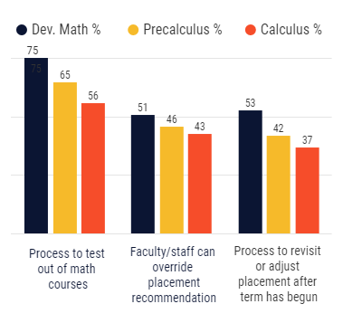
Mathematics Placement
Multiple measures used for placement, including high school transcripts
Advising about the placement process and results is given to students
Policies and practices ensure highest possible placement (e.g., retesting, test prep resources, adjusting after term begins)

Slide 37
Accessing TLC3 Tools
Institutional Self-Assessment Tool Multi-page document with interactive response set
https://drive.google.com/file/d/1-S9Y6jKo1LjUPb5oyc9V3IGR0qAfWwqo/view?usp=sharing
Notes:
ANNETTE, please post
https://drive.google.com/file/d/1-S9Y6jKo1LjUPb5oyc9V3IGR0qAfWwqo/view?usp=sharing

Slide 38
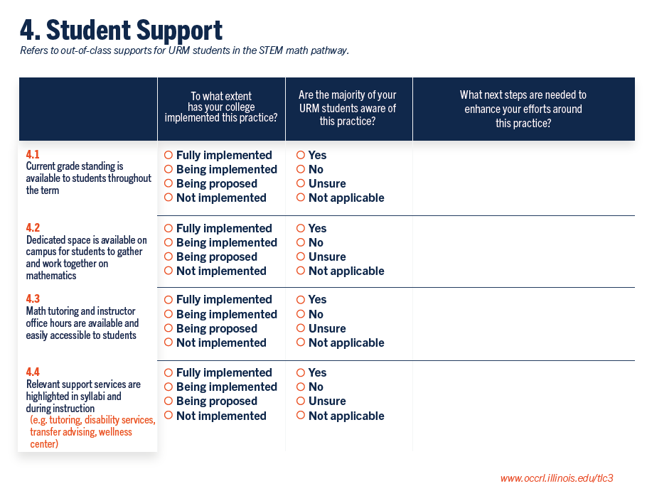
Notes:
Community of Learners
Positive out of class faculty-student interactions SEA
Space to work SEA

Slide 39
Accessing TLC3 Tools
Institutional Self-Assessment Tool
Online form (mobile-friendly)
https://survey.az1.qualtrics.com/jfe/form/SV_73BIw6xBAzFfbeJ
Follow-up available through 2020-21 academic year
hburn@highline.edu
Notes:
ANNETTE, please post
https://survey.az1.qualtrics.com/jfe/form/SV_73BIw6xBAzFfbeJ

Slide 40
Racial Equity in the STEM Math Pathway
Five Domains
Math Placement
STEM Math Courses
Instruction
Student support (out of class)
Institutional responsibility
Notes:
“You can’t do everything; but you can’t just do one thing.”

Slide 41
STEM Math Courses
The course sequence and required course materials in the STEM math pathway are optimized for timely progress
Courses are designed to transfer to baccalaureate institutions
Data on student outcomes in STEM math pathway courses, disaggregated by race/ethnicity (African American, Latinx, Indigenous, Southeast Asian) within gender, are reviewed at least annually by mathematics faculty
Notes:
Put Laura Schueller’s report in the chat

Slide 42
Institutional Responsibility
Permanent base funding is provided by the college to bolster and support the success of URM students in the STEM math pathway
High-quality and ongoing professional learning focused on inclusive teaching strategies, implicit bias, and racial microaggressions is provided to full- and part-time mathematics faculty
Targeted efforts are undertaken by the college to provide resources for students facing food, health, and housing insecurities (e.g., food pantry, free walk-in clinic, emergency financial assistance)
Notes:
Speak to first two.
~75% of two-year faculty identify as white; gender parity
The extent to which you can ground the practices in the context of math is beneficial

Slide 43
Instruction
Notes:
Reminder: This is one or many domains to focus on.
What research says versus what we say: These are realistic practices.
Deal with the top two in each case. Math ed: Active learning
Equity research: Students are skeptical and not trusting due to their lived experiences in education.
What proportion of your full- and part-time faculty are doing this practice for URM students? Are the majority of your URM experiencing this practice?

Slide 44
Thank you!
Helen Burn
Highline College
hburn@highline.edu (206) 592-3496
Burn, H., Mesa, V., Wood, J. L., & Zamani-Gallaher, E. (2016). Collaborative research: Transitioning learners to calculus in community colleges (TLC3): Advancing strategies for success in STEM (NSF Award 1625918, 1625387,1625946,1625891). Retrieved from National Science Foundation website: https://www.nsf.gov/awardsearch/showAward?AWD_ID=1625918
Burn, H., Mesa, V., Wood, J. L., & Zamani-Gallaher, E. (2018). Transitioning learners to calculus in community colleges: National survey of community college mathematics chairs: Technical report and summary (NSF Awards 1625918, 1625387, 1625946, & 1625891). The University of Illinois at Urbana-Champaign: Office of Community College Research and Leadership. [Available from ERIC database. (ED592079)]. Retrieved from https://occrl.illinois.edu/docs/librariesprovider4/tlc3/tlc3-math-chairs-survey-summary.pdf
Wood, J. L., Harris, F., III., & White, K. (2015). Teaching men of color in the community college: A guidebook. San Diego, CA: Montezuma Publishing.
Notes:
Add to chat window:
hburn@highline.edu

Slide 45
Planning Leadership Team
Annette Cook, Paul Nolting, Julie Phelps and Nancy Sattler
Steering Committee
Christina Cobb and Denise Lujan (NOSS)
Rochelle Beatty, Kathryn Van Wagoner, and Laura Watkins (AMATYC)
Connie Richardson and Paula Talley (Charles A. Dana Center)
Ann Edwards (Carnegie Math Pathways/WestEd)
April Strom (MAA)

Slide 46
The 4th National Math Summit begins at 1:00 p.m. on Monday, June 14th, and features keynote speaker, Jenna Carpenter, concurrent sessions, and more. The program will conclude Tuesday, June 15th 5:00 p.m. This is a pre-conference to the NOSS 2021 conference and requires separate registration (https://thenoss.org/Math-Summit/)
The Math Summit is sponsored by AMATYC, NOSS, and Paul Nolting. Supporting partners include: Charles A. Dana Center, Carnegie Math Pathways/WestEd, and the MAA.
The Math Summit is sponsored by AMATYC, NOSS, and Paul Nolting. Supporting partners include: Charles A. Dana Center, Carnegie Math Pathways/WestEd, and the MAA.

Slide 47
January 22, 2p.m. ET
Student Engagement
Presenters: April Strom and Julie Phelps
February - Title and Date TBA
Presenters: Mary Monroe-Ellis, Amy Tankersley, and Suzanne Etheridge
March - TBA
April - Professional Development and Department Issues

Slide 48
Questions??

