Slide 1
The Future is NOW Using Technology to Increase Social Presence in Online Classes
AMATYC
Roxanne Brinkerhoff
Evelyn Porter
Notes:
Welcome to our online session!

Slide 2
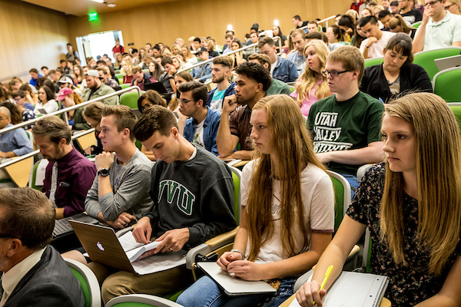
Who We Are
Utah Valley University
Located in Orem, UT
Open Enrollment
~40,000 students
Dual mission
Developmental Math Department
Intermediate Algebra and below
52% of incoming freshman test into remedial math courses
NOTE: "Online class" = asynchronous course where all content is done virtually
Notes:
Evelyn - To give you an idea of where we're coming from:
We're an open enrollment University in
Orem Utah, which is just south of Salt Lake City Utah.
We have a dual-mission from the State of Utah to serve both the community-college and University
We are in Developmental Math, which covers everything from
Pre-Algebra to Intermediate Algebra,
we also have the Quantitative Reasoning courses in our department.
Interestingly, 60% of our students come from the
local area and 52% test into Math remediation

Slide 3
Problem Statement
Notes:
Evelyn

Slide 4
Problem Statement
Online sections have much lower success rates
Plus Title IV Compliance
Plus Covid
Research indicates the social presence aids course completion + motivation
Notes:
Evelyn -
We have observed that our online courses have much lower success
We set out to find ways to improve the course – and decrease the achievement gap.
Then we were hit by Covid
Really – our question was – how can an online environment be most like a F2F environment.
Add stuff to the course that did that

Slide 5
Achievement Gap by Modality
Notes:
Evelyn
Achievement gap by modality
Grey – F2F courses
Corral – online classes
Success rates are different by about 20%
Blended delivery of courses –
demand for online classes going up, but we weren't serving students well

Slide 6
Title IV Compliance
"Online courses must have instructor-initiated, regular and substantive interaction with students."
Notes:
Evelyn
Not being in compliance with this means we risk financial aid

Slide 7
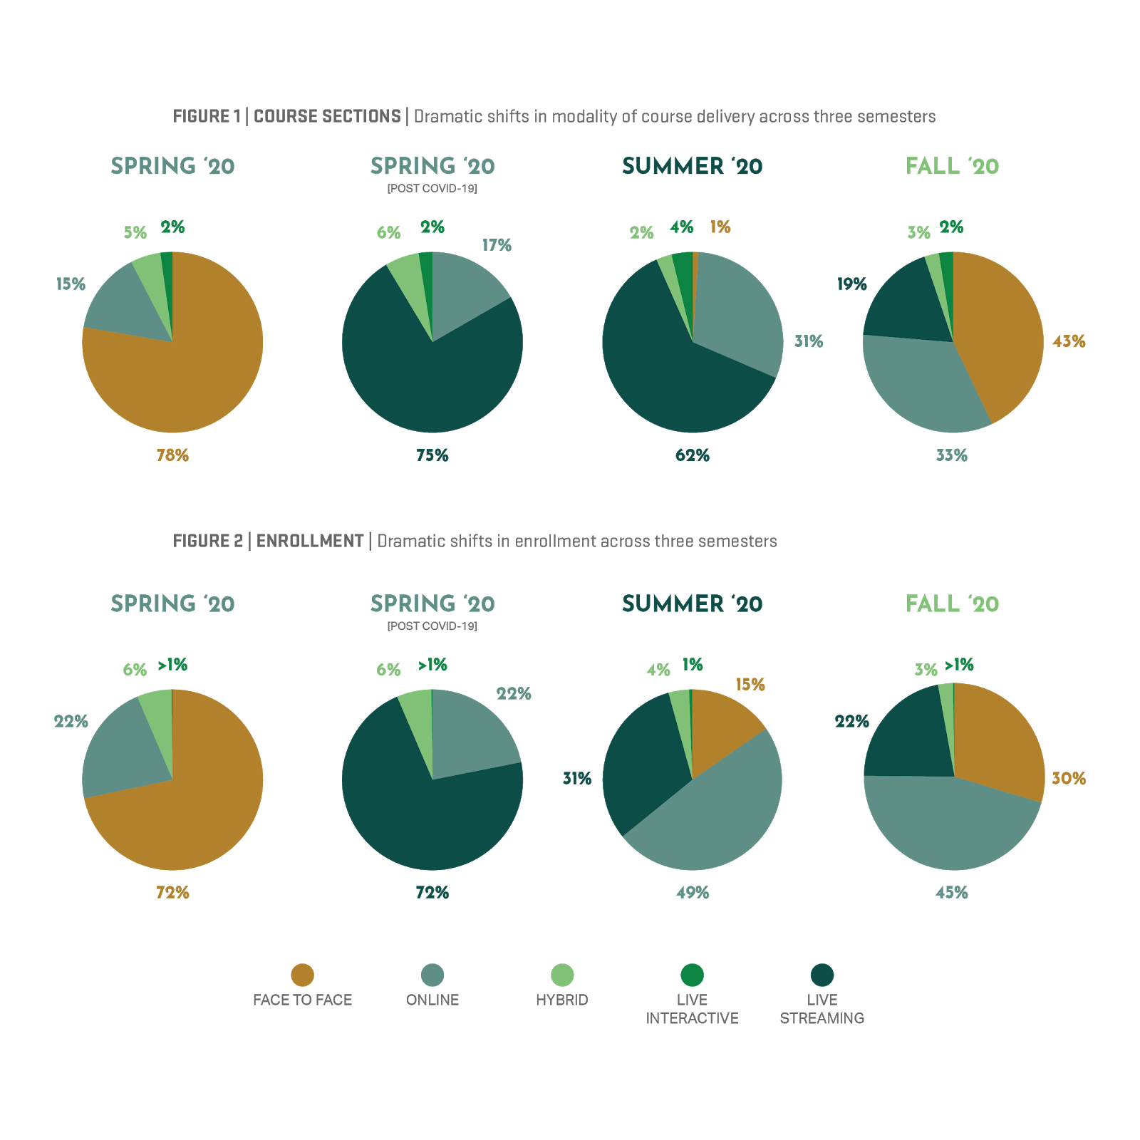
COVID-19
Notes:
Number of online courses went WAY up!
Brown is F2F ---> 70% were Face-to-Face
F20 about 43% are F2F, remaining are online/live-streaming
Our online classes more than doubled in a single semester
This meant that decreasing this achievement gap becomes even more critical.

Slide 8
Theoretical Framework
Notes:
Roxanne -
How we approached this problem
We felt like, because we use homework systems, and 3rd party texts, and videos from authors, etc.
We thought the mathematical content was good, what was missing was the social interaction and the in-classroom experiences'
So we focused on social presence

Slide 9
Social Presence
Definition:
"degree of salience of the other person in the (mediated) interaction and the consequent salience of the interpersonal relationships."
(Short, 1976)
In other words - "the degree to which a person is perceived as “real” in mediated communication." (Richardson, Swan, 2003)
Notes:
Short gave the original definition, but there are better interpretations out there.
I liked what Richardson, Swan defined it as – being "real" in communitcation

Slide 10
Social Presence
It exists as sub-area of communication theory
It occurs in
Instructor Student
Student Peers
Student Self
It develops as a result of users' perception over a sequence of interactions and can be described by one's perceptions of presence of others
Users of communication media are aware of the degree of social presence
Users tend to avoid using higher social presence media
Social presence can be "cultured" or normed
Notes:
Occurs in three ways
Student to instructor relationship
Student to peer relationship
Student to themselves
So this is how "real" the student feels YOU are, and how "real" they feel their peers are, and how "real" they see themselves in your class
Those relationships occur and build over time through the events in the course
It is their perception of how real you appear to them
What's interesting is......
Students come into a media understanding the degree of social interactions,
and they tend to avoid higher levels of social presence
This explains why students tend to avoid having cameras on in live stream courses
The good news is you can increase their willingness to participate at this higher level social presence

Slide 11
Does Social Presence Help?
Social Presence has been shown to positively influence:
Students' participation and motivation
Course and instructor satisfaction
Actual and perceived learning
Retention and intention to enroll in online classes
(Richardson et al, 2017)
Notes:
Literature

Slide 12
Session Goals and Outcomes

Slide 13
Session Goals and Outcomes
Ideas that can increase social presence
Course designs with high level of social presence and student pushback
Outcomes of enhanced courses versus standard online courses
Collaborate
Notes:
Roxanne
What kind of course designs are beneficial to high social presence
How to mitigate student pushback
Show you want we found from our pre and post survey
Have a discussion about what are some of the things you have tried

Slide 14
Ideas that Increase Social Presence

Slide 15
Ideas to Enhance Student to Teacher Interaction
Intensive and intentional feedback
Regular and frequent personalized emails
Office hour booking
Tutorial videos
with YOU doing the instruction
Notes:
Intensive and Intentional Feedback:
Pick one thing they did well, provide one suggestion
Typed this in to the feedback box
Everybody got a lot of feedback
Regular and frequent emails:
Once a week, sent an email NOT just to those struggling, but to everyone.
Sent individualized emails
Often times it was the higher performing students who were most grateful for the feedback
Comments in return from those who were successful were like, "Wow, no one has ever done this before. Thanks for your comments."
Office hour booking:
I've never had so many use my office hours before.
Comments were – I didn't know we could have this sort of connection with an online instructor.
Problem: misuse, over-use, it takes a lot of time
Tutorial videos:
Respond to questions on the homework and post on a discussion board for the whole class to see.
Students specifically REQUEST that I make them instead of going to a different sort of video
They want the connection to you

Slide 16
Ideas to Enhance Student to Student Interaction
Discussion boards
Real life
Open ended
Require some sort of analysis or decision making
Video responses for solutions of problems
Pick one from a list of intermediate level problems
Explain
Study skills are great to use here
Notes:
Student to Student Interaction can be tricky:
It is best if they are based in real life – open ended – require some sort of analysis or decision making
Discuss their process
Games, like the Game of 24
It can be difficult to find real life open ended questions that for a pre-algebra class
For example....
Having students respond by video instead of by text. Now they have library of solutions to problems.
Explain it, not just solve it.
Rubric was for proper language – proper notation – asked to explain like they are teaching everyone else
Also – added some study skill discussion, such as time management

Slide 17
Discussion Board Prompts
Notes:
There are resources for open-ended algebra problems. Finding those an embedding them is a great way to do this.
Percent discussion – list several percents that appear in your daily life
Try to focus on them as people, what are your goals, your major
Encourage them to interact with their classmates
Time management discussion
Take an inventory of all that you spend your time on
Discuss when and how you are going to make time for this class

Slide 18
Video Response from Student
Notes:
Here is a student response – video example

Slide 19
Course Design with High Social Presence and Mitigating Student Pushback
Notes:
Roxanne does this one

Slide 20
Course Design That Encourages Social Presence
Require content that provides social presence
If it matters, it must be given points
Be intentional
Hold high standards
Provide Rubrics
How-To Videos
Notes:
If it matters you are going to have to be given points,
We found extra credit discussion boards rarely work
Make sure the requirements are clear in your syllabus
You have to watch every video and give feedback on each one. The feedback needs to be specific to them and the
Video content
We felt like the video responses gave us an idea of who our students where, including a little bit of their personalities.
Learning curve can be high – need to be tutored through the technology of posting videos or using

Slide 21
Mitigate Student Resistance
Understanding Student Resistance
It is systemic
Students' resist because resisting has worked before
Ways to Mitigate Resistance
Be clear up front about what is required
Giving rationale and hold firm expectations
Campus push to increase quality in all online classes leads to higher quality overall
Open channel of communication
Mid-semester surveys
Open office hour
Notes:
It is helpful to understand WHY students are resistant. If we can understand WHY, then we can develop pedagogies and strategies to overcome it.
Everyone wants to resist change, and wants to move toward things that are more comfortable, this is all students are trying to do.
Compassion goes a long way here. Be compassionate about what the student is saying, but in order to stay in the class, they'll need to interact.
Be clear up front, write it in your syllabus, make sure students are aware of the expectations
If more people require it, students get used to doing it, a department push or campus wide effort to increase online quality will help
Keeping open channels of communication and conduct a mid-semester survey to get student feedback
Survey helps them to air grievances and address them
Making sure that they know they can contact you is helpful

Slide 22
Outcomes
Notes:
Evelyn takes over.

Slide 23
Numbers Spring 2020
Overall Department Numbers:
 | Traditional | Online
Pass | 78.5% | 74.4%
Success | 93.0% | 91.0%
Final Exam Median | 77.9% | 81.3%
Closer look within the online sections
Treatment Sections | Percent | Number
Enrolled |  | 49
Pass | 76% | 37
Retain | 92% | 45
Success | 82%
Non-Treatment Section | Percent | Number
Enrolled |  | 23
Pass | 74% | 17
Retain | 96% | 22
Success | 77%
Notes:
We tracked some of the outcomes
Traditional students are still passing at a higher rate – but this is a much bigger improvement.
Online students outperformed traditional students on the departmental common final exam
Break-down the other section:
Passed at a slightly rate, higher success rate
They retained at a lower rate - not a complete surprise
Numbers are low

Slide 24
Lessons Learned
A lot of work!
Caps need to be low
Recommend that this be considered in workload conversations
Mentors/Student aides help
Schedule time in your work time to complete
Pre- and post-survey – What we learned
Student to student interaction was weak
Very little change
Notes:
Takes a lot of time:
30 people in the caps
Recommend to future conversations that this be considered
Mentors are a big help
If you don't plan time, it will be very hard.
Pre & post survey questions were focused on the social presence aspect of the course. Some examples of questions asked were
“ Online or web based education is an excellent medium for social interaction."
"Online instructor creates a feeling of community"
"I felt the feedback from my online instructor was adequate"
"I valued the instructor feedback in my online classes"

Slide 25
Discussion
Notes:
Small group break-outs
What have you tried?
You'll have 5 minutes.
Select a group spokeperson

Slide 26
What have you tried?

Slide 27
Questions??

Slide 28
References:
Davis, A.M. (2017, January). How do we establish Social Presence within Online Mathematics Courses. Paper presentation at the Hawaii International Conference on Education, Honolulu, HI.
Richardson, J. C., Maeda, Y., Lv, J., & Caskurlu, S. (2017). Social presence in relation to students' satisfaction and learning in the online environment: A meta-analysis. Computers in Human Behavior, 71, 402-417.
Richardson, J., & Swan, K. (2003). Examining social presence in online courses in relation to students' perceived learning and satisfaction.
Short, J., Williams, E., and Christie, B. (1976). The social psychology of telecommunications. London: John Wiley and Sons.

Slide 29
Thank you!
Roxanne Brinkerhoff
Mbrinkerhoff@uvu.edu
Evelyn Porter
Porterev@uvu.edu

