Slide 1
Open Online Resources for Teaching Quantitative Concepts
in Nursing
Daniel Ozimek
Pennsylvania College of Health Sciences
dozimek2@pacollege.edu
Lindsay Good
Pennsylvania College of Health Sciences
lgood2@pacollege.edu

Slide 2
Objectives
Provide the motivation for teaching quantitative concepts in nursing.
Share open, online resources for creating authentic tasks involving quantitative reasoning in clinical practice.
Provide examples of tasks and activities that integrate clinical judgment and quantitative reasoning.

Slide 3
High Quality Mathematics Education for Nurses
The Covening, October 2019
Participants
Goals
Results
American Mathematical Association of Two-Year Colleges (AMATYC)
Bayer – Crop Science
The American Statistical Association (ASA)
Bill and Melinda Gates Foundation
CGFNS International
The Charles A. Dana Center at the University of Texas at Austin
Delta College
Ferris State University
Mathematical Association of America (MAA)
National Association for Healthcare Quality (NAHQ)
National Council of State Boards of Nursing (NCSBN)
The National League for Nursing (NLN)
The NROC Project
Organization for Associate Degree Nursing (OADN)
Pennsylvania College of Health Sciences
Quality and Safety Education for Nurses (QSEN)
The University of Miami
To work toward realizing the vision that “All students in nursing programs will gain the mathematical and statistical knowledge, skills, and attitudes to promote and provide safe, high-quality health care”
Representatives from the nursing, mathematics, statistics, and education communities met to:
1. Build connections between our communities.
2. Develop a forward-thinking consensus about the quantitative education of nurses.
The participants constructed recommendations which were then shared with the communities for input. A finalized publication summarizing the convening and recommendations is forthcoming.
The publication presents seven recommendations for dialogue, research, collaboration, and development of resources.
On-going collaboration based on the recommendations is occurring through webinars and presentations.

Slide 4
Recommendation 4: Integrate learning experiences throughout the nursing curriculum that provide learners an opportunity to develop sound quantitative reasoning, data reasoning, and clinical judgment.
It is important to reject a “once-and-done” mentality with respect to quantitative education in the nursing curriculum. Simply passing a mathematics or statistics course is not sufficient; rather, quantitative learning occurs with experiences throughout the curriculum.
Students should be provided with experiences (e.g., simulations, case studies, clinical-based activities) that go beyond simply obtaining a numerical solution. Instead, students should be prompted to notice, interpret, operate with, and reflect upon quantitative information within complex and authentic clinical environments.

Slide 5
A Shared Perspective
Mathematical Problem Solving
(Poyla, 1945)
Clinical Judgment Model
(Tanner, 2006)
Notice
Focused assessment
Information seeking
Recognize deviations
Interpret
Make sense of the data
Set priorities
Make a plan
Respond
Complete the interventions
Be skillful (think in action)
Reflect
Self analysis
Note the outcomes
Re-use or improve for the future
Understand the problem
What is unknown
What is the data
Devising a Plan
Find the connections
Have you seen this before
Carrying out the Plan
Complete the solution
Check each step
Looking Back
Examine the solution
Check the result
Use in the future

Slide 6
An Initial Approach to Dosage Calculation Tasks
(Ozimek et al., 2019)

Slide 7
An Updated Approach Following Collaboration
(Ozimek et al., 2019)

Slide 8
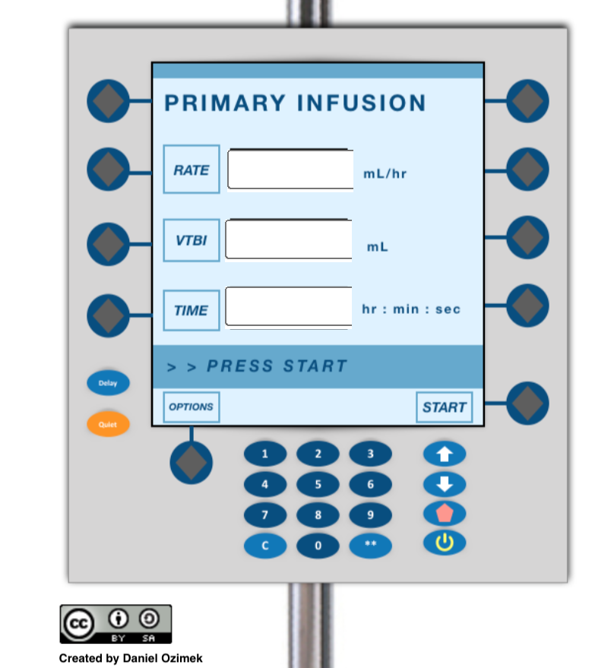
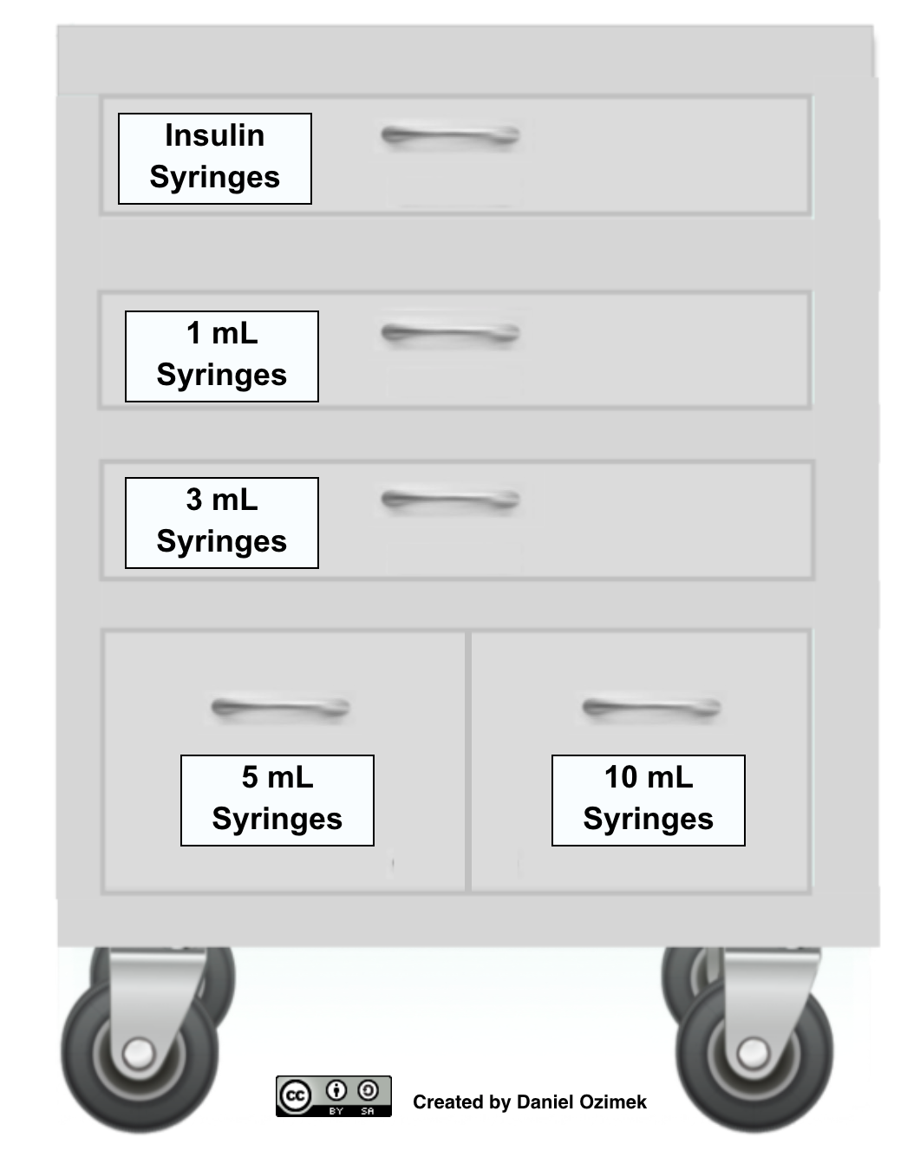
Open Online Resources
Dosagemath.com Graphics, animations, adjustable dosage tools, applets, Desmos activities
WikiDoc Medication labels, graphics, additional context for creating tasks
teacher.desmos.com
Desmos Activities Information
Getting Started with Desmos Activities
Notes:
1 min

Slide 9
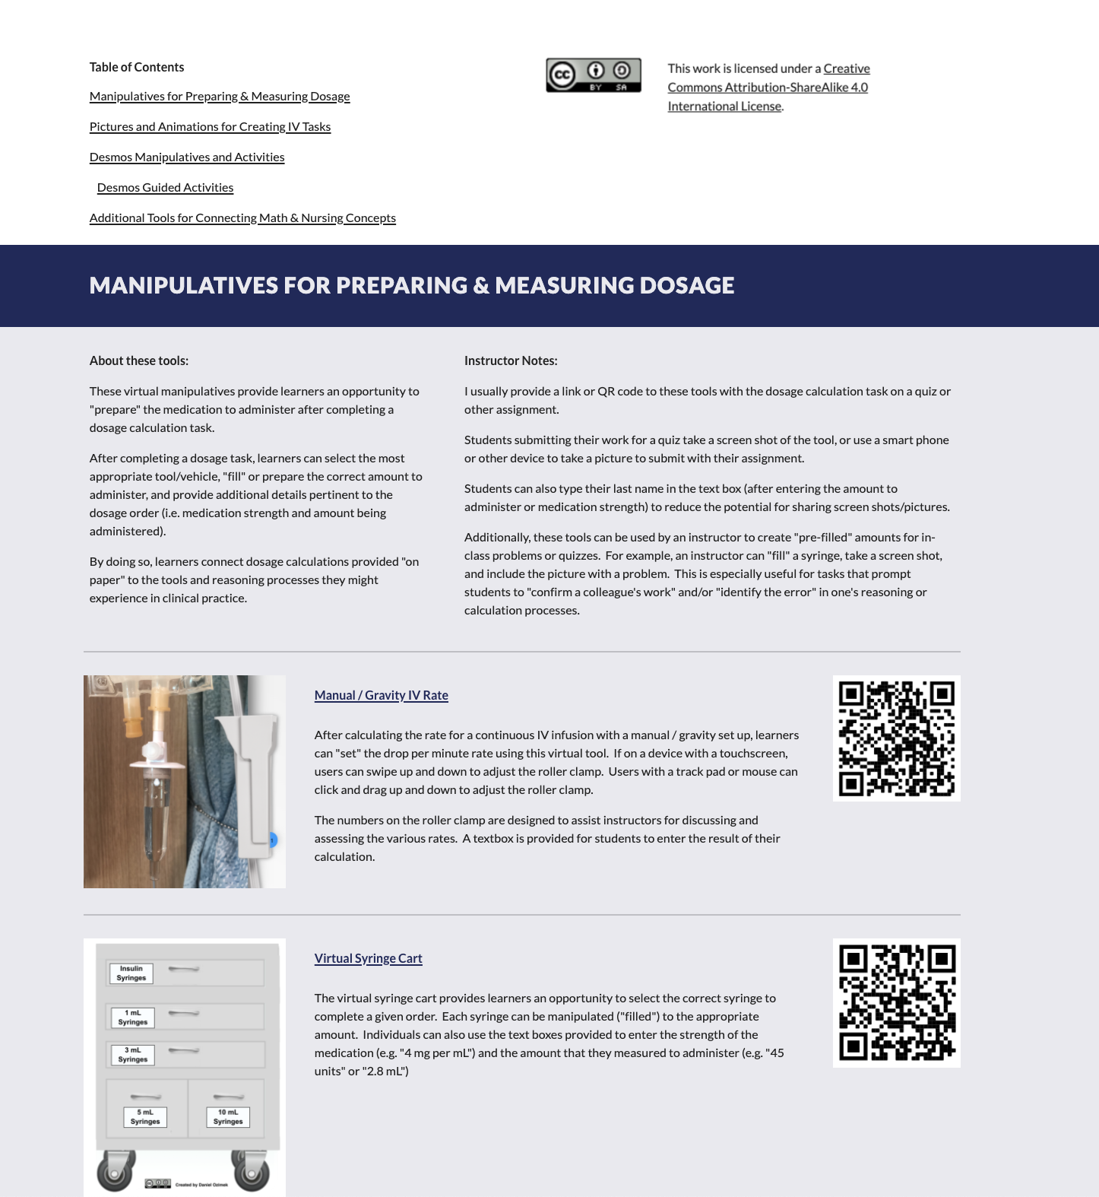
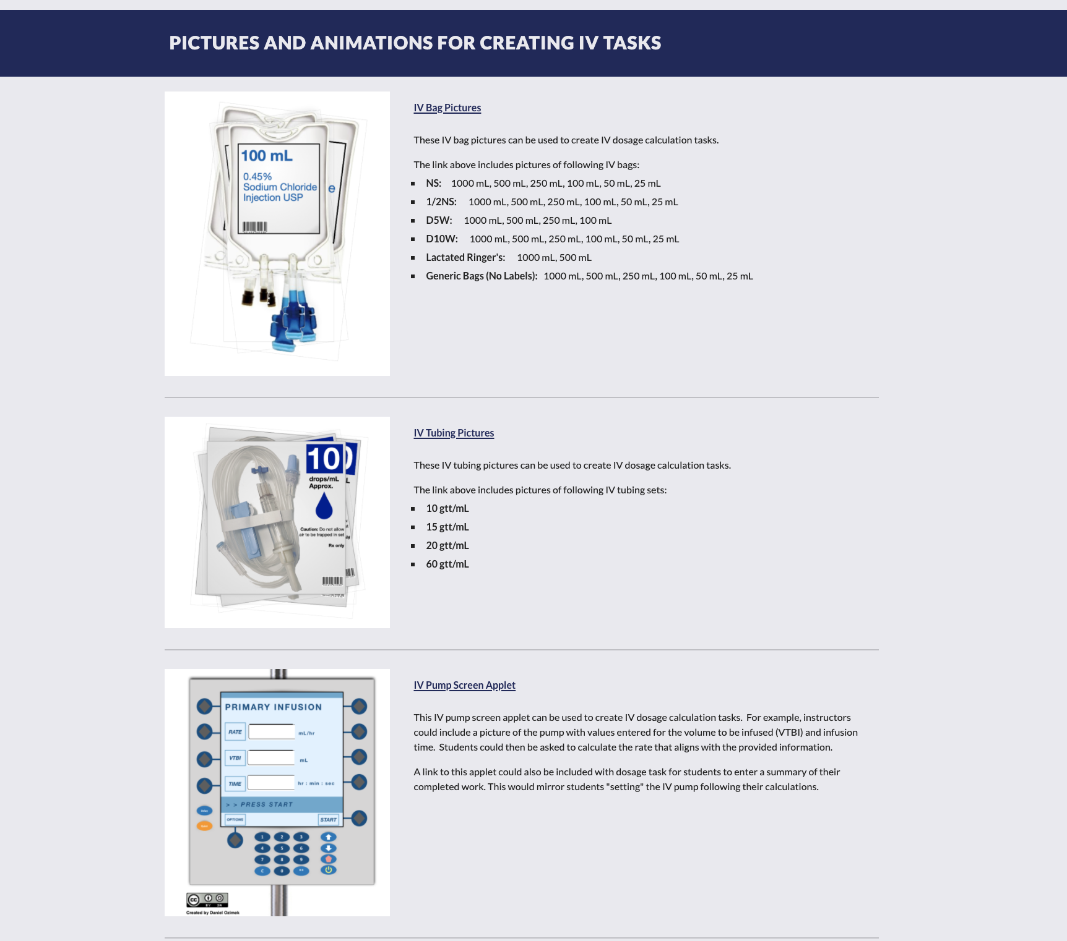

Slide 10
Oral Dosages in Tablets
Quantitative Concepts / Skills
Construct and reason with ratios
Conversions within the metric system
Measurement
Nursing Concepts / Skills
Calculate a dose based on the order
Identify the medication strength
Prepare the dose
“An order is given for Ibuprofen 0.6 g by mouth every 6 hours. The available medication is Ibuprofen 600 mg per tablet. How many tablets will the nurse give for one dose?”
Notes:
2:06 PM

Slide 11
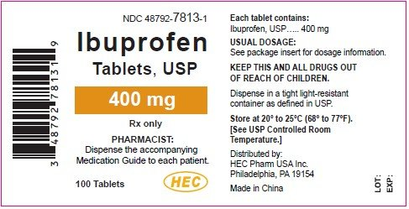
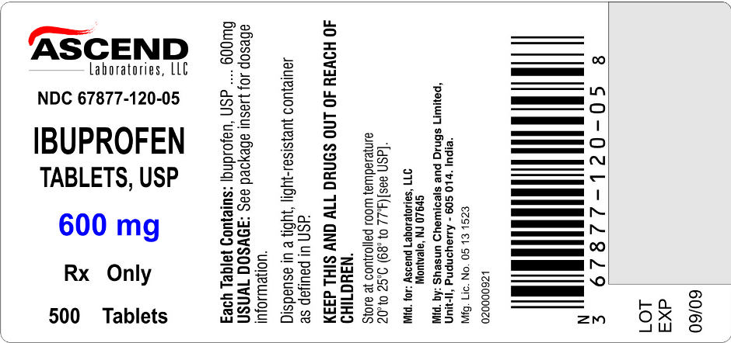
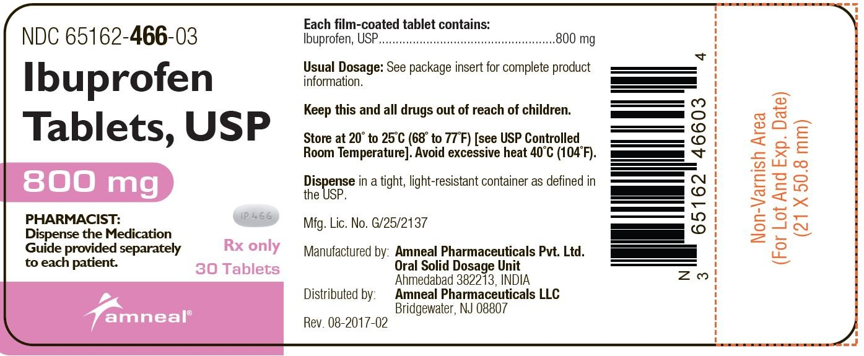
Transformed Oral Dosage Problem
Order: Ibuprofen 0.6 g by mouth every 6 hours for an adult in pain.
The nurse opens the medication cart and examines the available strengths of this medication.
What do you notice about the order and available medications?
Which medication should the nurse use for this order? Why?
Based on the order, calculate the amount to give the patient for one dose. Prepare this dose using the tools available.
Syringe Cart Dosage Cup for Tablets

Slide 12
Injection Calculations
Quantitative Concepts / Skills
Construct and reason with ratios
Conversions within the metric system
Measurement
Nursing Concepts / Skills
Calculate a dose based on the order
Identify and select the appropriate medication based on the volume of the dose and route of administration
Prepare the dose
“An order is given for Furosemide IV 30 mg every 12 hours. The available medication is Furosemide injection 40 mg per 4 mL. How many mL will the nurse give for one dose?”

Slide 13
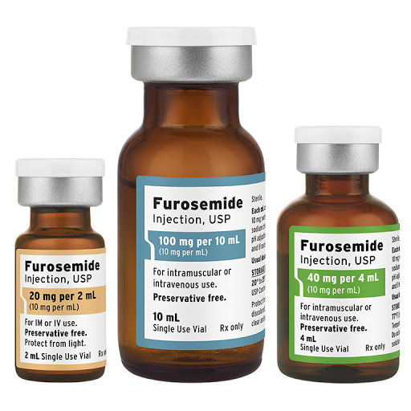
Transformed Injection Calculation Problem
The provider prescription is for IV Lasix (furosemide) 30 mg every 12 hours. The first dose is due at 6am.
Which vial could be used to supply the ordered dose?
After administering the 6am dose, at what time is the next dose of the medication due?
Use the QR code and/or URL provided to select the appropriate tool, prepare the dose, and take a screenshot of what you will administer.
http://products.fresenius-kabi.us/product-49.html
Syringe Cart

Slide 14
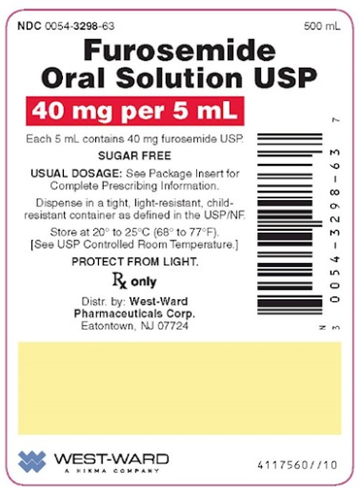
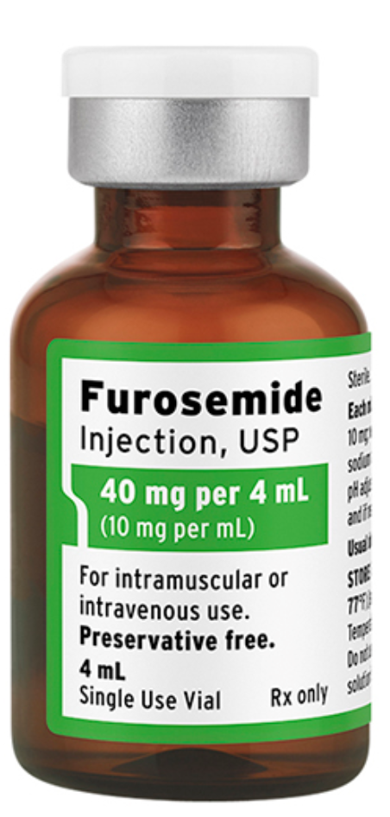
Additional Injection Calculation Problem
The provider prescription is for IV Lasix (furosemide) 20 mg every 12 hours. The first dose is due at 6am.
What volume will supply the correct dose?
After administering the 6am dose, at what time is the next dose of the medication due?
Use the QR code and/or URL provided to select the appropriate tool, prepare the dose, and take a screenshot of what you will administer.
https://dosagemath.neocities.org/syringecart.html

Slide 15
IV Pump Calculations
Quantitative Concepts / Skills
Construct and reason with rates.
Conversions between units of time and volume.
Nursing Concepts / Skills
Identification of available fluids and infusion time.
Interpret “appropriate” flow rates for available equipment.
“A 500 mL bag of normal saline is set to infuse for 7 hours. At what rate in mL/hr should you set the IV pump?”

Slide 16
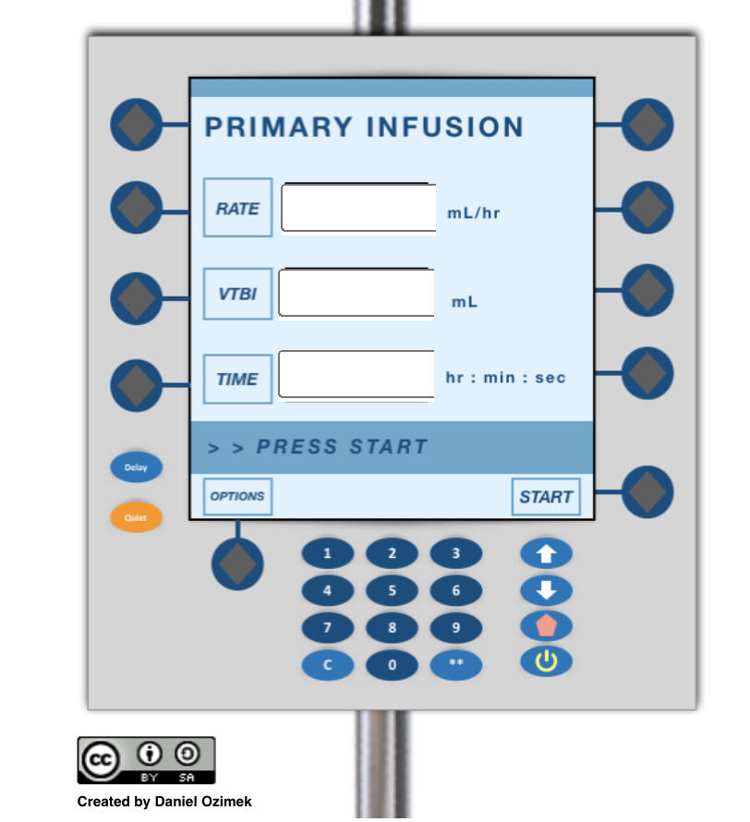
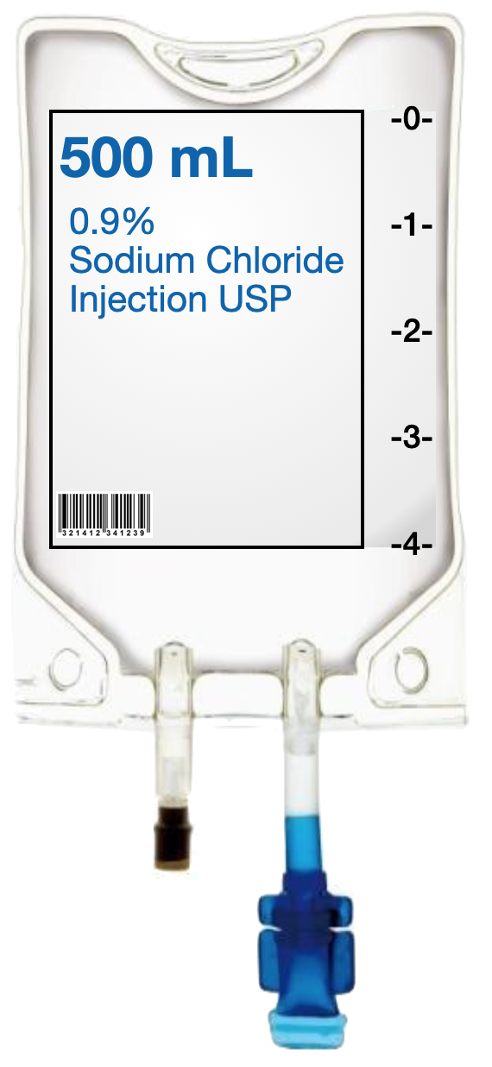
Transformed IV Pump Problem
We are given the available IV bag and infusion parameters stated below. Use the QR code or URL to access the IV pump applet and fill-in the spaces with the appropriate values for this order.
Start Infusion: 0430
Stop Infusion: 1145
Set the IV Pump

Slide 17
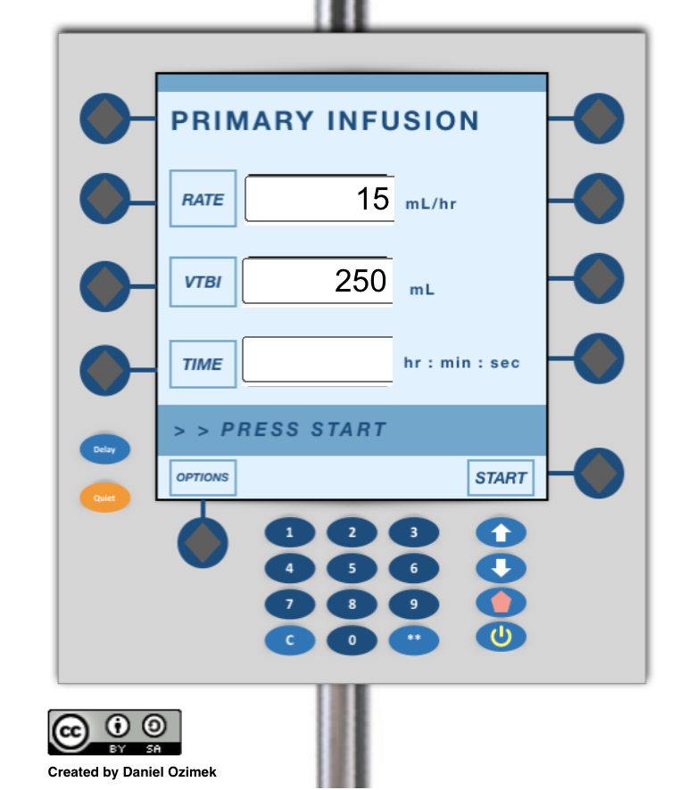
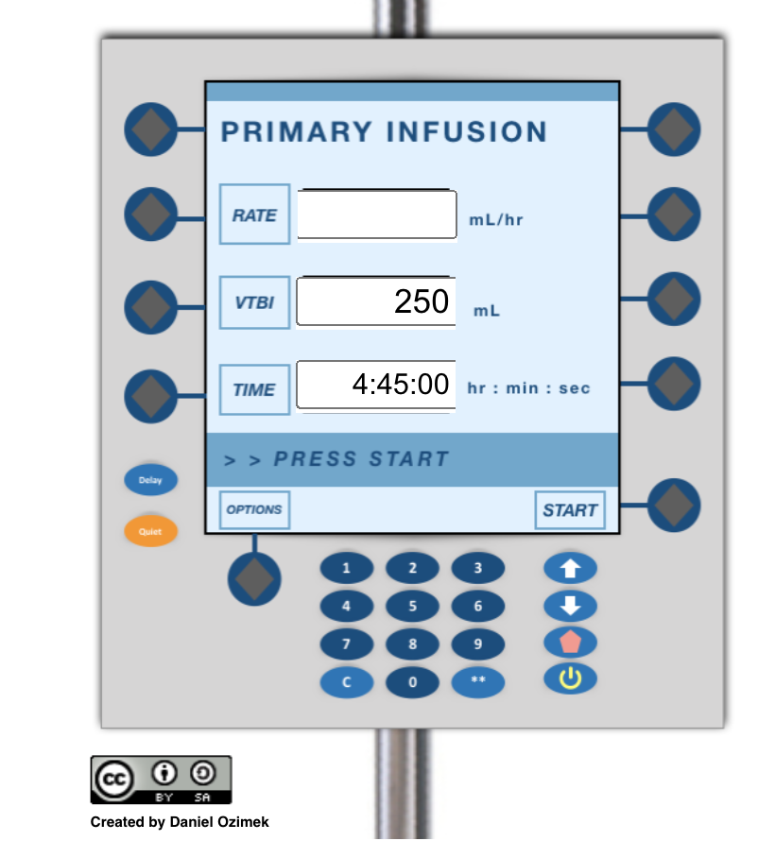
Additional IV Pump Problems Using the Applet
We are given three IV pumps screens below. Use the values provided to solve for the missing quantity. Show all of your calculations to support your work

Slide 18
Manual/Gravity IV Rate Calculations
Quantitative Concepts / Skills
Construct and reason with rates.
Conversions between units of time and volume.
Nursing Concepts / Skills
Identification of available fluids, equipment (drop factor), and infusion time.
Interpret “appropriate” flow rates for available equipment.
Connect the flow rate with drip chamber.
“100 mL of fluid is set to infuse over 3 hours. We are given a drop factor of 15 gtt/mL.
What rate in gtt/min is needed to complete this order?

Slide 19
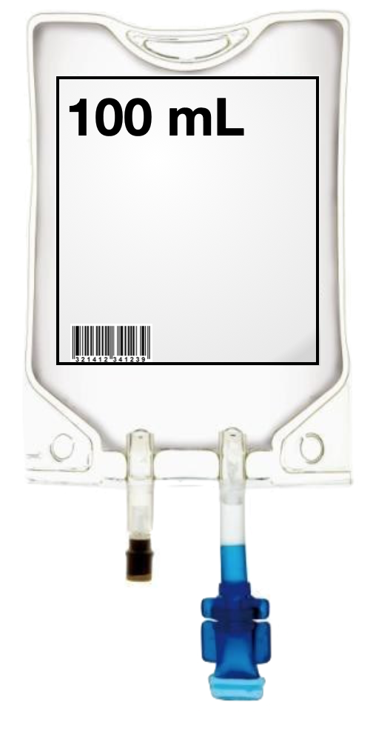
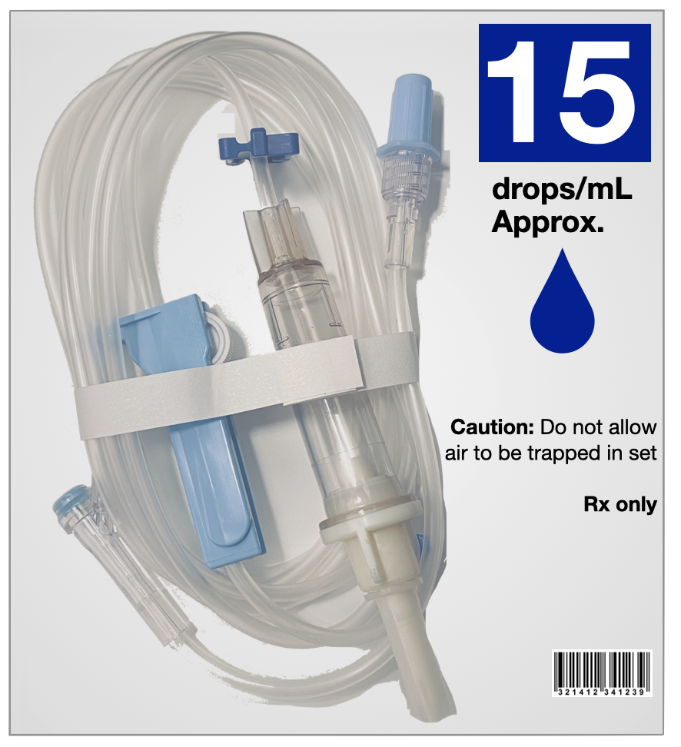
Transformed Manual/Gravity IV Rate Problem
Order:
Infuse 100 mL NS with antibiotic
Infusion Start: 0930
Infusion End: 1230
Drop factor is provided on packaging label
Calculate the rate needed to complete this gravity flow rate order.
Once you have calculated the rate, use the QR code or URL provided to “set” the appropriate rate in the drip chamber.
Discuss how you arrived at your answer.
Set the Drip Rate
Notes:
Nursing aspects:
Breaks the formulaic math approach to thinking critically about the tools/resources that are given. Noticing and interpreting.
Connecting the calculated rate to the speed in the chamber. Selecting the right drip rate would involve scaling of ratios. .

Slide 20
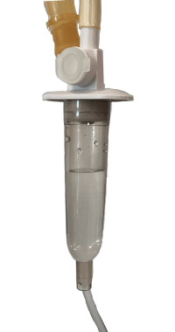
Additional Manual/Gravity IV Rate Problem
You are given an order and available tubing size for a gravity infusion.
Your colleague has prepared the infusion (on the right) and has asked that you confirm if it is appropriate.
How would you respond to your colleague?
Include all supporting calculations.
Order:
Infuse 100 mL NS with antibiotic
Infusion Start: 0900
Infusion End: 1130
Drop factor is provided on packaging label
Notes:
Nursing aspects:
Breaks the formulaic math approach to thinking critically about the tools/resources that are given. Noticing and interpreting.
Evaluation and not assuming that your previous nurse/colleague is accurate.

Slide 21
Desmos
A robust, online scientific and graphing calculator that is free for students and faculty
Launched an Activity Builder that allows instructors to create an interactive activity or use another instructor’s activity
Activity Features
Incorporate student feedback and responses, images, graphs, virtual tools and manipulatives such as syringes
Used for synchronous or asynchronous learning
Instructors can control the pace of the activity and view student responses
Notes:
2:26 PM

Slide 22
A Showcase of Problems in
Desmos Activity Builder

Slide 23
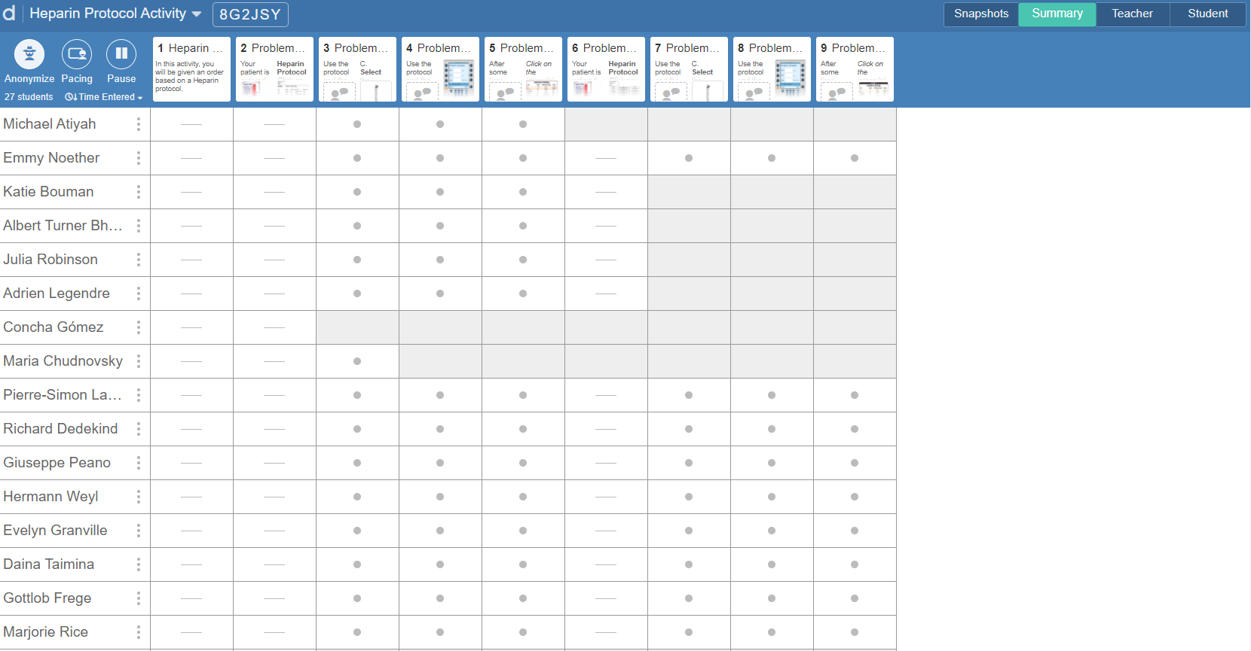
Screenshot from a Desmos Activity -- Faculty Perspective

Slide 24
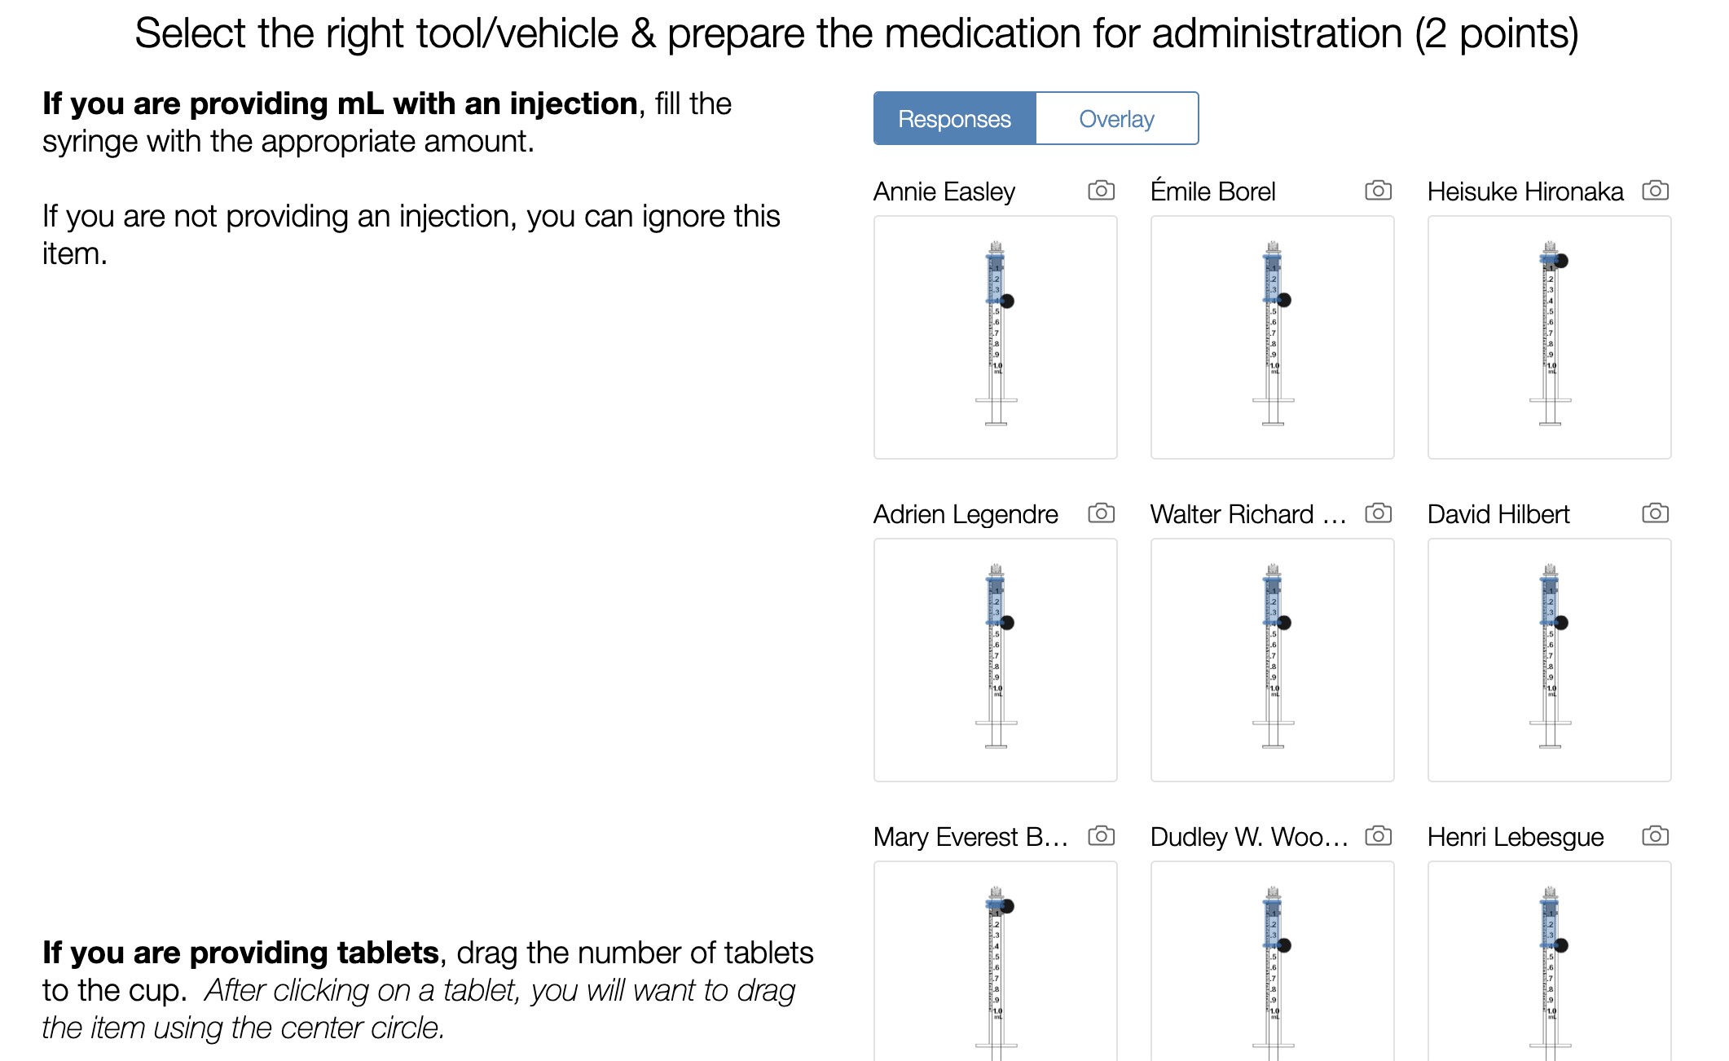
Screenshot from a Desmos Activity -- Faculty Perspective

Slide 25
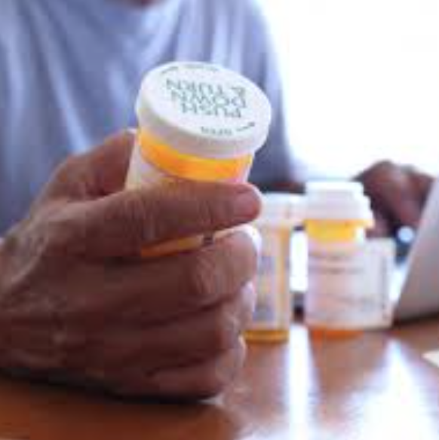
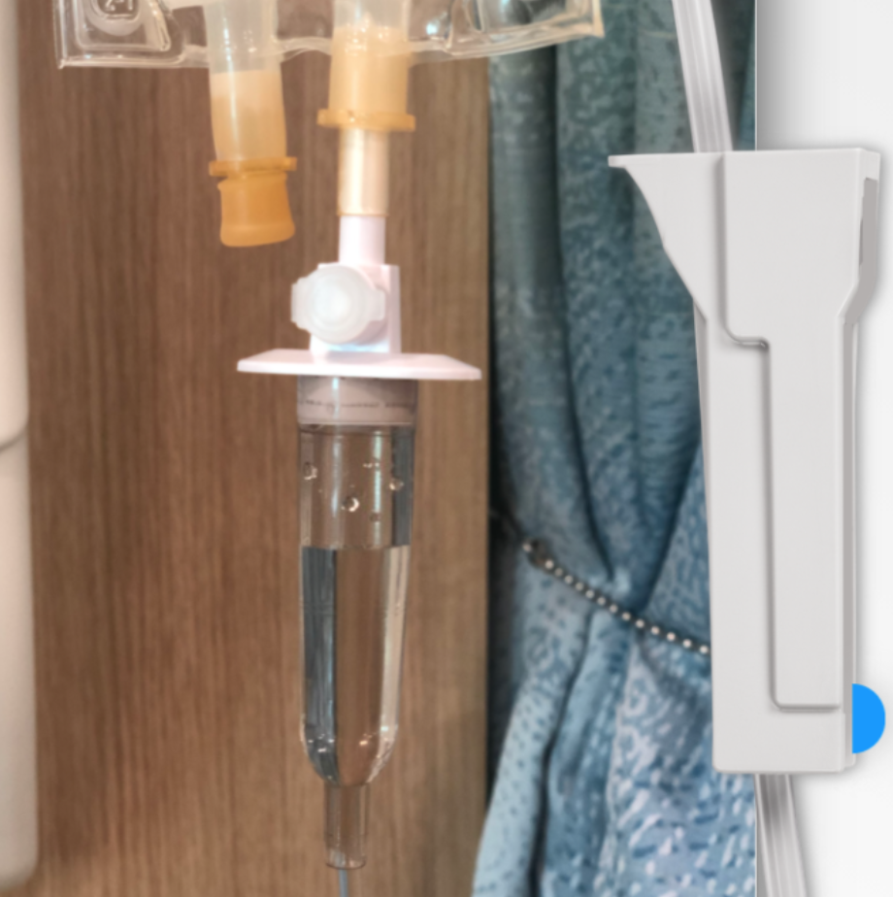
You Try!
Safe Dosage Desmos Activity
In this activity, students are given an order for a patient and must decide whether or not the order is safe. They will then need to determine how much of the medication to administer to the patient. Lastly, a decision must be made about how the medication will be given to the patient.
Showcase Desmos Activity
Click the link above to explore a Desmos activity from the students’ perspective
This activity illustrates the the variety of tasks that can be included.
IV Push Desmos Activity
In this activity, students will explore IV push dosages and the rate at which the medication must be given.

Slide 26
Webinars for Additional Information
Webinar #1 Recording & Materials June 19, 2019 Teaching Dosage Calculations: Strategies for Narrowing the Theory-Practice Gap
Webinar #2 Recording & Materials June 10, 2020 Teaching Dosage Calculations Online: Virtual Tools and Open Resources for Creating Engaging Content
Notes:
2:37

Slide 27
Questions?
Notes:
2:37

Slide 28
References
Murphy, G., & Murphy, J. (2019). Applied pediatric math: Bridging the gap between theory and practice for a diverse group of learners. Nursing Education Perspectives, 40(3), 181-183.
Ozimek, D., Good, L., Watson, G., & Wendel, A. (2019, November). Building bridges: A collaboration between math and nursing faculty [Conference session]. American Mathematical Association of Two-Year Colleges (AMATYC) 2019 Conference, Milwaukee, WI.
Ozimek, D., Kelch, B., & Zoellner, J. (in press). Math and statistics education for nurses (Convening Recommendations, No. 1). Austin, TX: The Charles A. Dana Center at The University of Texas at Austin.
Polya, G. (1945). How to solve it. Princeton University Press, Princeton, NJ. ISBN: 0-691-08097
Tanner, C.A. (2006). Thinking like a nurse: A research based model of clinical judgment in nursing. Nursing Education, 45(6) 204-11. doi: 10.3928/01484834-20060601-04

