Slide 1
Medical math
Heidi Lyne and chris berta
Joliet junior college, illinois
Notes:
Heidi: Introduction
Chris: Introduction
Heidi: We run a joint program called “Math Bridge” at Joliet Junior College in Illinois, the nation’s first community college founded in 1901 (we have to say that as our only claim to fame).
Chris: The program began in the Veterinary Technology (Nursing) Department of the college.
This presentation shares why and how we started the program and the multiple iterations the program has seen as it has evolved semester to semester.
Heidi: We co-teach Pharmacology which is in the first semester of the freshman year in a 50student cohort. Admissions are only in the fall, but students may be part time or full time which takes about 2 years. Our main outcome in this presentation is for you to see how collaborative efforts can positively impact student pathways as well as collegiate relationships.
Poll: How involved are you in cross-campus collaboration efforts?
A. Already in a partnership B. Have been contacted to crate a partnership C. Just interested in information

Slide 2
Math is hard.
“I could have gone to medical school, I said. Except for all the math and stuff.”
-Mary Janice Davidson
Notes:
Chris
Began teaching Pharmacology as an adjunct in 2017. Not new to academia but new to teaching.
In Veterinary Nursing, Pharmacology is expected to teach proficiency in drug terminology and dosing. Because of the dosing aspect, Pharmacology is where our 2-yr students first get their exposure to applied math or technical math
As soon as students are aware that math will be a part of the curriculum, we start getting the emails
Heidi: Chris was hearing those beautiful words we all hear as math instructors all the time.
“Math causes me Great anxiety”, “I’m not good at math”, “It’s my worst subject”
-How many students use the same superlative? Who is actually the ‘worst’ at math? Because they all claim to be the ‘worst’…and its accepted.
-And students tell us willingly how much they dislike our careers. Do any of us go to someone’s job and say ‘wow that sucks’? But it’s accepted because it’s math.
-Incoming Disability NOAs
- We know, we are preaching to the choir…
Chris:
Their concerns are not unwarranted. When I first started teaching, I was astounded by the overall weakness in math across the majority of my students. I approached my dean, and she suggested we develop a grant-funded program as a joint effort between the Math Department and Veterinary Nursing. We called it Math Bridge. Math Bridge began as a 1-hour math supplement to run parallel with Pharmacology. We placed the program between our AM & PM sections.
Our first step? To formally identify the many stumbling blocks our students face.
HEIDI: I really believe in collaboration and helping other instructors identify ways to improve.

Slide 3
Problems Identified
Math Prerequisite
Elementary Algebra
Veterinary Nursing (& Biology)
Math Anxiety
Disability Services
Time multipliers
Reading Comprehension
Multi-Step Organization
Nomenclature
% & : represent portions and concentrations
Metrics
Multiple Backgrounds & Approaches
Discontinuation or change in teaching concepts like long division & multiplication
Notes:
HEIDI
-First the program changed the prereq from Elementary Algebra to Intermediate, but they didn’t need more algebra exposure. You don’t solve quadratics in medical math, you need more practical, elementary application. I have done presentations on Math in Context that follow this thinking; contact me if you want some ideas for your classrooms. Regardless, the prereq is Elementary Algebra again.
-Students suffer from and share allowed that they have math anxiety and put up a brick wall that we need to breakthrough.
-Many don’t realize that high school IEPs don’t translate directly to college. So by the time we have paperwork squared away, they are already failing.
-And reading comprehension is a major issue because we are not just reading about Sally buying an exorbitant amount of watermelons, we are calculating weights on animals that can be life or death situations and students jump into their career feet first.
CHRIS
Reading comprehension is a nice segue into the next few problems we identified. In a tech program like Veterinary Nursing, we are teaching nursing nomenclature, which is totally foreign to most of our students. We found the technical math that runs concurrently is no different. A couple of examples:
I expected to explain to students that a concentration can be expressed using symbols we already use: % and :
EXAMPLE - % means g/100ml and : means g/ml and that 1 gram = 1 ml, although one represents a mass and the other a volume.
However, I did not expect them to have such trouble with the fundamental concepts of knowing when to multiply or divide or the meaning of a mathematical % or ratio. Teaching both pharmacology math principles and basic math principles at the same time quickly becomes confusing for the students.
An even more profound example involving nomenclature involves the Metric System
Conversions are covered in isolation in previous coursework
Many students say they have never been exposed to metrics
This is a new language and even more concerning a new system to grasp conceptually – Our program had allotted no time for this.
how does it relate to the measurement systems they know?
Introducing another number line
We were asking them to learn a new language on the fly while we used them to explain their pharmacology curriculum
I was taught metrics in grade school and HS. This was a learning experience for me. I could not rely on the depth of concept taught or the fact that the concept had been taught at all.
Metrics are ESSENTIAL for all STEM disciplines – from Chem to Geology, and yes, medicine.
As we tried to adapt and teach the above concepts, like percentages, we found a tremendous dislike of FRACTIONS. As we dove deeper into fractions, we found they didn’t understand a remainder. Then we learned many had not been taught LONG DIVISION. We’ve been peeling back the layers of that onion since 2017.
Lastly, changes in math curriculum over the last 2 decades have not helped the cause. For example, if Heidi had not been in my classroom, I could never have made any sense out of the ladder method of multiplication. And, I’ve become a firm believer that students should not be issued a calculator until HS!

Slide 4
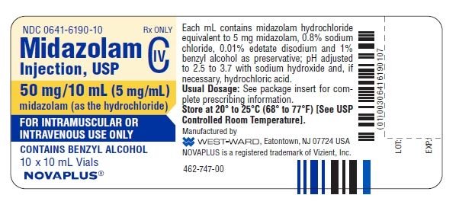
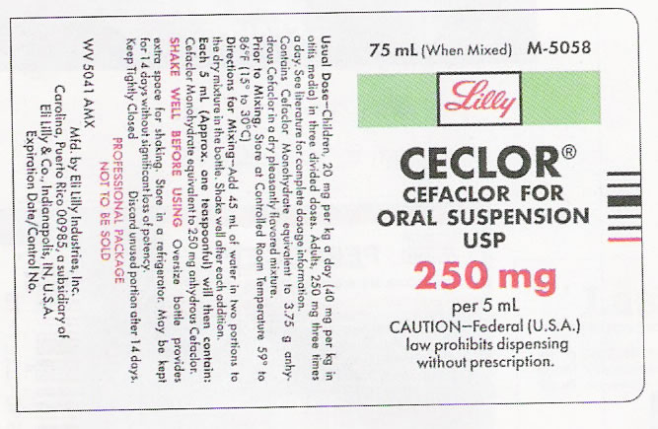
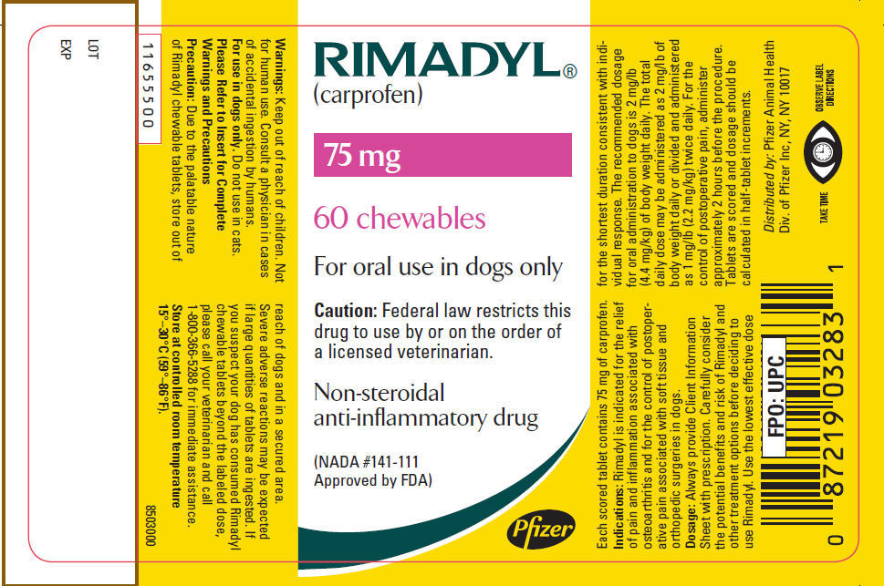
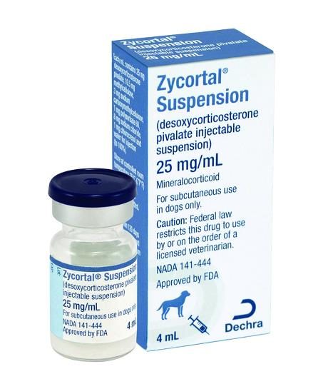
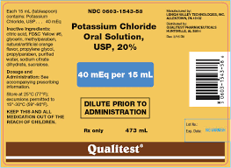
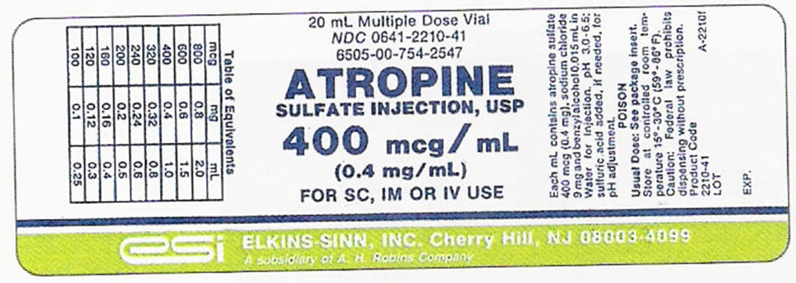
Don’t Kill the animals!
Notes:
CHRIS
This slide depicts just a small example of the type of information we expect our students to digest in a semester.
Rx: They must understand the drugs, their routes, their indications and contraindications and then be able to dispense them appropriately using label & formulary information.
Note: various concentrations and how they are presented
Note: the use of metrics
In addition to label information, they are expected to learn how to assess the accuracy of various syringes – which involves rounding.
They learn to run fluid pumps (another new concept) while having to calculate fluid rates
Ultimately in other classes, they learn constant rates of infusion and titrations, which involve multiple levels of problem solving and the incorporation of time.
The concepts require a knowledge of fundamental math only—not high level at all. But, If the students don’t come into the program with a solid understanding of math fundamentals—the 4 basic operations, percentages, proportions and how to solve for X—the frustration is palpable.
HEIDI Yes, as a math person, I do not typically pull out labels and prescribe in my College Arithmetic classes. In our word applications, the idea of an application is there, but how often does it literally mean life and death?

Slide 5
GRADING DIFFERENCES
Fall 2017
FALL 2020
Notes:
Heidi: With an emphasis on math and the introduction of Bridge, math was separated from a previously integrated curriculum.
Students now were required to pass math and pharmacology separately.
Chris: Previously, students passed with poor math skills because pharmacology scores buoyed their overall score

Slide 6
LEARNING Units identified
Whole Numbers & Operations
PEMDAS
Metrics
Nomenclature
Number Line & Conversion Factors
Fractions, Decimals, Percentages
Rounding
Proportions & Unit Conversions
Using concentrations
Using conversion factors
Solutions and Dilutions
C1V1 = C2V2
Other, more complex problems
We haven’t gotten here…yet!
Notes:
Heidi: We identified 5 main units as such. Now we can open a book and find fractions examples, but we not only need to emphasize fraction word problems, but also review rules.
Chris:
Metrics material is impossible to find overall
More complex word problems specific to the sciences were difficult to find—especially for VETERINARY nursing
A lot of fundamental material is geared toward Pre-K – 6th
Development of assessments still takes a great deal of time. We scour teaching websites and nursing manuals and then adapt.

Slide 7
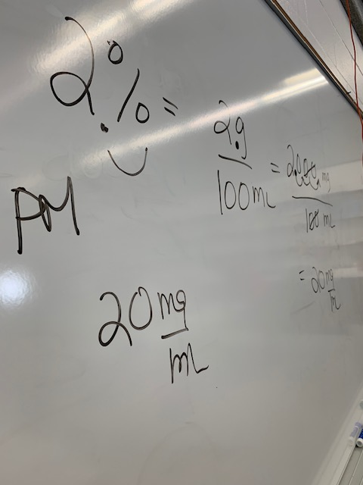
Evolution of Class Structure
Initial: ‘18F - ‘19S
1-Hour Supplemental Instruction
Repeats in ‘19S from ‘18F: 20%
Additional opportunity to retake vs. removal from the program
Iteration #1: ‘19U with final assessment
Summer optional BRIDGE program + supplemental instruction
Repeats in ‘20S from ‘19F: 32%*
Iteration #2: ‘20F - ‘21S
Course broken into two semesters, fall to spring
Summer mandatory BRIDGE program ‘20U
Supplemental instruction now involves dedicated labs
Two semester curriculum now warrants a warning for ‘21S
Drops in ’20F: 12%
# of repeats increased when we removed the averaging of grades and began identifying students with math issues.
From ’18F – ’20F, 17 students passed Pharmacology instead of being removed from the program → Board Results (pending)
Notes:
Chris: #1
Students respond positively to supplemental Bridge program; we wish we had evaluated them earlier
Heidi: We were teaching one of the units in one hour. So imagine going over all of fraction rules in one hour and serving the students their homework on the way out the door. Just not enough time!
Chris: #2
We offer an optional Summer Bridge; we note improved scores over summer assessment and scores of other classmates for those who attended
Heidi: This was more time as we devoted a day ~3 hours to a review concept. Students could then at least practice some in front of us.
Chris: #3
Changes in the department and increased focus on math precipitate a curriculum change. The class is now offered over 2 semesters. The Pharmacology lectures are split and hands-on labs, most of which include math, are developed.
Students no longer fail if they fail math. They get a warning and are able to pass on to the second semester with their co-hort.
Covid, Online & Reading Comprehension will skew analysis of this past year
Heidi: So we actually we the increase in repeats as a good thing. Before students were dropping the program, but now we are identifying students that need more time to make up skills and learn the fundamentals of application a few times. Also – it allows us to identify students who realize that this is not the career for them; while taking care of animals sounds fun, killing them because you moved the decimal the wrong way is not fun.

Slide 8
Progress Summer - Fall
2019 Summer - Fall Assessment vs Test 1
Scores (Need 80%) | TEST 1 | % Increase
100 | AVG: | 12%
56 | W
56 | 46 | (10)
60 | 97 | 37
72 | 92 | 20
76 | 84 | 8
75 | 48 | (27)
28 | 32 | 4
84 | 78 | (6)
56 | 71 | 15
48 | 80 | 32
60 | 85 | 25
44 | 35 | (9)
52 | 89 | 37
32 | 31 | (1)
84 | 98 | 14
92 | 96 | 4
60 | 73 | 13
60 | 76 | 16
32 | 55 | 23
40 | 64 | 24
19.5% average increase for those increasing their scores (12% overall)
←Outlier
19 students chose not to participate in the optional program
Notes:
Heidi: Like Chris referenced, we have preliminary grade data from the last two years. This is last summer-fall’s spreadsheet of those that attended bridge. We thought a 19.5% increase in their exam scores from initial bridge assessment to final exam was inspiring enough to continue.

Slide 9
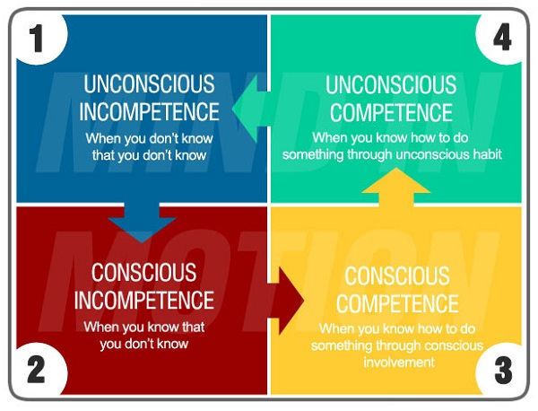
Classroom adjustments a vision of conscious competence
The highest level of learning is APPLICATION
Fundamentals must be solid
Early assessment can be key
Teach concept → application
Regardless of skill
Include “technical or applied” math in curriculum
Additional time and exposure helps!
Repetition
Active learning – lab environment
LINK TO SYRINGE LAB
Notes:
Chris: The 4 stages of learning resonated with students.
Students didn’t feel like failures when they saw that learning was a process and how they were progressing through it.
When students first arrive at the program, they fall mostly in Stage 1; some are in Stage 2.
Our standard for passing is Stage 3. Sometimes this takes 1 semester; sometimes this takes 2+
Our hope is that the students keep developing their skills and eventually achieve Stage 4.
Heidi: We’re not talking about college arithmetic students, some of these students took high school calculus, high school statistics. We have to get these students to level 2 asap before it’s too late. Humility.

Slide 10
We never learned this stuff
An obese retriever weighs 115 lb. As a CVT, you suggest that the ideal weight for this dog is 80 lb. What percent of the dog’s body weight must be lost?
Penelope the Pointer isn’t doing well. So, Dr. Costa adjusts her heart meds and orders Digoxin, 0.25 mg IV STAT. Digoxin is available at 0.1 mg/mL. How many mL will you administer?
How many L of 0.9% KCl do you need to prepare 3.5L of a 0.5% KCl solution?
Notes:
Heidi: I know a line I hear in my regular math classes over and over when calling on prerequisite skills is “I never learned this”. Now in some cases, maybe the student had a gap in learning for various reasons, but we know they learned it just in different context. How often do you hear “you never taught us this one”, well we didn’t’ do THAT EXACT ONE, You’re correct.
Chris: Heidi taught me this in our first year ☺
Heidi: These are three examples of the types of questions we need students to be able to understand and interpret before their first semester of freshman year is over.
Poll: How many of these questions are you confident in solving?
A. One B. Two C. All Three D. I’m scared.

Slide 11
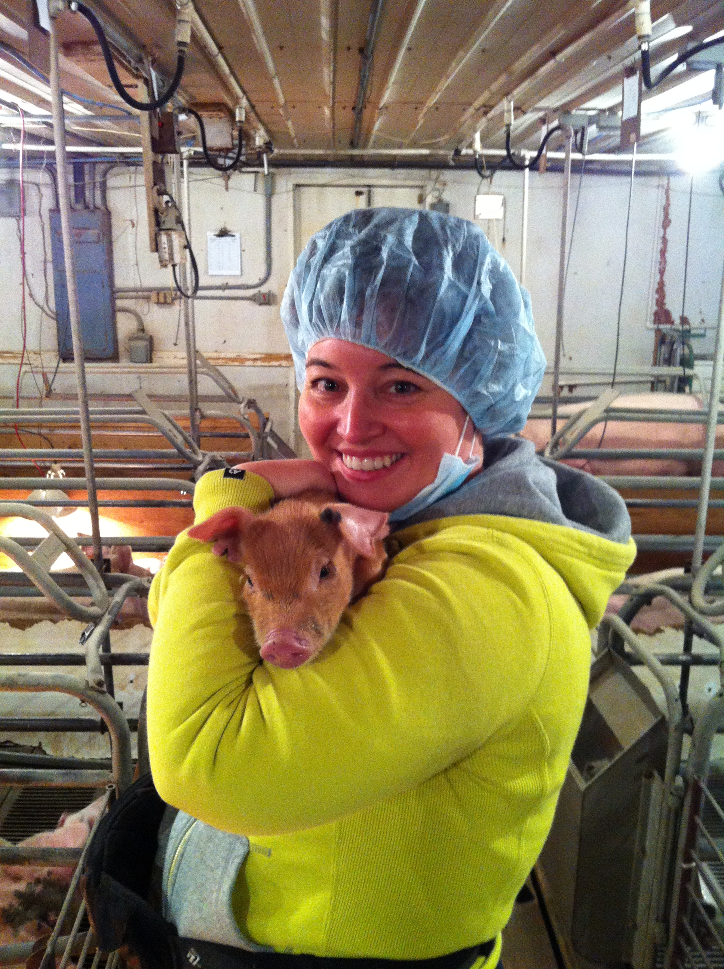
extras
Veterinary math content provided by the author/publisher was scant.
We created:
Labs, face-to-face and virtual
Case studies
Kahoots
Quizlets
Informal and formal assessments
Anything we could think of!
Notes:
Heidi: We have put a lot of work in thanks to a grant to develop resources for these students. While publisher content is great, there is not much out there to fill in the gap between math and career fields. There are packages for technical skills which show proportions, work with percentages, but how much do we see students directly equate an example proportion to real life?
Chris: Final comments

Slide 12
Thank you!
Heidi Lyne, EdD
hspeer@jjc.edu
Chris Berta, CVT
cberta@jjc.edu
Notes:
We owe a big thank you to our Perkins Grant for helping with funding through the Dean of Career and Technical Education, Patricia Zuccarello. We also have support from our chair Brad Angus and then Vet Coordinator Eileen McKee. And then OUR STUDENTS for being flexible and many being very responsive.
From a student that gave us a run for our money and shot daggers through our skin for a whole semester, then repeated.

Slide 13
Student Thanks
“Hi guys!! I just wanted to thank you both for never giving up on me when I was struggling with math, as well as taking extra time to help me! I’m currently doing my externship at my work and I’m calculating doses for everything, and having a blast while doing it! Math is so fun and kind of satisfying to me now, especially when I figure out the correct dose with zero help from my doctors. From propofol to ketofen, ampicillin to cerenia, and many many MANY more, I have never felt so confident with math before and I have you two to thank. Thank you both for being so patient with me!”

