Slide 1
Collaborating to Create OER Courses for Future Teachers
Marcia Corby
Krysten Pampel, PhD
Frank Marfai, PhD

Slide 2
Agenda
A tale of saving money…
Interactive Notebooks
Building the Beast
Brain Break!
Lightboards…
Virtual Manipulatives
How you can get involved!

Slide 3
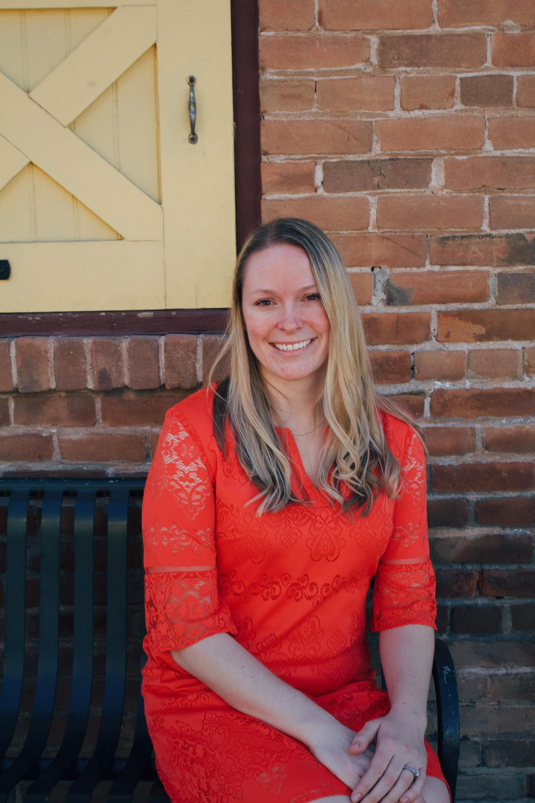
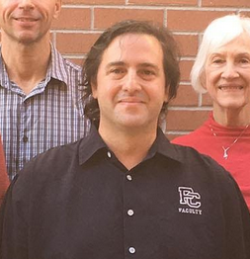
A tale of three teachers….

Slide 4
Maricopa County Community Colleges

Slide 5
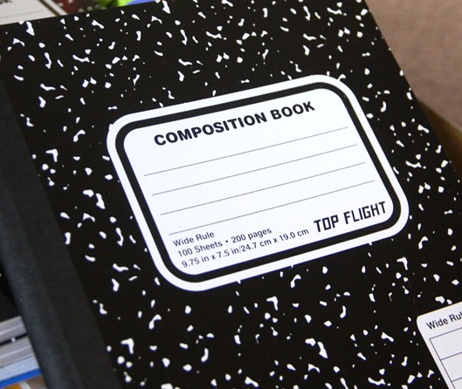
Interactive Notebooks (Click On the image to see the finished product!)
Click me!!

Slide 6
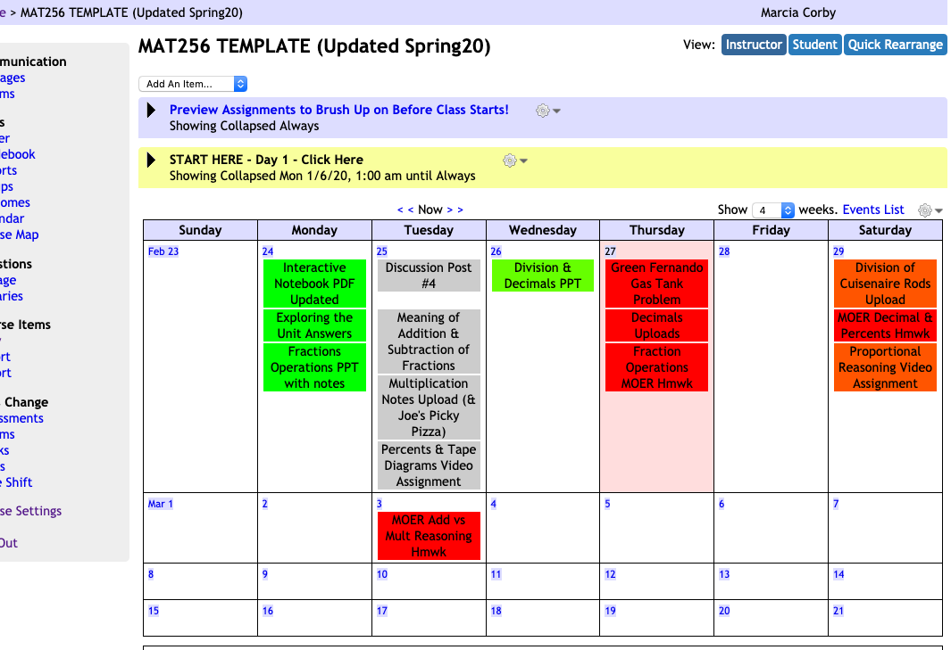
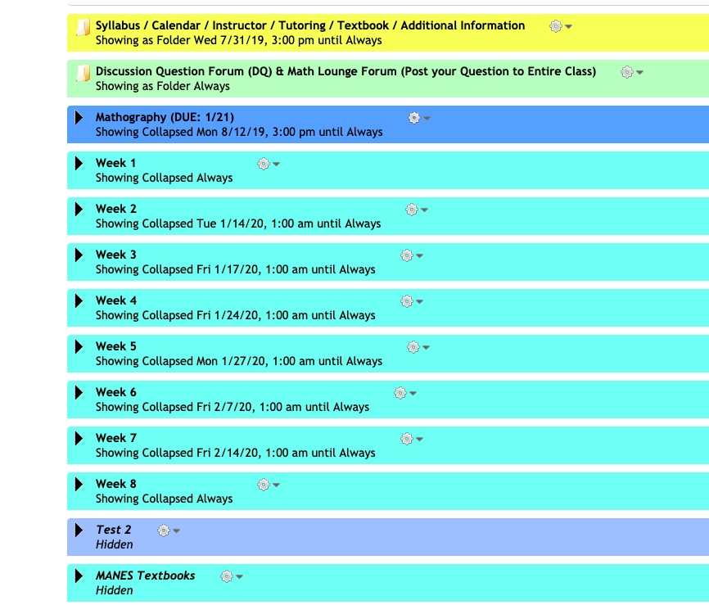
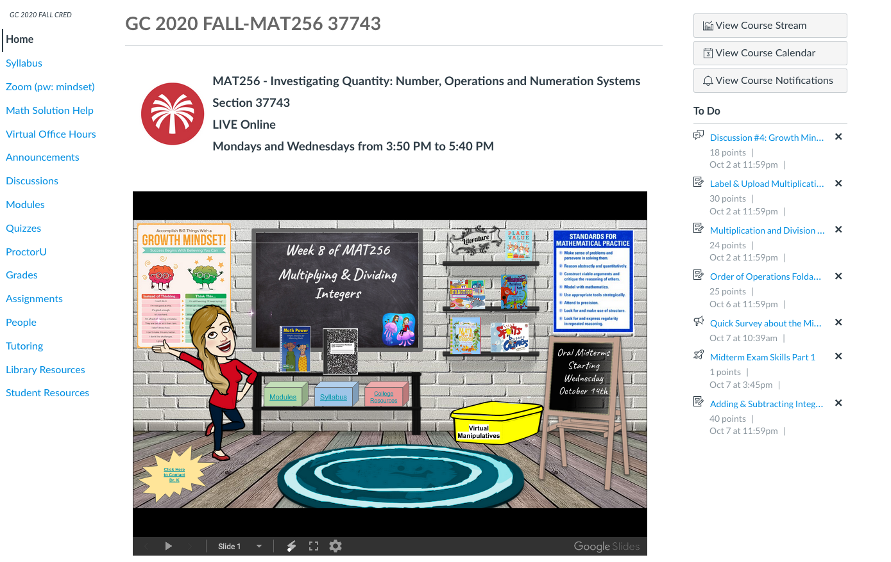
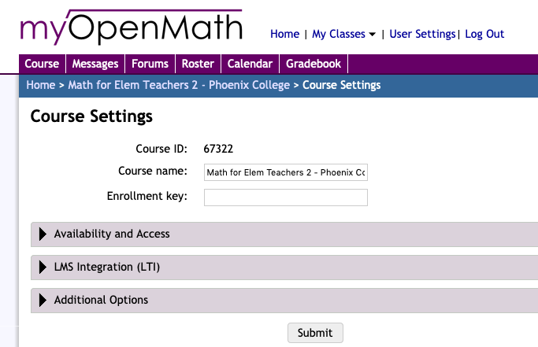
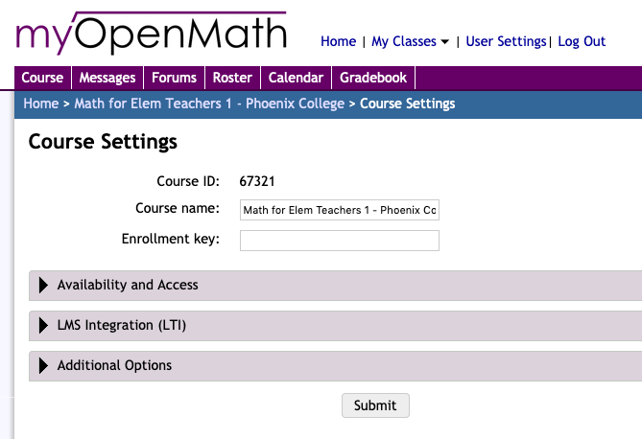
Building the Beast
MOER to M.O.M to Canvas

Slide 7
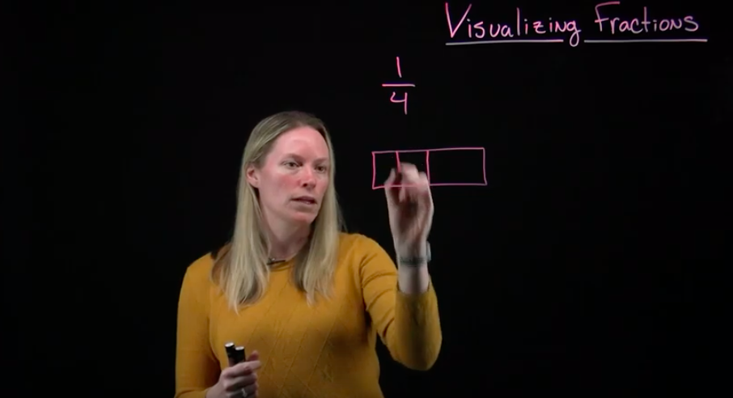
And then there was a lightboard…and another….

Slide 8
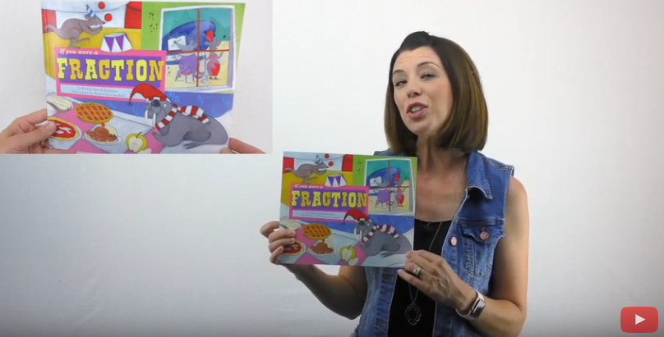
Good books for your future classroom
https://smile.amazon.com/You-Were-Fraction-Math-Fun/dp/140484791X
Notes:
Video: http://www.youtube.com/watch?v=T_M-kzcTl4A

Slide 9
Brain Break!!!
Ten Count!
Any player can start off the count saying, “One.” Any player can say “two” at any time. The goal is for the group to get to 10.
However, if two players call out a number AT THE SAME TIME, the group must start over.
https://www.barnesandnoble.com/w/silly-sports-goofy-games-spencer-kagan/1029381559
https://smile.amazon.com/Silly-Sports-Goofy-Games-Grades/dp/1879097567

Slide 10
And then there were Virtual Manipulatives...

Slide 11
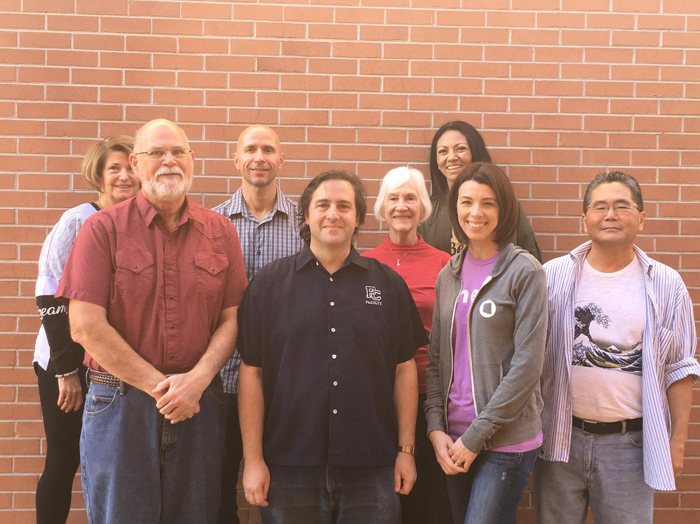
Meet the Project Team
Top row: Deborah Ermoian, James Sousa, Marianna McClymonds, Minerva Pargas
Bottom Row: Bill Meacham, Frank Marfai, Marcia Corby, Joe Sueyoshi
Notes:
Frank

Slide 12
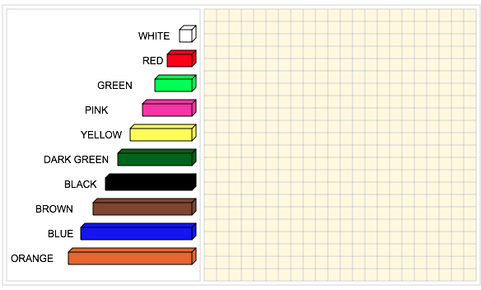
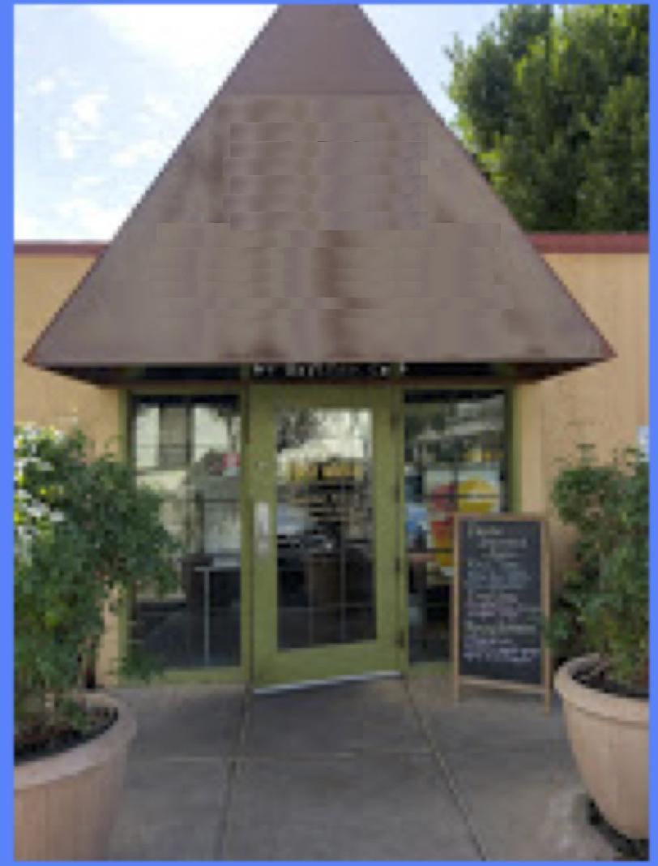
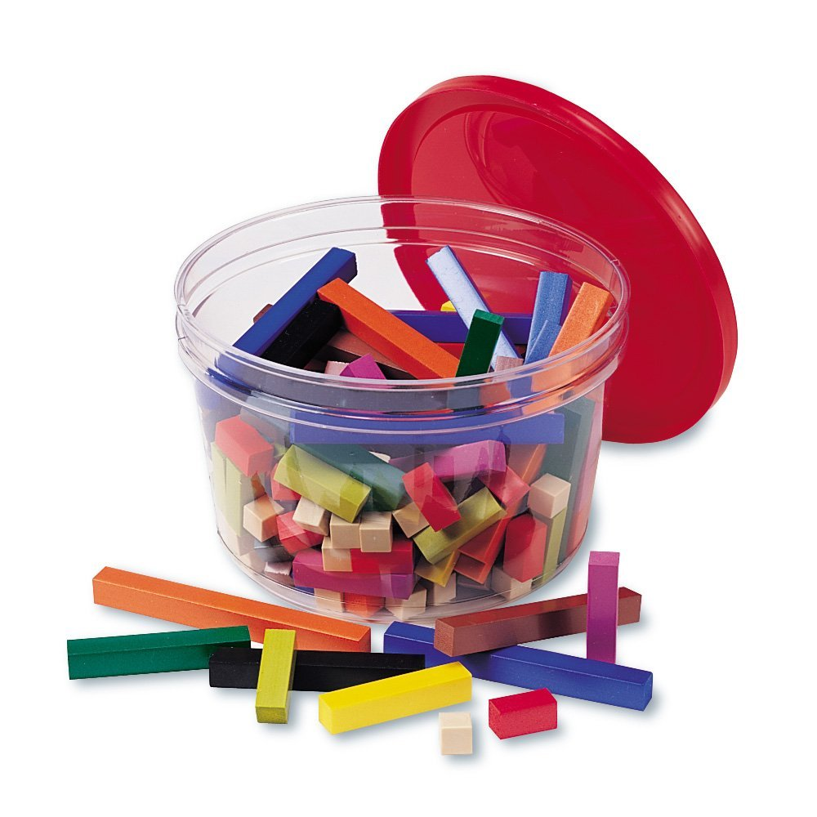
Developing Cuisenaire Rods
Notes:
Frank
Collaborative weekly meetings: We examined how used for teaching within the classroom.
We visualized how each could be used in a virtual environment, ensuring they are intuitively easy to use
Here’s an example of one such manipulative, which are called Cuisenaire rods. It has many uses, including teaching the concept of fractions.
Here an examples of an early prototype we developed working collaboratively,

Slide 13
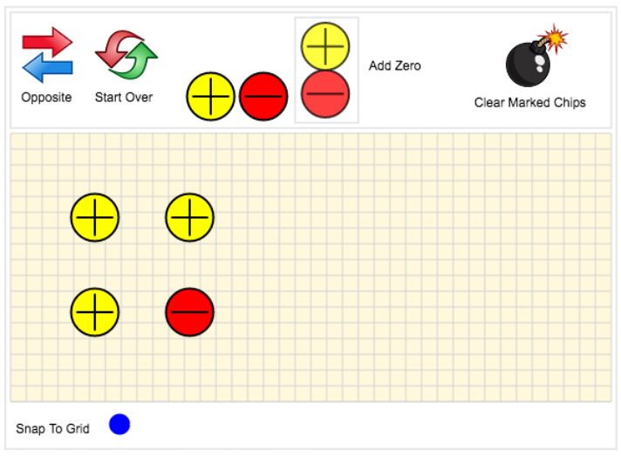
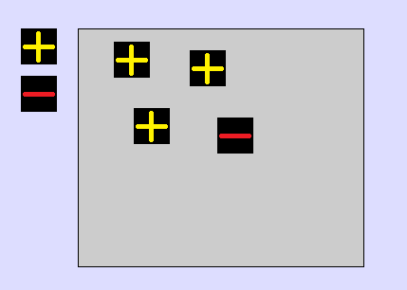
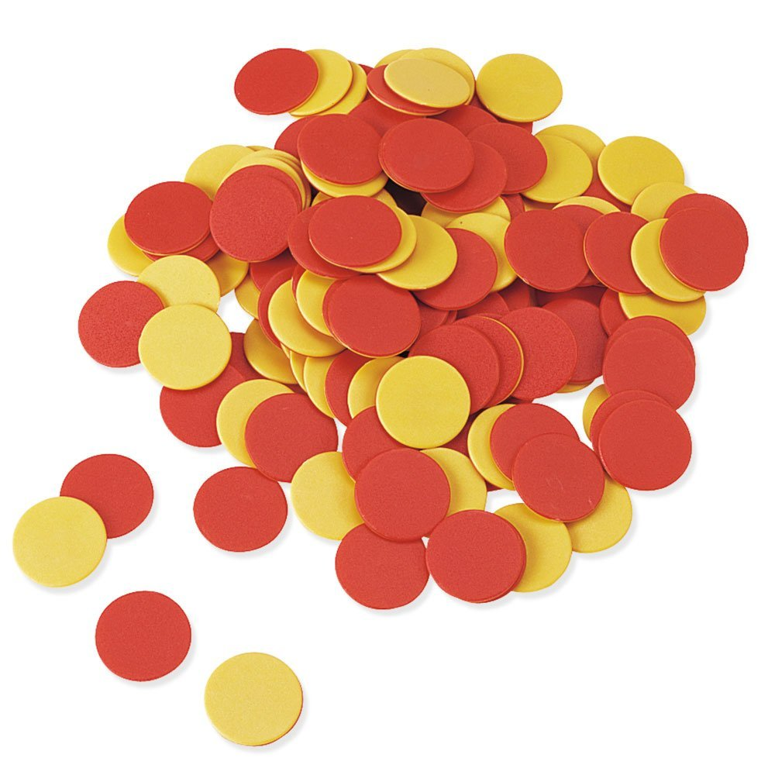
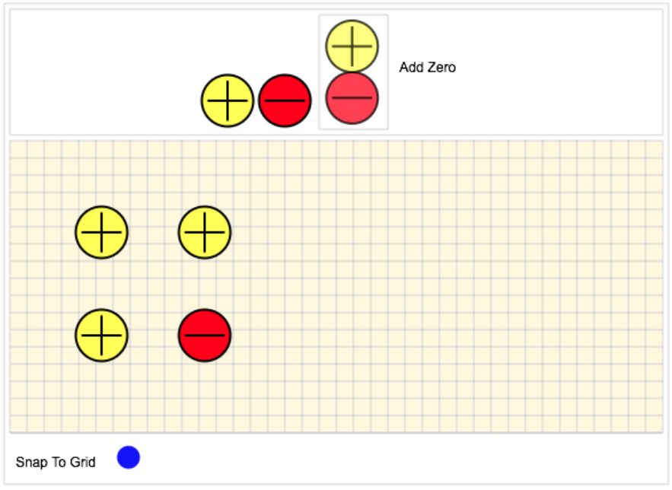
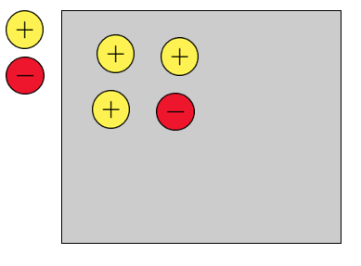
Integer Chips- Evolution of the Virtual Manipulative
Notes:
Frank
Talk about the evolution of this manipulative. Mention how original VM started.

Slide 14
Virtual Manipulatives (Click on Image to access the site)
https://pcmathoer.wordpress.com/base-10-manipulative/

Slide 15
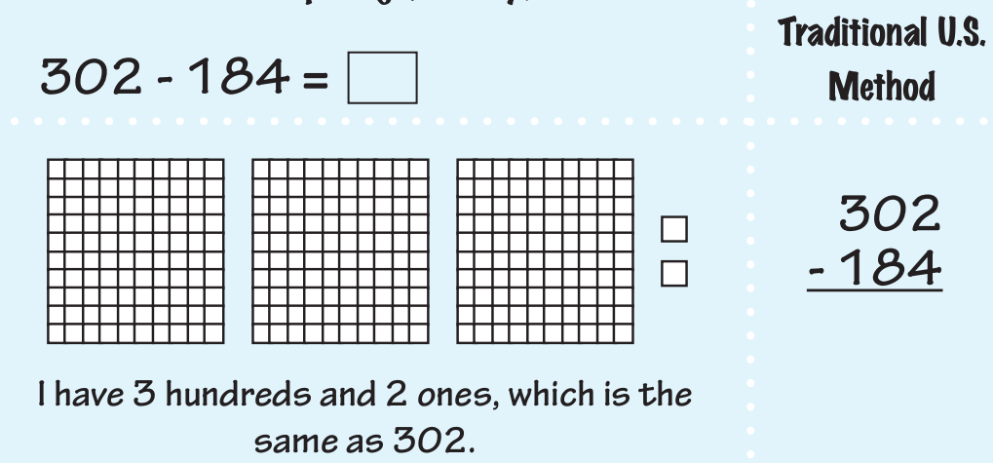
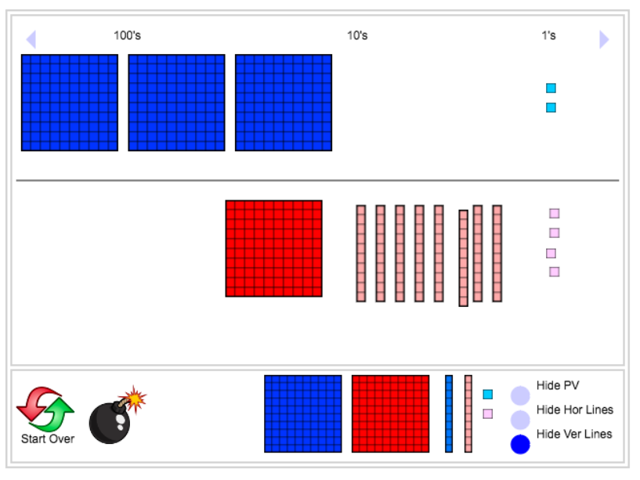
Subtrahend – The number you are “taking away”

Slide 16
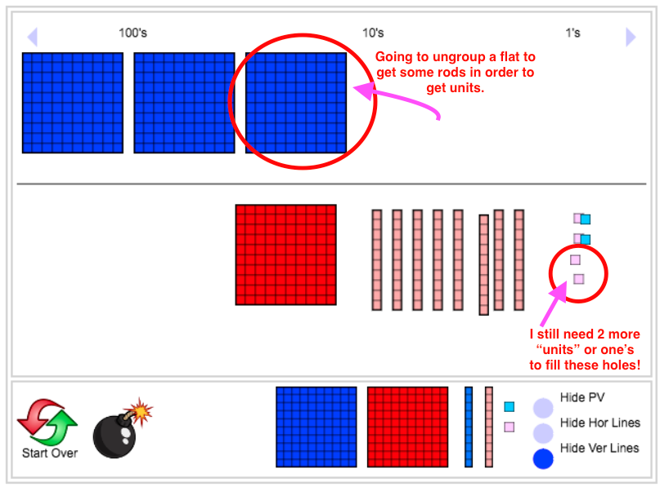
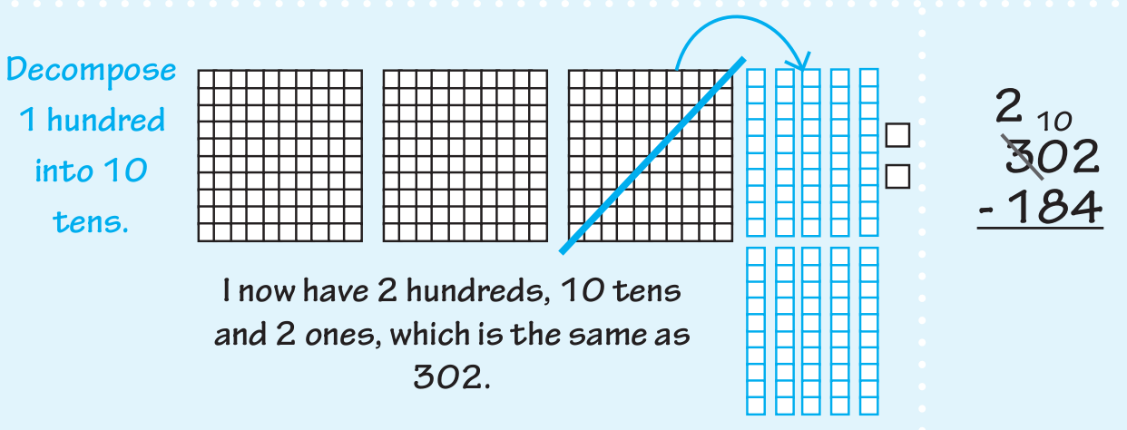
Notes:
Related Youtube video
https://youtu.be/KG6_qliqVf8
Embedded version:
https://www.youtube.com/embed/KG6_qliqVf8?rel=0

Slide 17
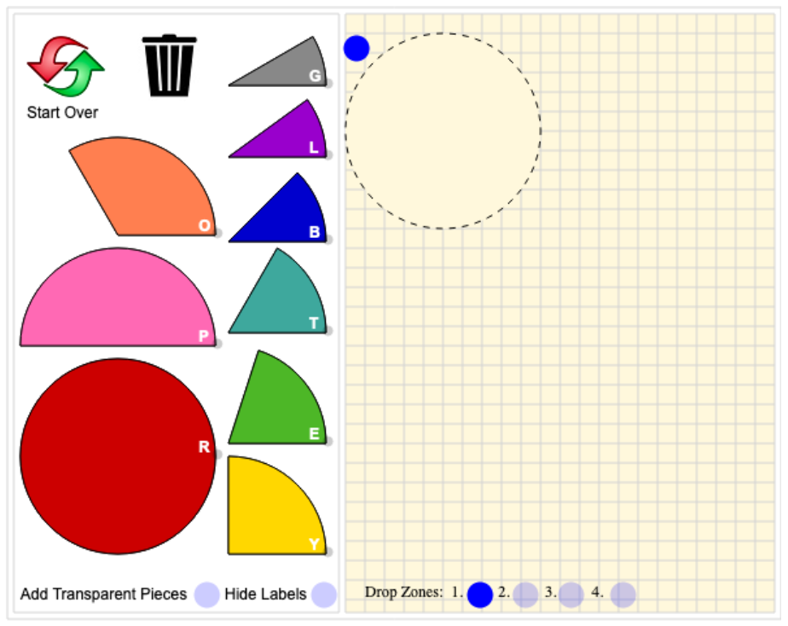
MOER questions that support VM

Slide 18
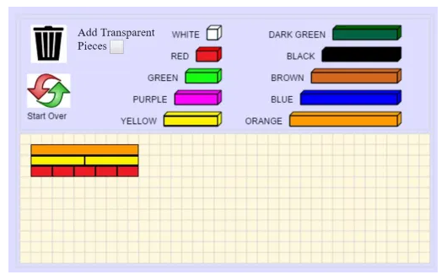
MOER questions that support VM

Slide 19
Using The Integer Chips Virtual Manipulative
https://youtu.be/5lNzCTsAhIM
Notes:
Frank
Talk through the use of the manipulative.
Youtube video
https://youtu.be/5lNzCTsAhIM
Embedded version
https://www.youtube.com/embed/5lNzCTsAhIM?rel=0
Representing 2 multiple ways (through zero pairs)
Finding 2 – 5 in a “sea of zeros”

Slide 20
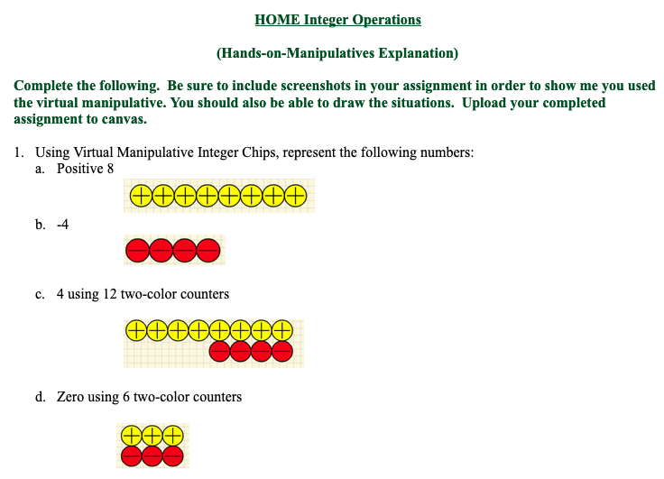
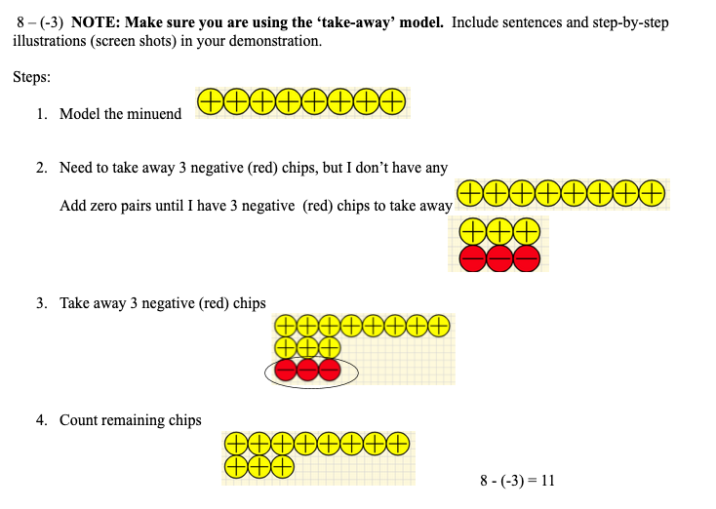
How do we create meaningful assignments that are done from a distance and allow students to interact with the V.M.?
Notes:
Marcia/Krysten

Slide 21
Getting Students to Interact with the Virtual Manipulatives
Notes:
Marcia/Krysten

Slide 22
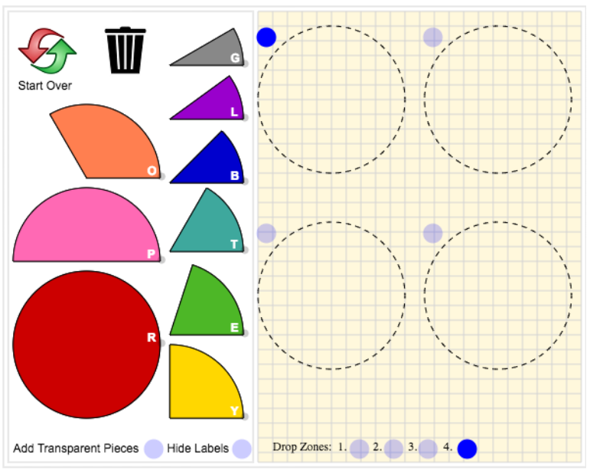
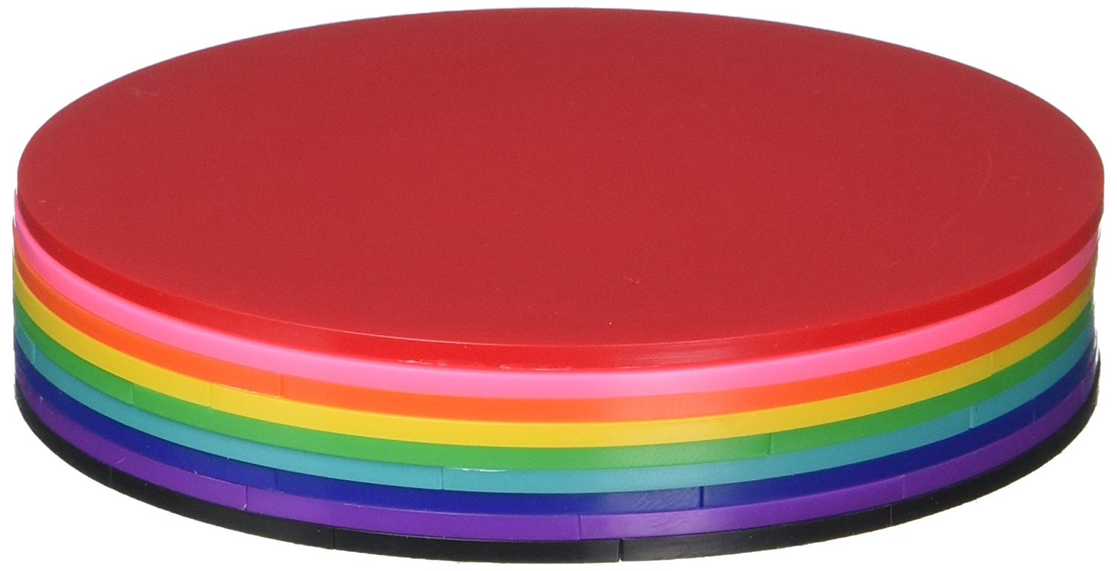
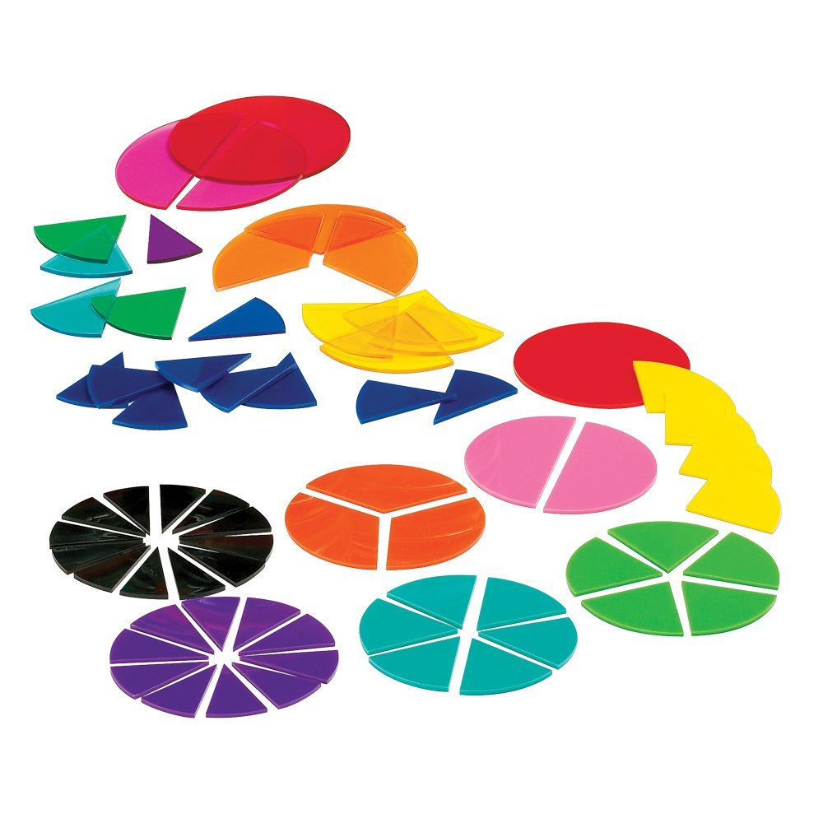
Fraction Circles-Evolution of
the Virtual Manipulative
Information from Pilot
Refinements made to the Virtual Manipulatives
Notes:
Frank
Pilot information from students and faculty. Students experiencing limitations with color vision didn’t the manipulative as useful. 8 ½ percent of population some form of limitations with color vision.
So we ran through a filter to simulate varying degrees of color blindness. Refinements made, a more accessible manipulative for all students.
Colblindor site:
http://www.color-blindness.com/coblis-color-blindness-simulator/

Slide 23
Using The Fraction Circles Virtual Manipulative
https://youtu.be/PgFb6EdJtXk
Notes:
Frank
Walk through representing ½ multiple ways.
Video:
https://youtu.be/PgFb6EdJtXk
Embedded version
https://www.youtube.com/embed/PgFb6EdJtXk?rel=0

Slide 24
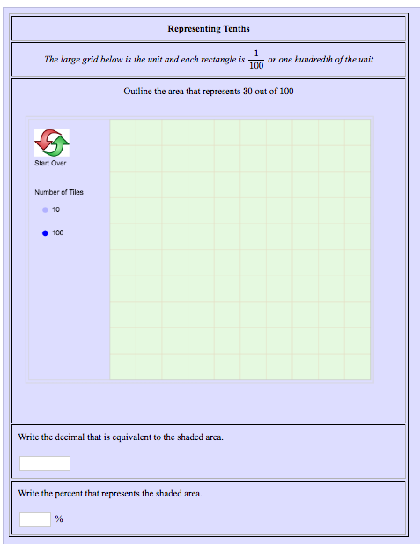
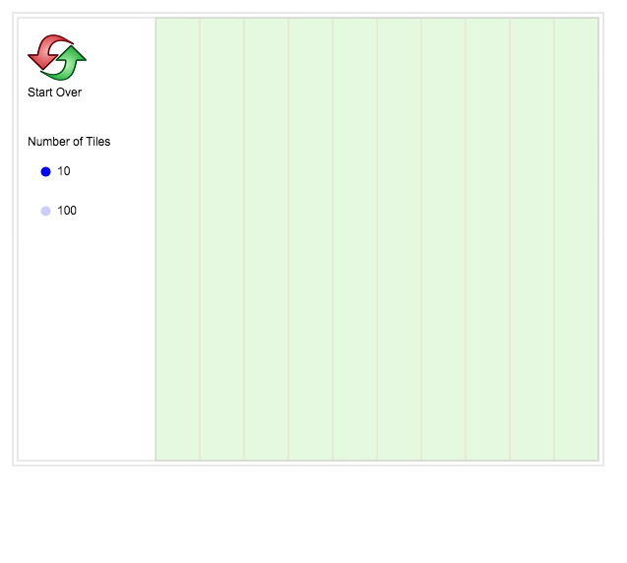
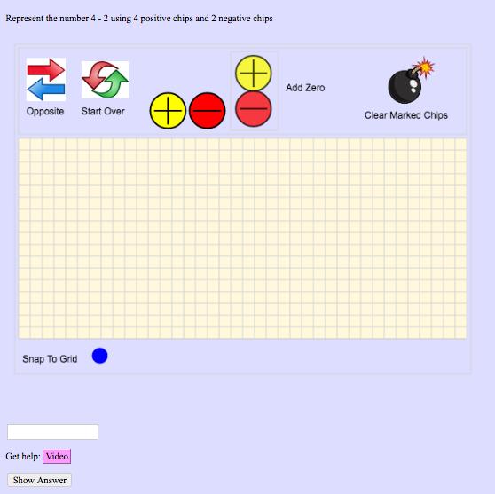
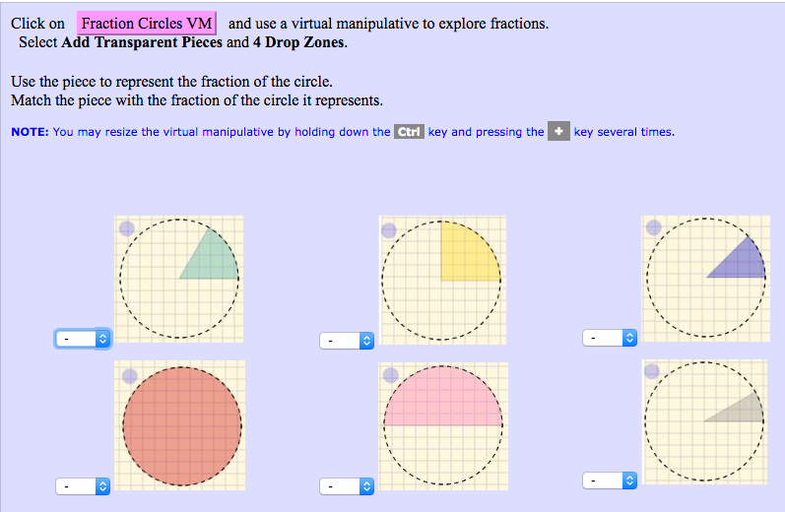
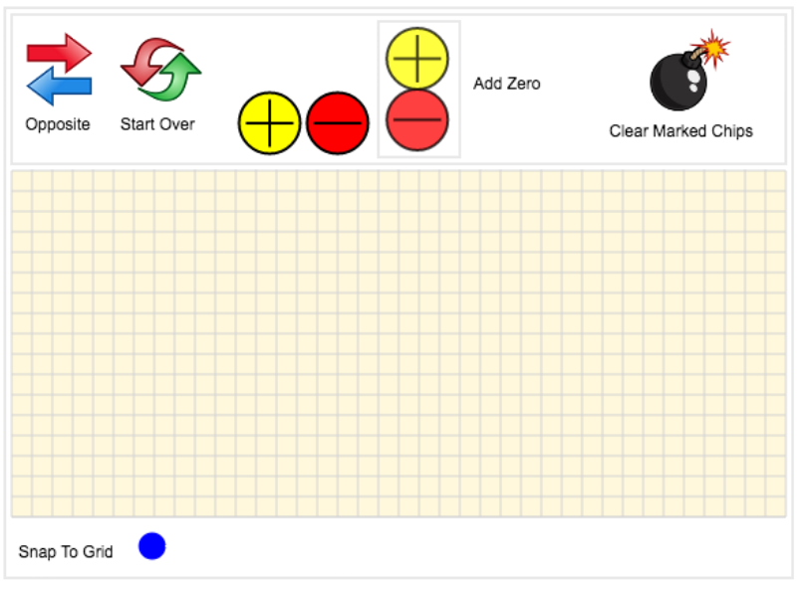
Assessed Manipulatives
Notes:
Frank

Slide 25
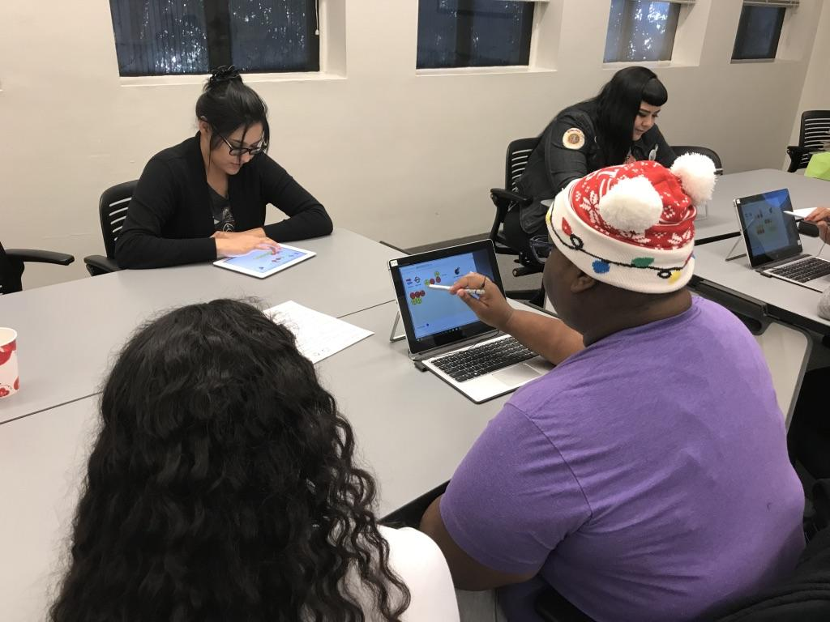
An OER resource for students
Students from Mathematics for Educators class using the Virtual Manipulatives… ☺
Notes:
Frank

Slide 26
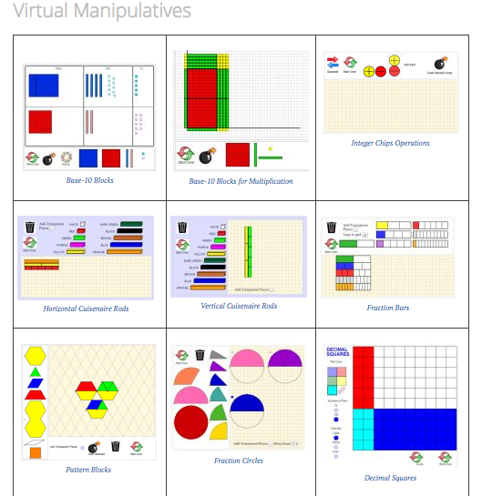
An OER resource for students and faculty
Winner of 2018-2019 Phoenix College Innovation of the Year award
Notes:
Frank
Some of the manipulatives we have built. As collaboration continues, our library grows and functionality enhances.
What’s next ? Continue building virtual manipulatives that assess students understanding of the concept.

Slide 27
Want to get started using the VM?
Hands On Manipulative Exploration Assignments: Handout

Slide 28
Resources….
Hands On Manipulative Exploration Assignments: Handout
Virtual manipulatives: https://pcmathoer.wordpress.com/
Colblindor: http://www.color-blindness.com/ https://www.color-blindness.com/coblis-color-blindness-simulator/
MOER: https://moer.maricopa.edu
MyOpenMath: https://www.myopenmath.com/
MathisPower4U - Virtual Manipulatives & Number Sense Playlists https://www.youtube.com/c/Mathispower4u/playlists
Special thanks to: Our colleagues at Phoenix College, Scottsdale Community College, Glendale Community College, and Mesa Community College who have helped continue to support this collaborative endeavor.

Slide 29
How you can get involved!
Accessing….
COPY THE COURSES
MOER Templates
MAT 256 Course ID: 10576
MAT 257 Course ID: 10577
MOM Templates
Mathematics for Elementary Teachers 1 Course ID: 67321
Mathematics for Elementary Teachers 2 Course ID: 67322
Coming soon to Canvas Commons
Link to the presentation! --->

Slide 30
Questions?
Marcia Corby
Marcia.Corby@Phoenixcollege.edu
Krysten Pampel
Krysten.Pampel@Gccaz.edu
Frank Marfai
Frank.Marfai@Phoenixcollege.edu
More about the virtual manipulatives project
https://www.youtube.com/watch?v=pn6qMAEqizQ

Slide 31
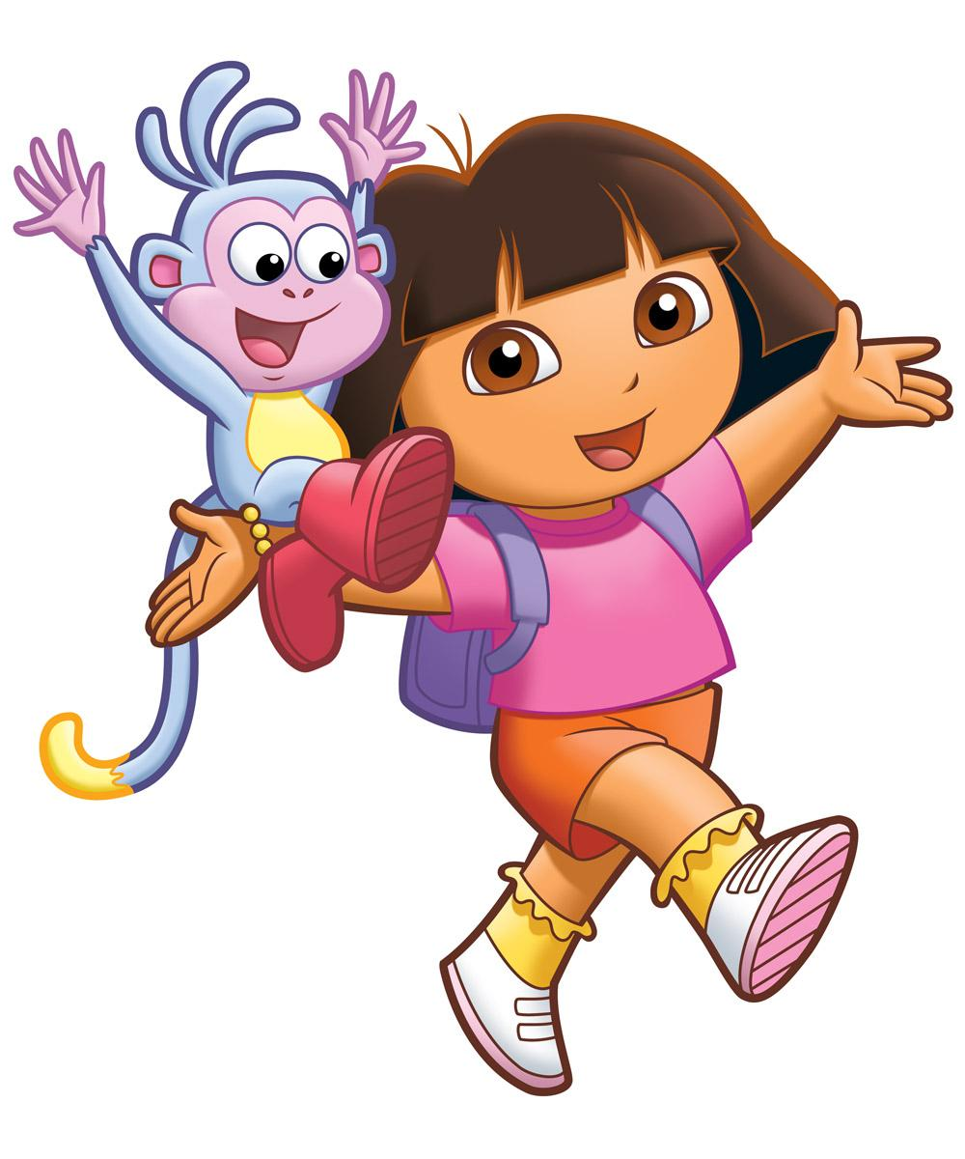
Let’s explore these
resources!
Have your Laptop or Mobile Device ready…
You will be going a breakout room…
let’s a take a poll where you’d like to go!
Notes:
We will want the poll results shared

Slide 32
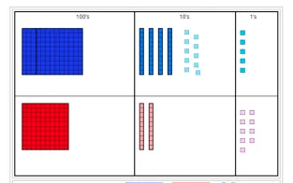
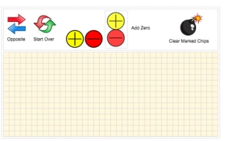
Would you rather explore…
Base-10 Blocks?
Integer Chips?
The Website?
Notes:
Frank
Poll #4. From that we plan in the moment…. Breakout rooms follow.

Slide 33
Thank you for coming!!!
Marcia Corby
Marcia.Corby@Phoenixcollege.edu
Krysten Pampel
Krysten.Pampel@Gccaz.edu
Frank Marfai
Frank.Marfai@Phoenixcollege.edu
More about the virtual manipulatives project
https://www.youtube.com/watch?v=pn6qMAEqizQ

Slide 34
Ice Breaker Examples
used in this presentation
Interactive Polls
A way to engage students
An alternative approach to taking attendance

Slide 35
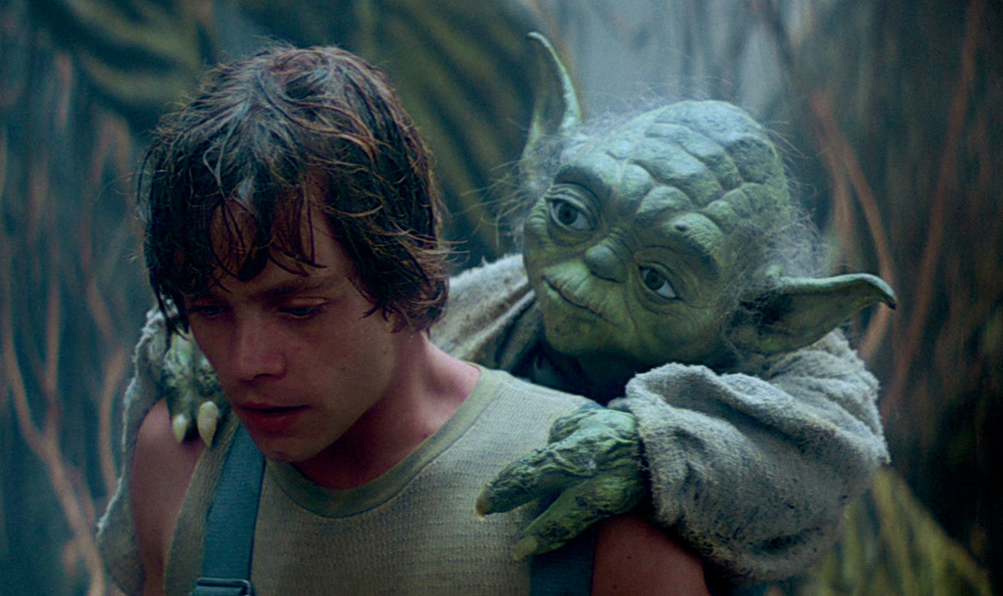
Would you rather have…
Someone older at your side?
Someone younger at your side?
or
Mmm, yes. Much wisdom will you have.
You have spoken - this is the way.
Notes:
Poll exampte #1

Slide 36
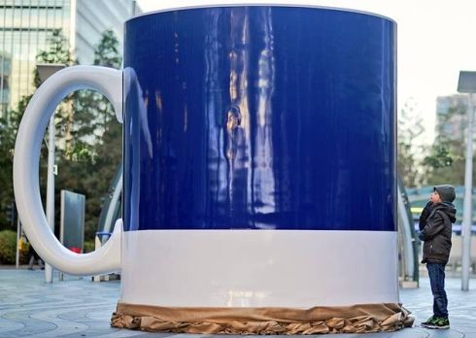
Would you rather have a Large serving of…
Coffee
Tea
or
Notes:
Poll example #2

Slide 37
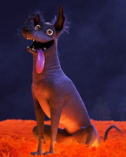
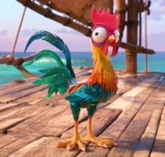
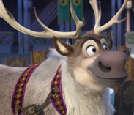
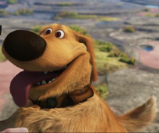
Who would you rather have by your side?
Heihei (Moana)
Dante (Coco)
Sven (Frozen)
Dug (Up)
Notes:
Poll example #3

