Slide 1
Statistics – Then and Now
George Woodbury
georgew@cos.edu
College of the Sequoias
Visalia, CA
AMATYC 2020

Slide 2
In the Beginning …
business-through-adversity-kroselli.wikispaces.com

Slide 3
A Word of Encouragement
lorettasjourney.blogspot.com

Slide 4
A Word of Encouragement

Slide 5
Then
Formula Driven
Computations
www.justintarte.com

Slide 6
Now
Experimental Design
Technology
Interpretation of Results
learning.nd.edu

Slide 7
Engaging, Active Classroom
https://historytech.wordpress.com/2010/03/12/tip-of-the-week-interactive-lectures-i/

Slide 8
Active Learning Strategies
Flipped Classroom
Assessing to Learn – “Clicker” Questions, IF-AT
Class Activities and Projects

Slide 9
Role of Technology
http://tsaponar.blogspot.com/2013/05/my-students-prezi-presentation_8.html

Slide 10
Technology
Technology allows the shift from computation to interpretation
Technology can help students gain conceptual understanding of big picture ideas
Powerful, yet easy for students to use

Slide 11
Binomial Distribution

Slide 12
Binomial Distribution - Technology

Slide 13
What’s Important?
Identify when to use the binomial distribution
Being able to extract the correct values and signs to use

Slide 14
What’s Less Important?
Working the formula by hand
Reading binomial tables to find probabilities

Slide 15
Binomial Distribution – Then and Now
Less time working with the formula and the binomial tables
Less time trying to find the quickest/most efficient way to use the formula or tables to get the result
More problems and more interpretation
More time to connect to inference

Slide 16
What About Formulas?
smithlhhsb122.wikispaces.com/Nathan%20B.

Slide 17
Test Statistic – One-Proportion Test

Slide 19
My Inference Strategy
Being able to perform inference and understand the inferential work of others is my primary goal.
As often as possible, instruction/activities/projects should be aimed towards inference.

Slide 20
Inference: One Proportion
I tell my students that 30% of college students own an iPhone.
Suppose we take a random sample of 50 students, and find that 20 of them own an iPhone.
Would it be unusual to have 20 or more students who own an iPhone in a random sample of 50 students if 30% of all students own an iPhone?

Slide 21
Investigation 1: Coin Flipping
wikipedia.org

Slide 22
Technology
I will be using StatCrunch, but there are many other options for technology.
You can find plenty of applets at the Rossman Chance website: www.rossmanchance.com .

Slide 23
Investigation 1: Coin Flipping

Slide 24
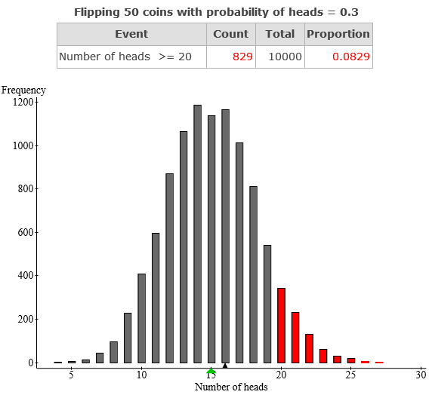
Investigation 1: Coin Flipping

Slide 25
Investigation 2: Binomial Distribution

Slide 26
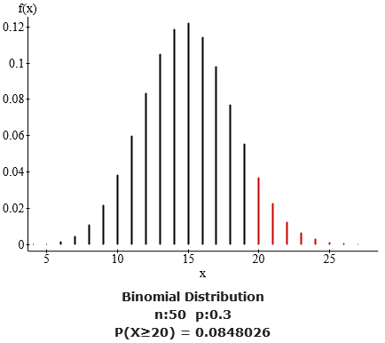

Slide 27
Investigation 3: One-Proportion Test

Slide 28
Investigation 3: One-Proportion Test

Slide 29
Inference: One Mean
The mean wait time at a drive-thru of a fast food restaurant is 90 seconds. A new system is implemented to reduce the wait time.
Wait times (seconds) for 10 randomly selected customers: 109 67 58 76 65 80 96 86 71 72
Has the new system reduced the wait time?

Slide 30
Investigation 1: Bootstrapping
pixabay.com/fr/chaussure-de-randonn%C3%A9e-chaussures-25489/

Slide 31
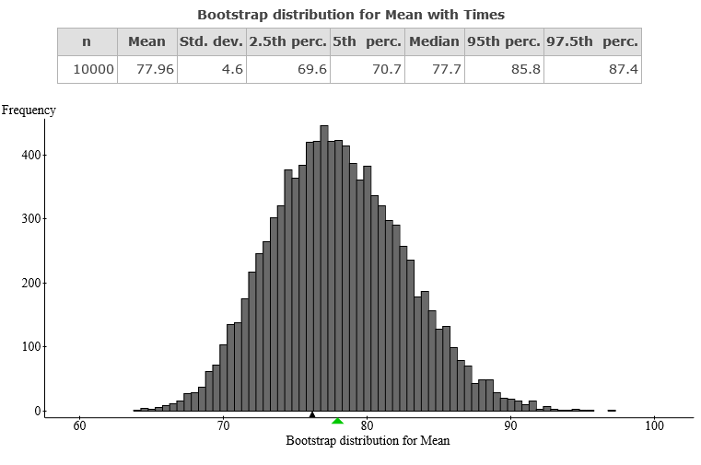
Investigation 1: Bootstrapping

Slide 32
Investigation 2: Sign Test
profslusos.blogspot.com/2014/03/comparacao-entre-proposta-de-alteracao_6681.html

Slide 33
Investigation 2: Sign Test
The mean wait time at a drive-thru of a fast food restaurant is 90 seconds. A new system is implemented to reduce the wait time.
Wait times (seconds) for 10 randomly selected customers: 109 67 58 76 65 80 96 86 71 72

Slide 34
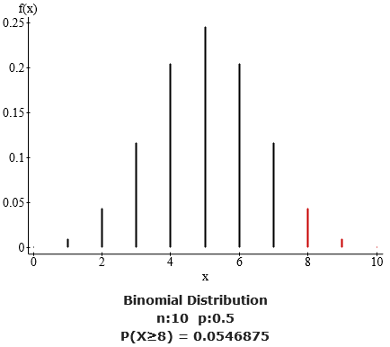
Investigation 2: Sign Test

Slide 35
Investigation 2: Sign Test

Slide 36
Investigation 3: One Mean t-Test

Slide 37
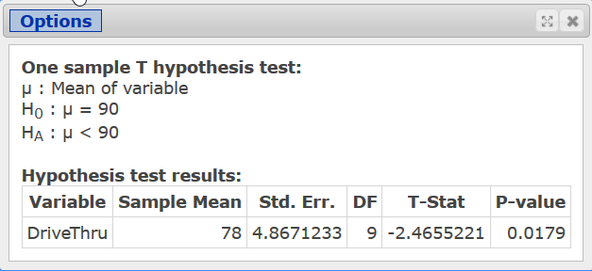
Investigation 3: One Mean t-Test

Slide 38
Inference: Two Means
Give students two sets of exam scores.
Ask them to determine whether the two versions of the exam are of equal difficulty.

Slide 39
Inference: Two Means

Slide 40
Investigation 1: Descriptive Statistics
Compare measures of central tendency
Compare graphs
Students look for evidence they think is significant
No wrong answers … yet

Slide 41
Investigation 2: Randomization
jcruz661.wikispaces.com/Dwire+February+Shapes

Slide 42
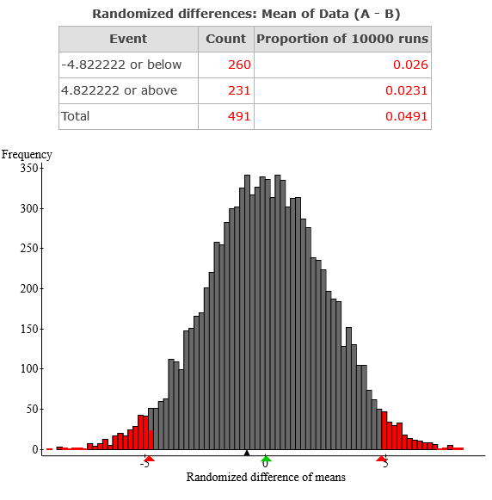
Investigation 2: Randomization

Slide 43
Investigation 3: Two-Mean Test

Slide 44
Other Tests
Paired Difference Test
Bootstrapping
Wilcoxon Signed Ranks
Two Proportion Test
Urn Sampling
Randomization
ANOVA
Kruskal Wallis

Slide 45
Crossroads
thewearypilgrim.typepad.com/the_weary_pilgrim/leadership/

Slide 46
Now
Focus on Setup and Design
Collecting Data
Interpreting Results
Keep an Eye on the Big Picture
“Just Enough” Probability
Active and Engaging
Leverage Technology to Increase Intuition and Understanding

Slide 47
Contact Info
Email: georgew@cos.edu
Twitter: @georgewoodbury
Website: georgewoodbury.com
Blogs:
Statistics Blog: georgewoodbury.com/statblog/
Math Blog: georgewoodbury.com/blogarithm/

