Slide 1
Collaboration and Mindsets in a Virtual Mathematics Experience
Mel Taylor, Ridgewater College
Lewis Hosie, Carnegie Math Pathways at WestEd
AMATYC 2020 (virtual)
Nov 6, 2020
Notes:
Lewis/Mel/moderator
2 min
Introductions and welcome
Some background on the CMP
For nearly two years, we’ve been designing, developing, and testing new online course versions of our in-person Quantway and Statway courses. Over the next hour or so, I’ll share the foundational pedagogy behind the Carnegie Math Pathways curricula and supports that have been pivotal in our network’s success over the past ten years, and how we have worked to incorporate all of those aspects in our new fully online versions of our courses.

Slide 2
Session Overview
A contest!
Design considerations
Our virtual model
Video analysis and share-outs/debrief/discussion
Course structure
Testimonials
Q&A
Notes:
Lewis
1 min
Key takeaways are: 1. a course course design that includes content, technological and pedagogical structures that allow for authentic and rich collaborative learning experiences, 2. Examples of social emotional activities are norms that bolster student collaborative and individual learning in an online environment.

Slide 3
Introductory Contest!
List as many things as you can that all the members of your group have in common!
You have 4 minutes!
Notes:
Lewis
~10 min
Participants put into breakout rooms.
Getting To Know You Contest.
A contest: List as many things that you have in common with your group members as possible!”
4 minutes for task in breakout rooms; 5 minutes for share-outs with whole group

Slide 4
Introductory Contest Results!
How many commonalities did you find?
Any interesting and/or unusual findings?
Notes:
Lewis
5 minutes
Have participants share-out total counts interesting/unusual commonalities.

Slide 5
Intentional Design
Our network of faculty have developed a suite of courses following a set of critical design principles:
Accelerated
Pathways
Relevant curricula and researched-based pedagogy
Appropriate supports built into the courses
Embedded Social Emotional Supports
Help more students achieve college math credit in less time and advance toward their goals
Ensure high quality learning opportunities for all students
Deliver targeted and effective scaffolding for students who need additional support
Foster growth mindset, confidence, and belonging to support the whole learner
Notes:
Lewis
4 min
For the past 10 years, students in Carnegie Math Pathways courses succeed at 3-4 times the rate of students in the traditional math sequence. They also graduate, transfer, and earn 4-year degrees at significantly higher rates than their matched peers, and our goal is to achieve these rates across all our offerings - whether face to face or online.
At Carnegie Math Pathways, our mission is to empower all students to reach their college and career goals by transforming their mathematics learning experience.
We believe that math should be a gateway, not a gatekeeper to college graduation.
So, we’ve fundamentally reimagined teaching and learning by collaborating with a national network of educators to help students - whether on campus or learning from a distance - deeply understand and even love the subject.
By transforming the math classroom experience nationwide, we're helping generations of graduates develop the skills they need to apply math to their everyday lives and to reach their full potential.
Nicole: The Pathways were a part of start of the movement that lead legislation around the country like AB 705, because they demonstrated that students could move through developmental math more quickly and successfully.
Lewis: With all the uncertainty facing campuses due to COVID-19, it is paramount that our students continue to learn without compromising their momentum toward graduation. Yet, it’s the current crisis that actually highlights for us how relevant and valuable many of the facets of our design are for educators and especially students.
Our success is as much the approach to pedagogy as curricula, though both are tightly integrated. We utilize an intentional design that combines thoughtful accelerated courses, research-based and relevant pedagogy and curriculum, and critical learning and social emotional supports into every course sequence we offer.

Slide 6
Student-Focused Collaborative Pedagogy
Online collaborative learning structures
Learning content designed for collaborative engagement
Students drive, instructors guide
Notes:
Lewis
1 min
Collaborative learning structures that meld technology, pedagogy, and content into a unified force.

Slide 7
Social Emotional Supports for Students
Building growth mindset
Fostering belonging
Reducing math anxiety
Promoting use of good learning strategies
Notes:
Lewis
2 min
This component of the Pathways system is called Productive Persistence…
This practical theory was developed by a diverse team of academic researchers in the field of social psychology and educational psychology and expert practitioners. Based on surveys and interviews with math faculty and students in community colleges, the most high leverage drivers were identified for the specific population of developmental mathematics students.
The drivers are:
(Growth Mindset) - first that students believe that they're capable of learning, that it's even possible for them to succeed in this setting
(Sense of Belonging) - second is that students feel socially tied to peers faculty and the course that they develop a sense of belonging a sense of identity as a mathematics learner
we also want students to believe that the course has value and when we talk about value we mean both short-term is it related to their current interest or current job but also long-term is it related to their sense of purpose where they want to go with their career and what they want to do with their life
(Good Learning Strategies) we also want students that have skills habits and know how to succeed in the college setting there are many different things that skills that aren't traditional study skills we include emotional regulation so we teach students about stress reappraisal but we also help students navigate a syllabus and navigate the environment and last but not least we want faculty in colleges to support students skills and mindsets and this is really important to create that learning environment in which it's okay and it actually promotes the development of these thoughts about themselves in the development and application of these skills
Despite confidence in the drivers and in our process developing this theoretical framework, we also realized that we needed to actually measure whether these drivers actually did matter for developmental college students

Slide 8
Innovative and Relevant Curricula
Understanding Heart Rate
QW lesson
Trends in Social Media
QW lesson
Authentic and Contextualized
Learning Material
Language and Literacy Supports
Notes:
Lewis
1 min
Hand in hand with an accelerated math pathway design is the development of an innovative and relevant curriculum. Quantway and Statway provide alternative pathways relevant for students in the humanities, communications, social sciences, and allied health fields, among others. They provide statistical reasoning or quantitative reasoning skills needed for higher level research and professional work in these fields. The curriculum is structured not on drills of formulaic equations, but rather on word problems that are based on real world scenarios and contexts familiar to their area of study or life experiences.
The curriculum has also been designed to mitigate language and literacy barriers that impede the math learning.
Challenging = deeper learning leading to more flexible knowledge, more conceptually sophisticated and rigorous not more or higher
Emphasis on real data, update contexts
Engaging students in mathematics tasks that are authentically meaningful results in more powerful content learning and more engagement in the learning.

Slide 9
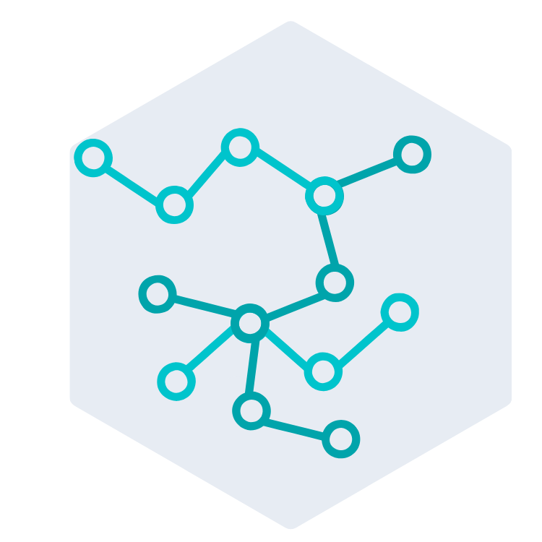
From Face-to-Face to the Virtual Space
Authentic
Online Collaboration
Proven curriculum and pedagogy
Variabilized Assignments
Notes:
Lewis
1 min
The result of nearly 2 years of design and development on our online courses, is a fully integrated system that includes Carnegie’s proven curriculum, active learning focus, and social emotional supports built into an adaptive learning platform with fully integrated video conferencing to enable group collaboration.

Slide 10
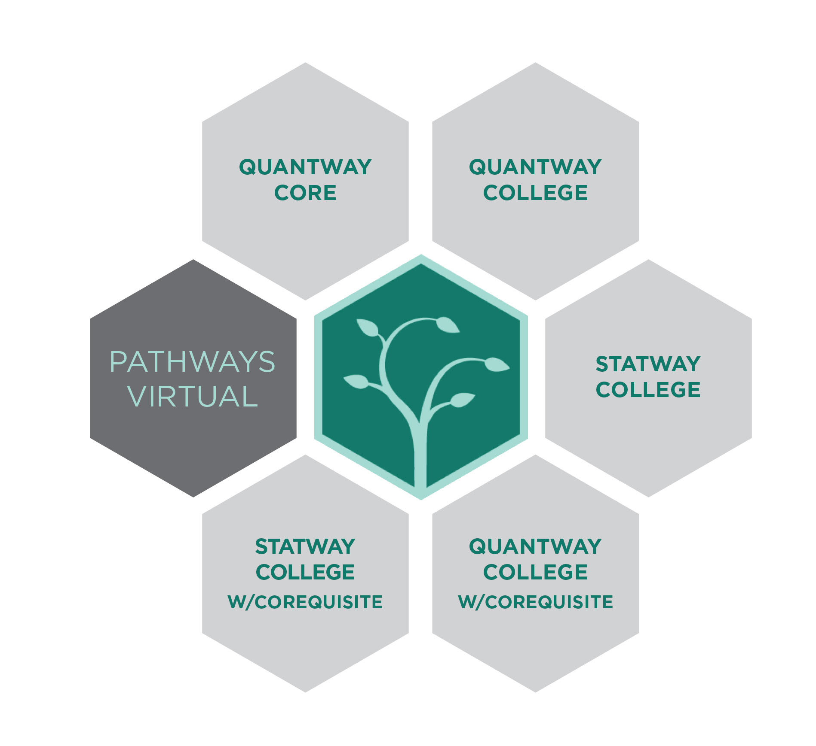
Pathways Virtual Courses
Quantway Core Virtual
Quantitative Reasoning Pathway
Notes:
Lewis/Mel
3 min
What is Quantway? And what question does Quantway answer (in both the MN context, and beyond)? Talking about how QW Core is used at Ridgewater. Mel, let’s take a minute or so and talk folks through how how course are implemented at Ridgewater and the context and student demographics around implementation?

Slide 11
Collaboration Analysis: Part 1
This clip shows a student group doing some work online together.
Whilst watching, make notes of anything that jumps out. Think about content, technology, and interaction.
Notes:
Things to consider: content, technology, and student interaction.

Slide 12
Part 1: Debrief and Discuss
What did you notice?
Post your comments in the chat!
Notes:
Mel/Lewis
~2 minutes
Open discussion

Slide 13
Social Emotional Supports
Welcome Package
Establishing norms and expectations
Shifting students’ beliefs about themselves
Shifting faculty members’ mindsets
Staying Strong
Reinforcing norms and expectations
Sustaining Students’ Beliefs about Themselves
Motivational and Cognitive Supports
Notes:
Mel
3 min
Productive Persistence

Slide 14
Welcome Package
Welcome email + video
Synchronous orientation session(s)
Getting To Know You + Group Resume activity
Contract Activity
Notes:
Mel
2 minutes
Goals of Welcome Package: Course launch supports (orientation session(s), Working Together instruction to collaborative learning, Group Resume and other introductory course activities (like what we did at the beginning of the session), and initial PP surveys and activities.

Slide 15
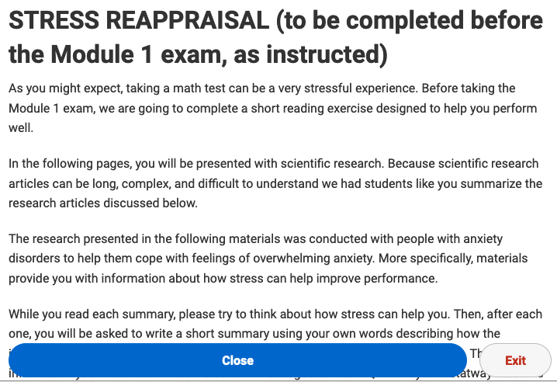
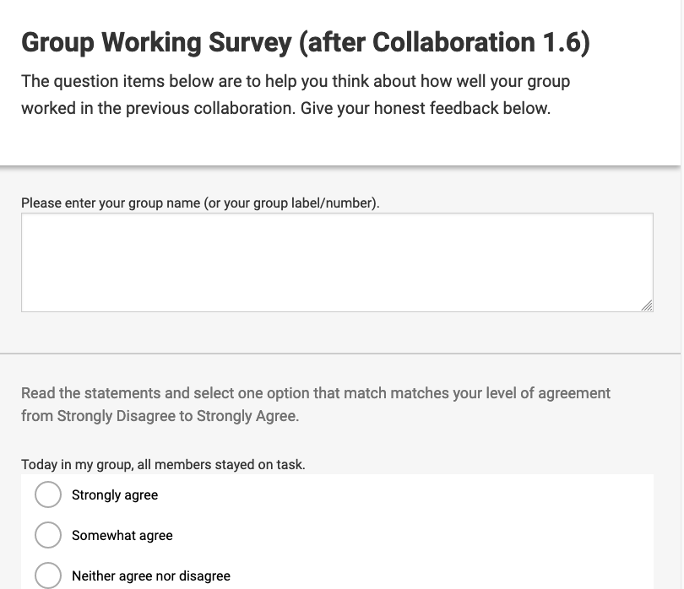
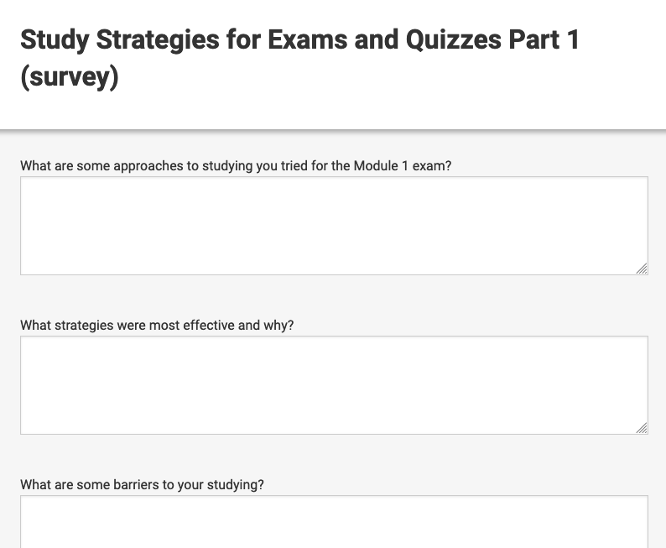
Staying Strong
Notes:
Mel
1 min
Staying strong: meta-cognition discussions, SRL surveys, Group Working Well Surveys, study strategies activity, stress reappraisal activity.

Slide 16
Collaboration Analysis: Part 2
This clip is the same student group later.
Question being discussed: How would you explain the relationship of million, billion, and trillion to someone else?
Whilst watching, make notes of anything that jumps out.
Notes:
Mel
3 min
Have participants watch and note things of interest. Highlight the information on the slide, but don’t give too many details. We’ll want to elicit from participants the key characteristics.

Slide 17
Collaborations: Debrief and Discuss
What did you notice?
Post your comments in the chat!
Notes:
Mel/Lewis
~10 minutes
Open discussion

Slide 18
Collaborations: Key Characteristics
Student-led
Collaboration Sessions
Seamless Zoom integration into courseware
Social-emotional
Supports
Notes:
Mel
2 minutes
Highlight these key characteristics that should have been identified in the video clip digest. Typically, these Collaboration sessions are unfacilitated. Instructor can join if they wish to guide or upon request. Collaborations sessions are automatically recorded, with the recordings only made available to the instructor for review. Group connection evident engendered by course launch activities and instructor and content framing of how students are expected to engage and learn in the course.

Slide 19
Example Flow through Typical Course Unit
Instructor
Feedback
Assignment (individual)
Assignment
(individual)
Collaboration
Session
Socio-emotional support survey/activity
Notes:
Lewis/Mel
2 minutes
Take a step back and discuss how the collaboration sessions fit in with other course content. The first thing to note is how a student and instructor flow through a typical course unit.
Preparation activities and exercises are both auto-graded. Collaborations are faculty graded, per group, vs per student. The instructor has access to all student production to inform instruction and intervention. There will be more on collaborations later in the presentation.

Slide 20
Student Feedback
“I went completely online with my major and did not feel that I had any connection with the other peers once the class was over. With Quantway College Virtual, I was able to establish an actual relationship with peers and actually felt that I was in a class with others.”
Stephanie
Paszkiewicz
Notes:
Lewis
If there is time
We’ve had really great feedback from students during the first year these courses have been available, starting in fall 2019 (before the COVID pandemic).
This is Stephanie. She’s a student at the University of Wisconsin-Milwaukee studying Community Education and Engagement. She works at a hospital as a Mental Health Technician and hopes that her degree will help her advance at the hospital. She told us… (read quote).
In addition to building relationships with her classmates, she says her class has also helped her grow in her workplace. Let’s have a listen.
Play video if possible.

Slide 21
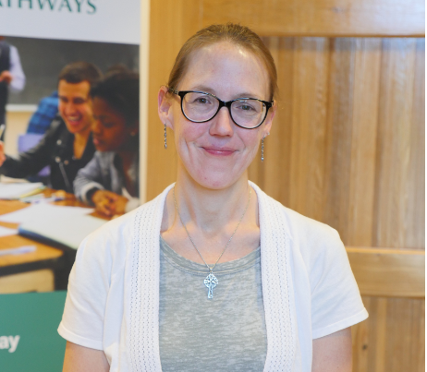
Faculty Feedback
“One of the things I really love about the Quantway Virtual class is that the Zoom rooms are built into the course. It's not separate and the lessons are actually within the system. So the students actually work through the lessons, as they would do in class answering the questions, inputting their questions into the system, talking about their answers.”
Notes:
Lewis
If there is time
This is one of our network faculty members from the University of Wisconsin-Milwaukee, who also has experience with our classroom-based curriculum, and now two semesters teaching multiple versions of Quantway Virtual. She told us about how she really values the way in which the online design mimics the in-person classroom experience through the collaboration opportunities…(read quote). She expands further on the benefits of the collaborations in this video. Play video.

Slide 22
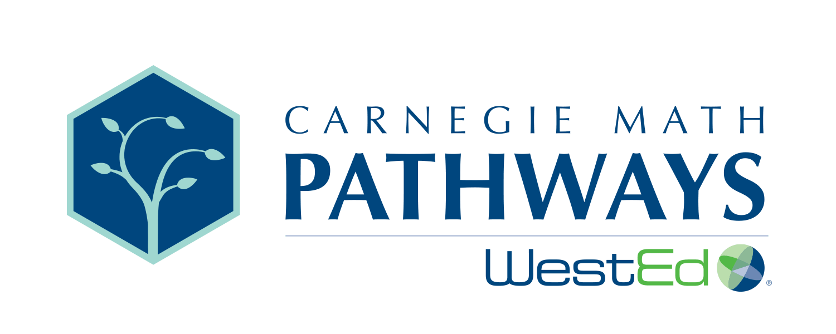
Learn more at: www.carnegiemathpathways.org
Lewis Hosie: lhosie@carnegiemathpathways.org
Mel Taylor: Mel.Taylor@ridgewater.edu
This program of work is supported by the Bill & Melinda Gates Foundation, Ascendium Education Group, the ECMC Foundation, and the National Science Foundation's grant DUE-1322844 in cooperation with the Carnegie Foundation for the Advancement of Teaching and WestEd
Notes:
For more information, including access to a live demo course, please visit our website and contact us anytime.

