Slide 1
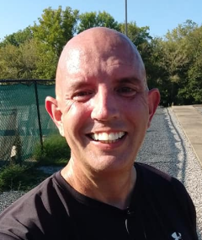
Analyzing Movie and TV Scenes Using Math
PAT RILEY
HOPKINSVILLE COMMUNITY COLLEGE (KY)

Slide 2
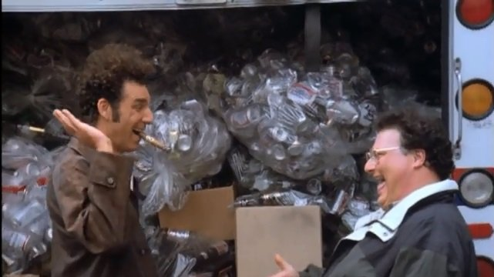
(One of) My Teaching Epiphanies

Slide 3
(Another of) My Teaching Epiphanies….well, maybe not a surprise

Slide 4
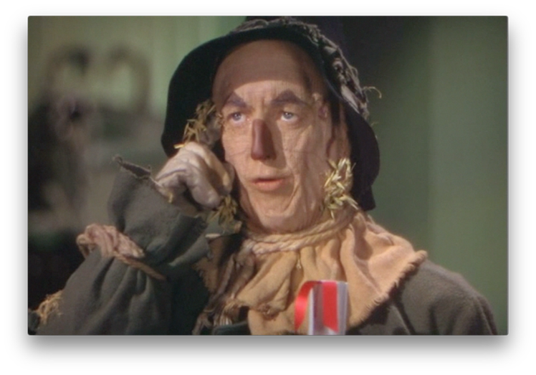
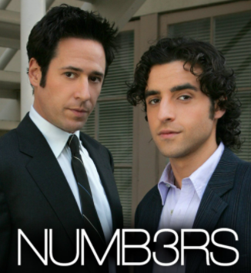
Some math in TV and movies are clear

Slide 5
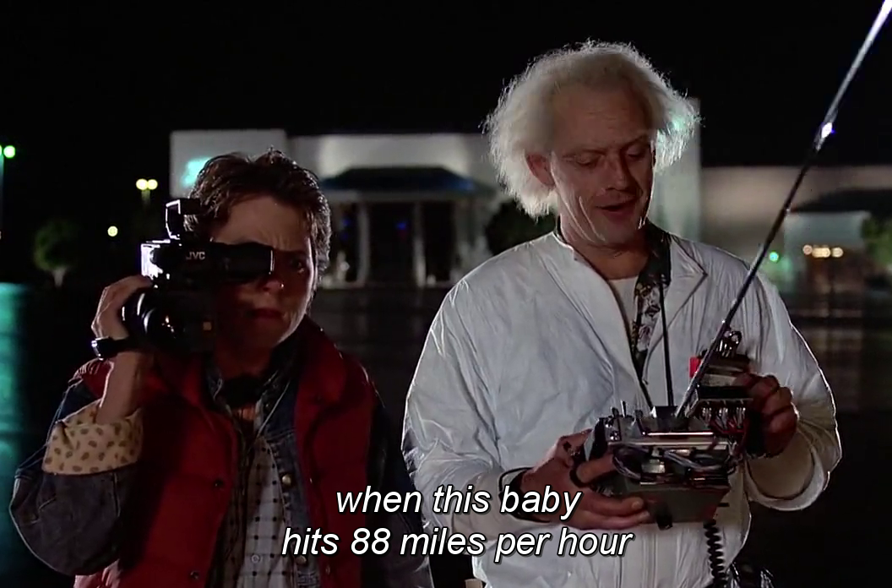
This is about creating math that isn’t clear

Slide 6
What do you think students would enjoy more?
If a projectile travels 3 x 103 feet in one second, how far will it travel in 18 minutes?

Slide 7
What do you think students would enjoy more?

Slide 8
What do you think students would enjoy more?
A manufacturer of processing chips knows that 2% of its chips are defective.
Suppose an inspector randomly selects 4 chips for an inspection.
What is the probability that at least one of the selected chips is defective?

Slide 9
What do you think students would enjoy more?

Slide 10
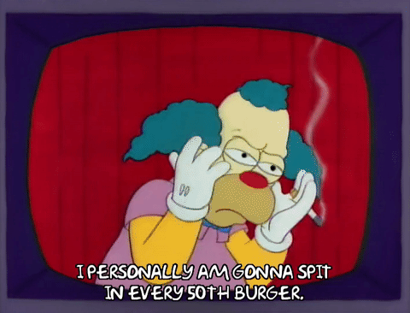
What do you think students would enjoy more?

Slide 11
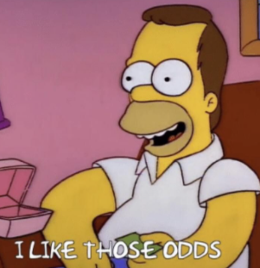
What do you think students would enjoy more?
If Homer is OK with a 30% chance of not getting a bad burger, how many could he order before having a 30% chance of at least one bad one?

Slide 12
What do you think students would enjoy more?
If y varies inversely with the square root of x and x = 3 when y = 38, find y when x = 21.

Slide 13
What do you think students would enjoy more?

Slide 14
What do you think students would enjoy more?
The number of flaps a bird makes varies inversely with the length of the wing. What kind of bird could this be?

Slide 15
What do you think students would enjoy more?
Find the arc length of a circle with a radius of 17 inches with an angle of 30 degrees?

Slide 16
What do you think students would enjoy more?
How fast is Spiderman moving?

Slide 17
What do you think students would enjoy more?
The radius of a circle is increasing at a rate of 3 inches per second. Find the rate of change of the area of the circle when the radius is 3 feet.

Slide 18
What do you think students would enjoy more?
https://www.youtube.com/watch?v=R_cczIWvBq4

Slide 19
What do you think students would enjoy more?
Solve the following
0 = 36x² + 147x + 15

Slide 20
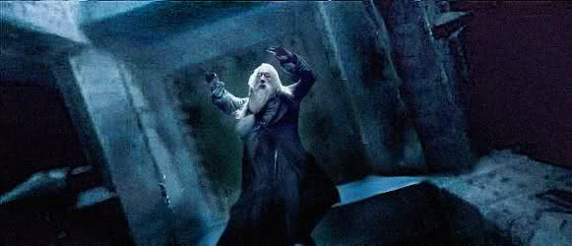
What do you think students would enjoy more?

Slide 21
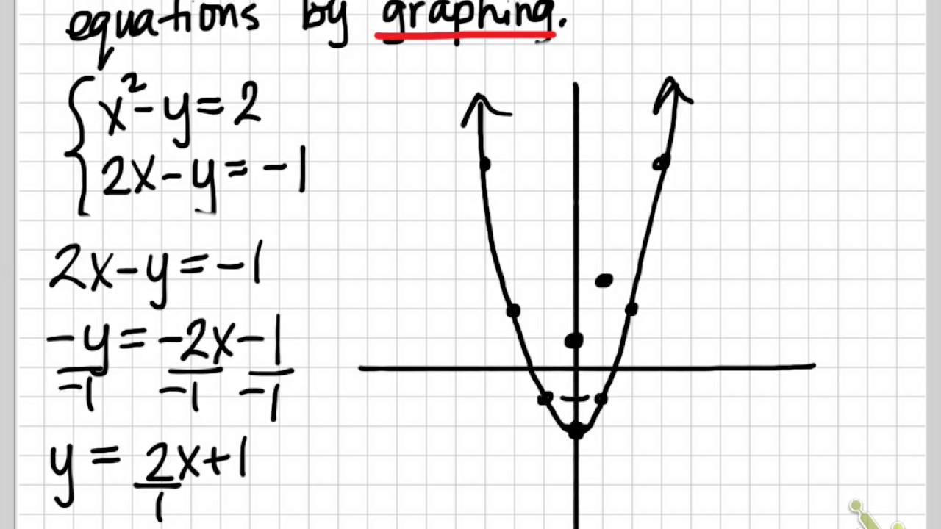
What do you think students would enjoy more?

Slide 22
What do you think students would enjoy more?
https://www.youtube.com/watch?v=TEAhmCkkHYM

Slide 23
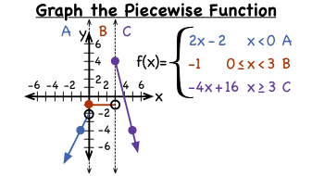
What do you think students would enjoy more?

Slide 24
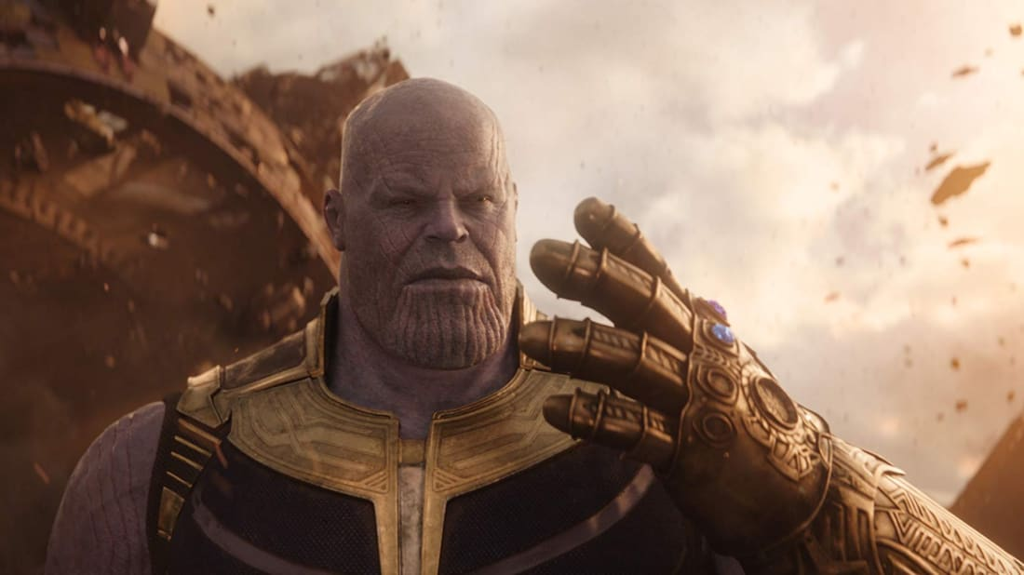
What do you think students would enjoy more?

Slide 25
Course Projects
Select a scene from a movie, TV show, novel …a famous historical event…a current event….etc. and a practical, relevant, and interesting question to base your project on.

Slide 26
Course Projects
Topic Idea (25 points)
Calculations (50 points)
PowerPoint Presentation (25 points)
Live Zoom Discussion (50 points)

Slide 27
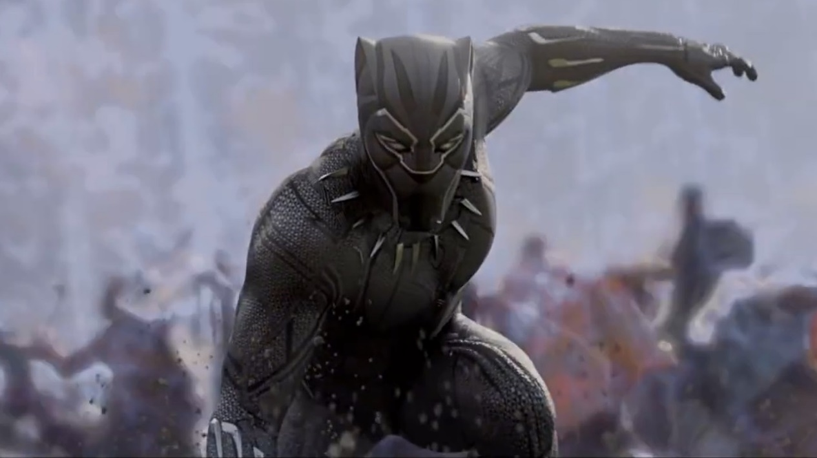
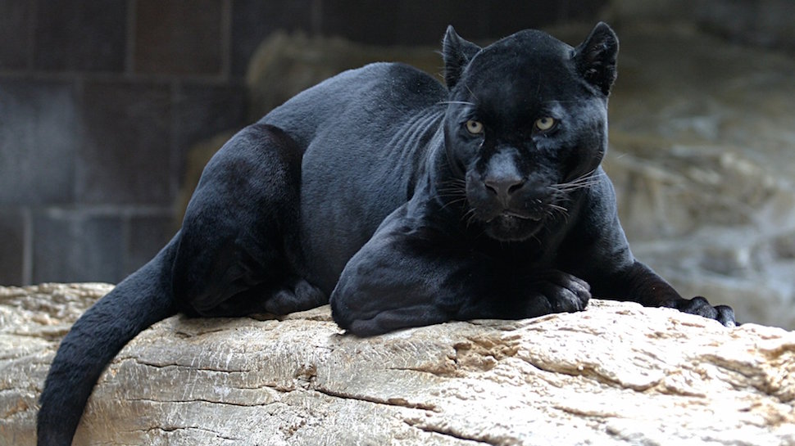
Some Better Course Projects

Slide 28
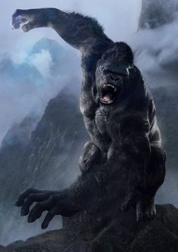
Some Better Course Projects

Slide 29
Some Better Course Projects

Slide 30
Some Better Course Projects

Slide 31
Some Better Course Projects

Slide 32
Some Better Course Projects

Slide 33
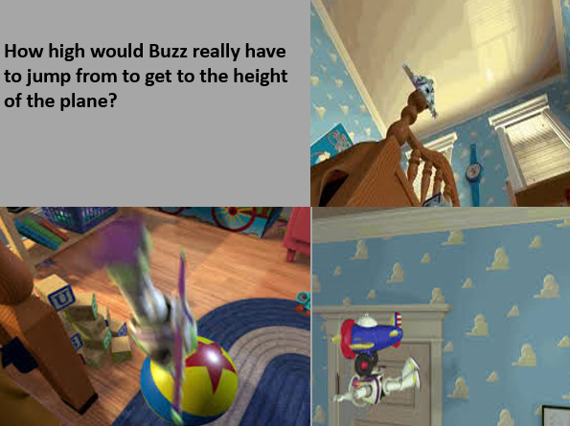
Some Better Course Projects

Slide 34
QUESTIONS / COMMENTS??

Slide 35
THANK YOU FOR ATTENDING!!
Contact Information
patrick.riley@kctcs.edu

