Slide 1
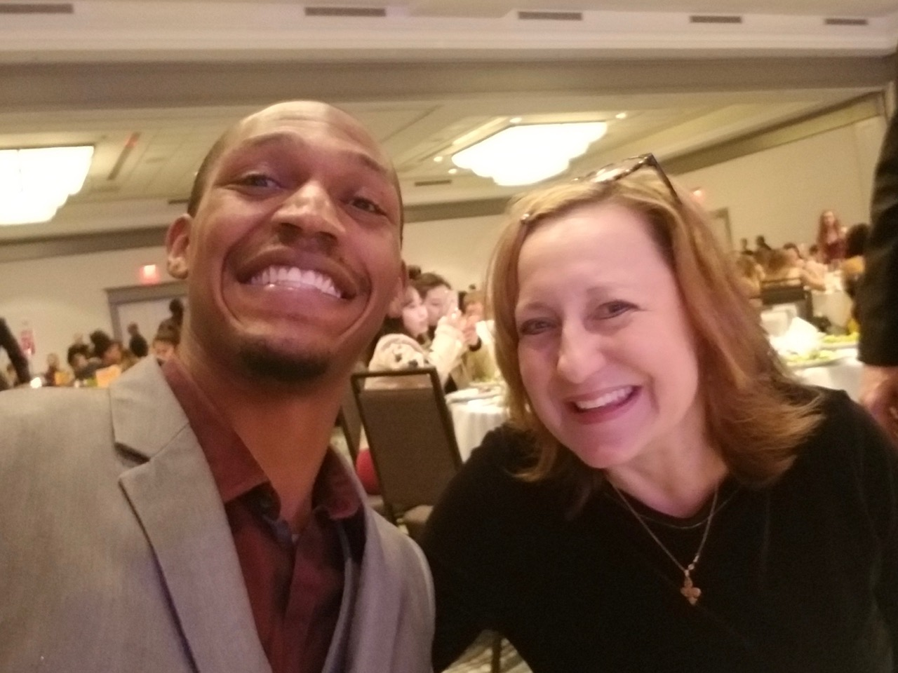
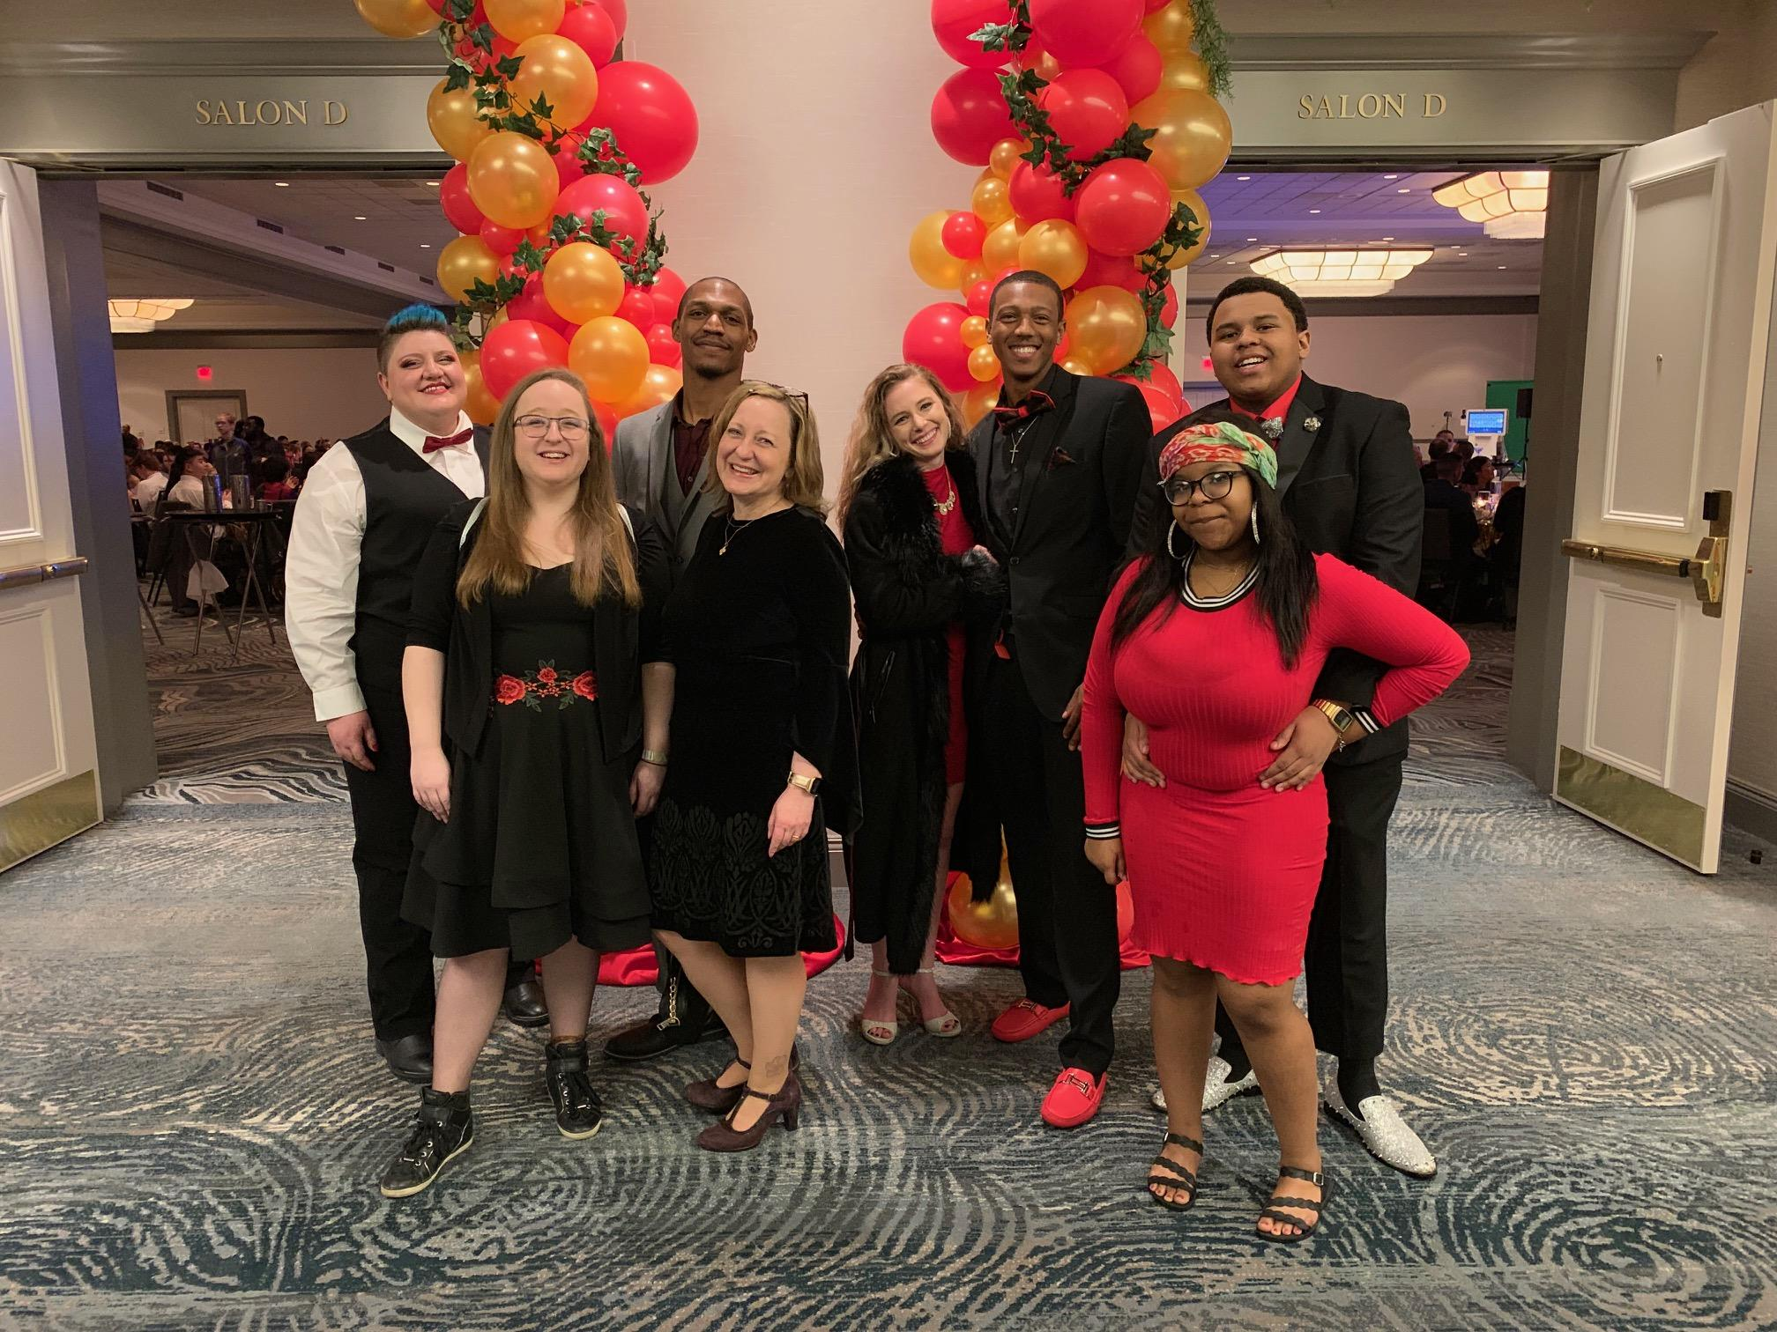
Sharon North Professor of Mathematics
Center for Teaching and Learning Coordinator
snorth@stlcc.edu
AMATYC 2020
Sharon North Professor of Mathematics
snorth@stlcc.edu
Teaching Corequisite Courses: Two Years Later and Lessons Learned

Slide 2
Math sequence redesign considerations:
Completion rates in college level math courses
Meaningful math pathways that align with a student’s major
Missouri Department of Higher Ed task forces in math pathways and math corequisite at scale
Missouri Core 42: a recommended core curriculum of at least 42 semester credit hours that will transfer to any public college or university in Missouri (includes math pathways courses)
Missouri House Bill 1042 requires higher ed institutions to replicate best practices in remediation (2012)

Slide 3
Corequisite Models for Missouri Math Pathways
https://dhewd.mo.gov/documents/implementationstrategies.pdf

Slide 4
Math Pathways Blended Corequisite Model
Meta Major
Social Sciences
Humanities
STEM
General Education
Math Course
MATH 180
Introductory Statistics
MATH 161 Quantitative Reasoning
MATH 185
Precalculus or
MATH 160
Precalculus Algebra
Learning Support
MATH 058
Statistical Principles
Taught as a Corequisite
MATH 056
Quantitative Reasoning Principles
Taught as a Corequisite
MATH 140
Intermediate Algebra
Taught as a Prerequisite
*Corequisite in 2021

Slide 5
Math corequisite recommendations:
All work in corequisite course supports work in college level course
Just in time support of college level content and expectations
Importance of communication between co-req and college level instructors
Scheduling co-req directly before or after college level course
Active learning strategies with group work, math study skills, building mathematical vocabulary
Training for faculty, advisors, and leadership

Slide 6
Lessons learned:
Many corequisite students struggle with the terminology and reading.
It was surprising to me how much vocabulary work I end up doing with my co-req students. Warm-up activities such as fill in the blank skillsheets, flashcards, crossword puzzles, and short writing assignments where students use the vocabulary can be used to help address this. The more practice my students can get speaking the language of mathematics, the better their chances for success.

Slide 8
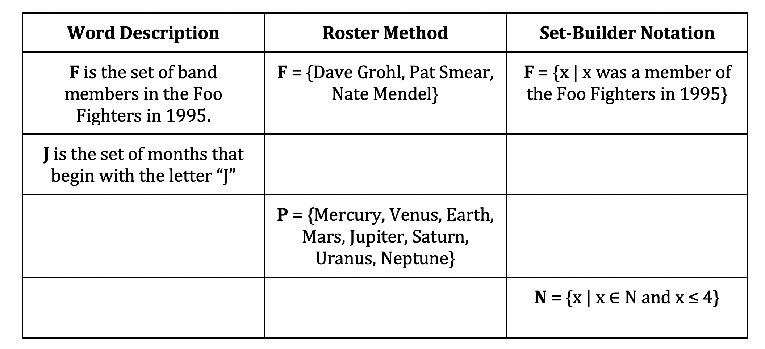

Slide 9
Scaffolding has been used in math education and in college math course settings in particular. Instructional scaffolding is defined as the “provision of guidance and support which is increased or withdrawn in response to the developing competence of the learner” (Mercer, 1995, p. 75). Scaffolding can be implemented in different ways, including through teacher practices and pedagogy or through supplemental supports and instruction outside of a traditional class setting.
Mercer, N. (1995). The guided construction of knowledge: Talk amongst teachers and learners. Tonawanda, NY: Multilingual Matters Ltd.
Scaffolding Mathematics Remediation for Academically At-Risk Students Following Developmental Education Reform in Florida
COMMUNITY COLLEGE JOURNAL OF RESEARCH AND PRACTICE

Slide 10
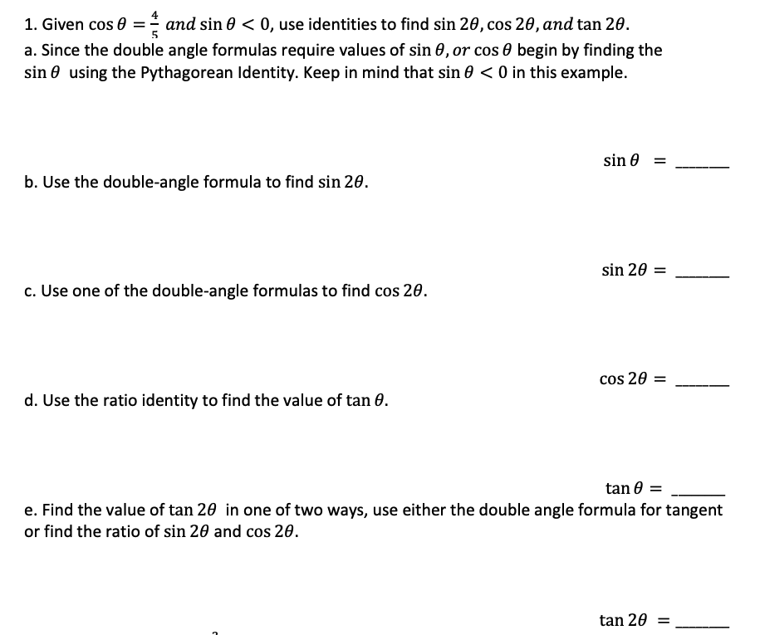

Slide 11
Students love a good preview...
In all of my research and planning I hadn’t really considered the power of this. My students actually enjoy closing our co-req class with a short preview of the material to be covered in the college level class that day. I’d say my previews are about ten minutes in length and focus on the big picture ideas. My students shared that having this extra bit of prior knowledge helped make class much easier. It has been truly rewarding to see my co-req students emerge as group leaders in their daily active learning work because of this content boost.

Slide 12
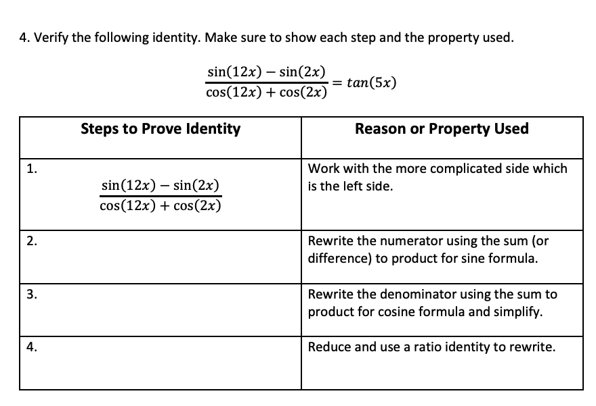

Slide 13
Students have content gaps in unexpected places.
Courseware analytics really help me to better understand my students as individuals with a variety of math backgrounds. Before each corequisite class, I dive into the class analytics to see individual mastery scores on due assignments, the time spent working with the material, when they last engaged with the content, and which learning objectives they were struggling with. This data allows me to customize my mini-lectures to their specific areas of weakness.

Slide 14
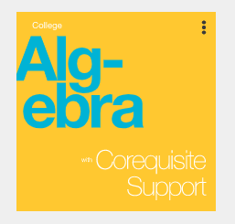
College Algebra with Corequisite Support openstax.org
“Just in time support” integrates comprehensive algebraic principles with effective foundational review.
Each College Algebra textbook section is paired with a thoughtfully developed, topically aligned skills module that prepares students for the course material.
The modules include conceptual overviews, worked examples, and guided practice; they incorporate relevant material from OpenStax’s Developmental Math series.
The modular approach and richness of content ensure that the book meets the needs of a variety of courses.

Slide 15
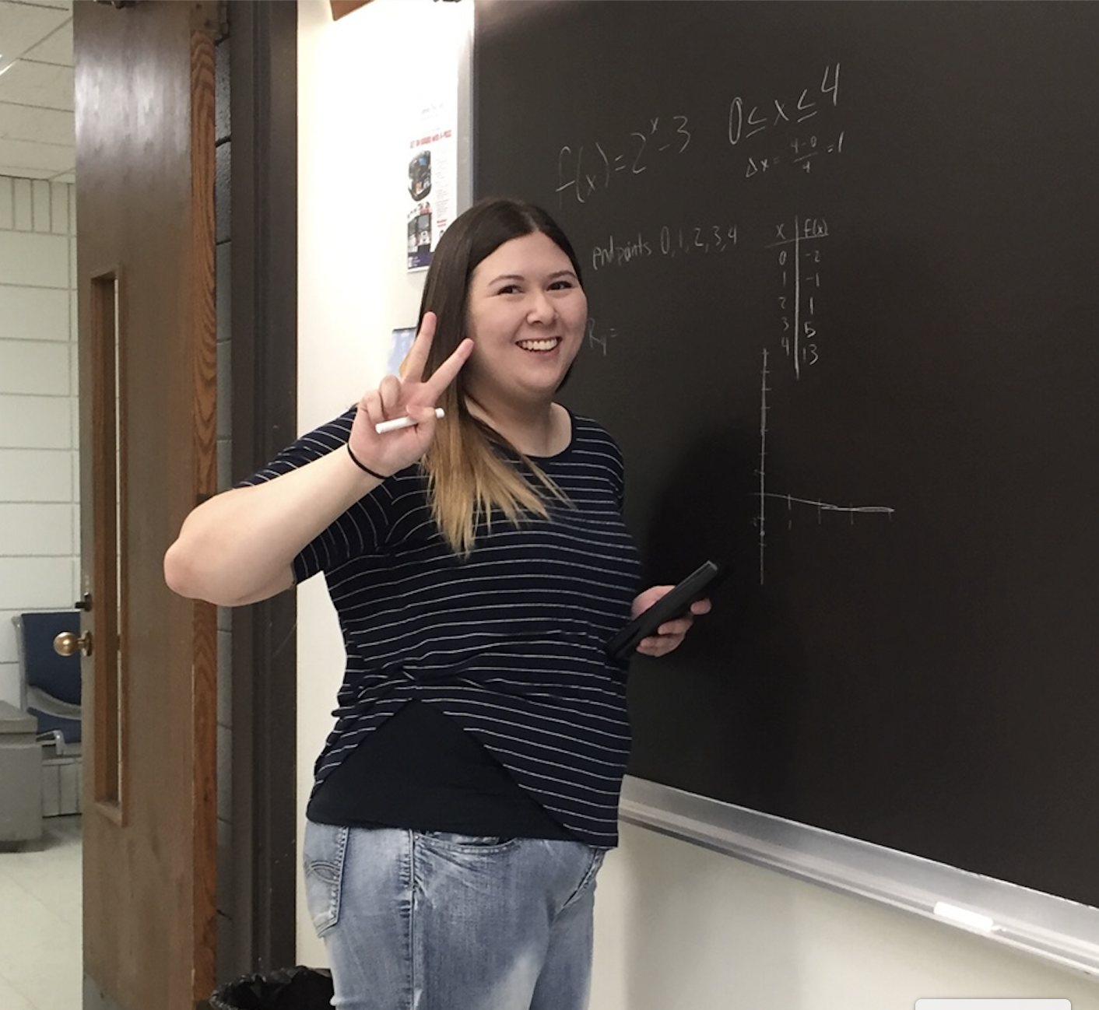
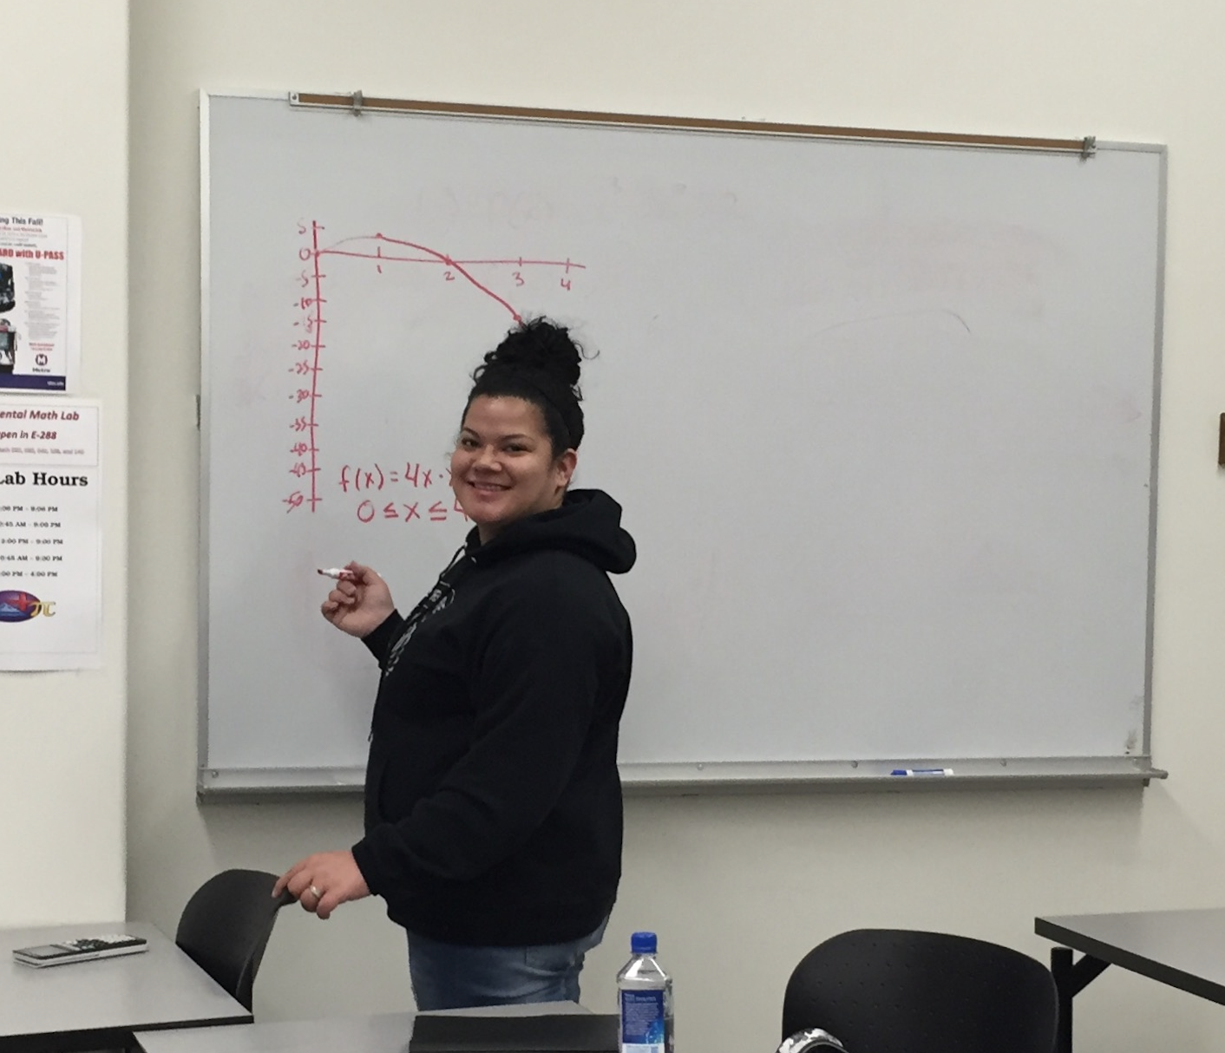
Recommendation: Redesign as single course with support component.
(student apprehension about taking 2 math classes at once, students enrolling in wrong co-req sections, student attendance issues in coreq, staffing issues, advising issues)

