Slide 1
Planning units rather than lessons
Debbie Olson
Mathematics Education Collaborative
Spokane Falls Community College
November 6, 2020
AMATYC Virtual Conference

Slide 2
Inspirations
Basic process
Examples
Citations
Reach out!

Slide 3
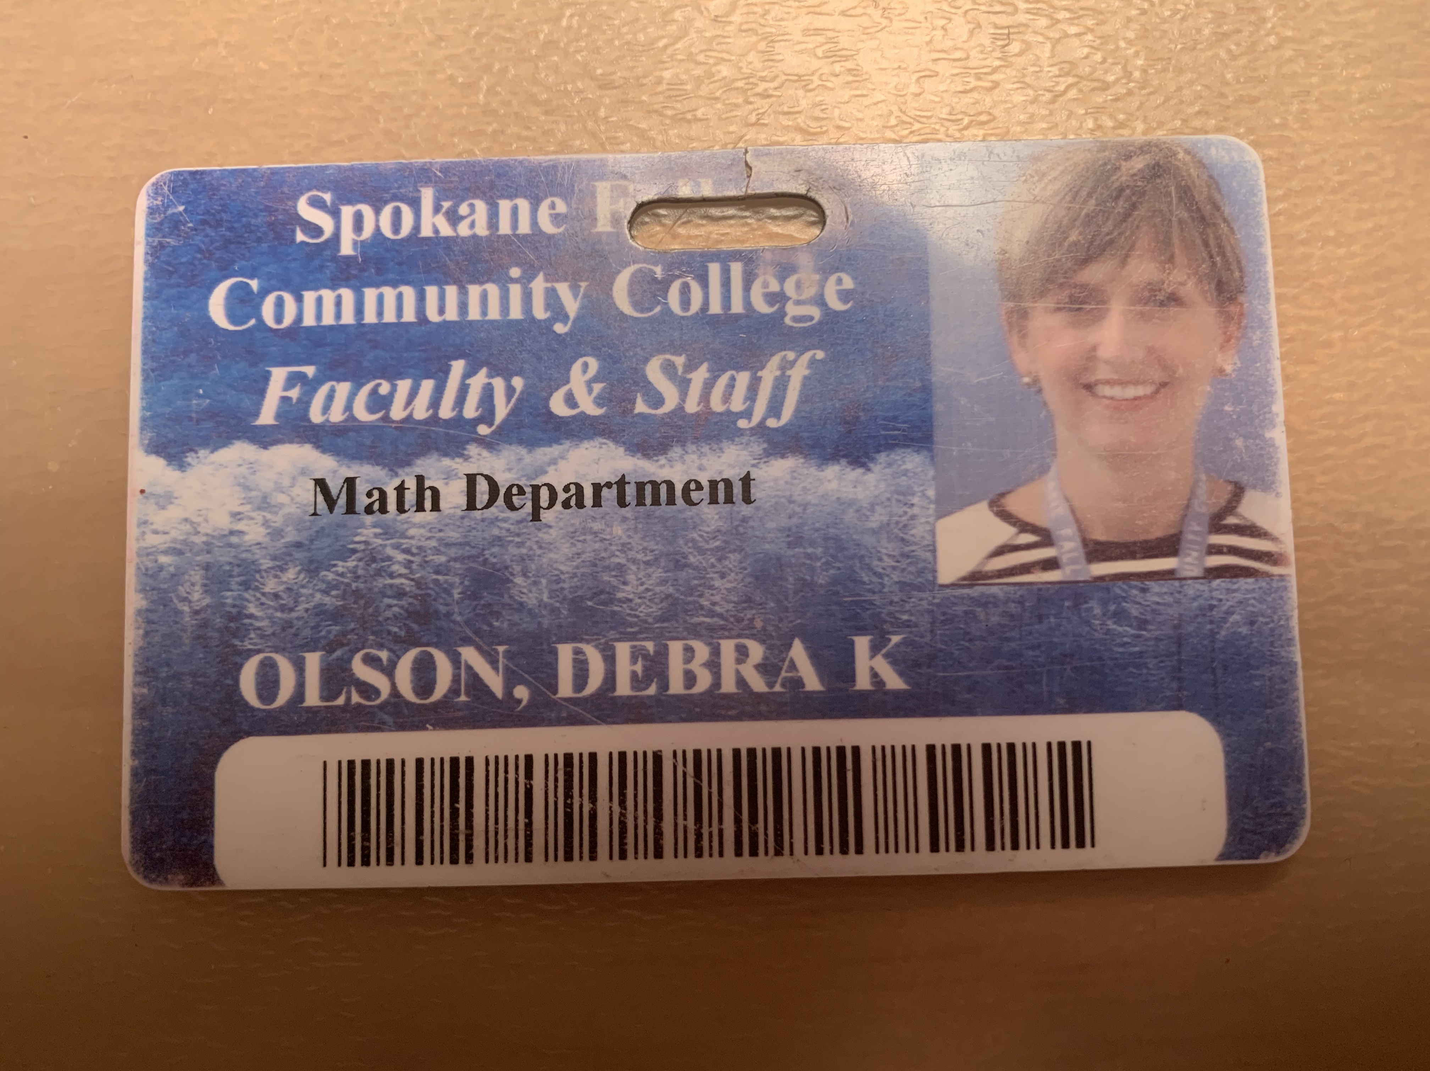
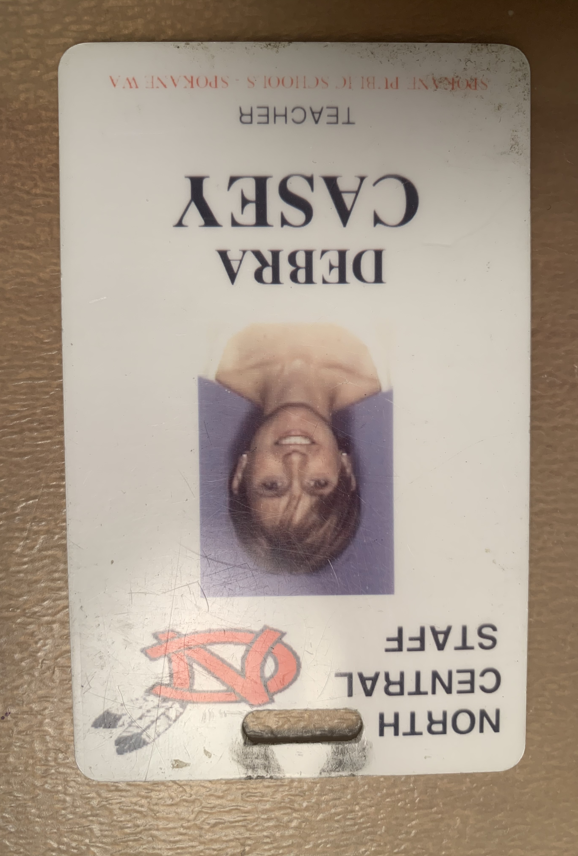
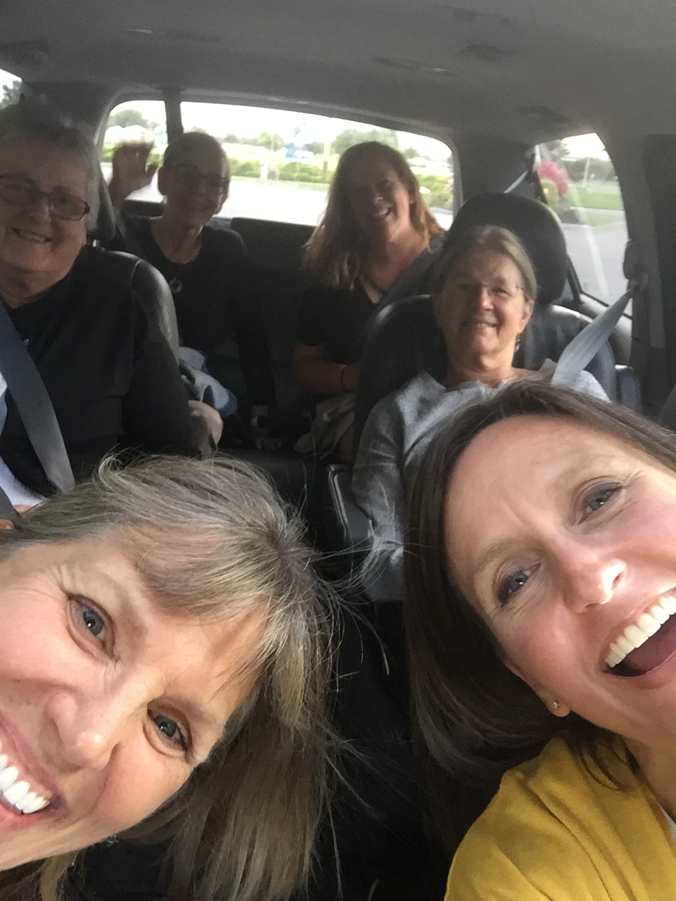
A little about me
High school math and physics – 5 years
Community college math - since 2003
Mathematics Education Collaborative (MEC) - since 2015

Slide 4
Why units instead of lessons?

Slide 5
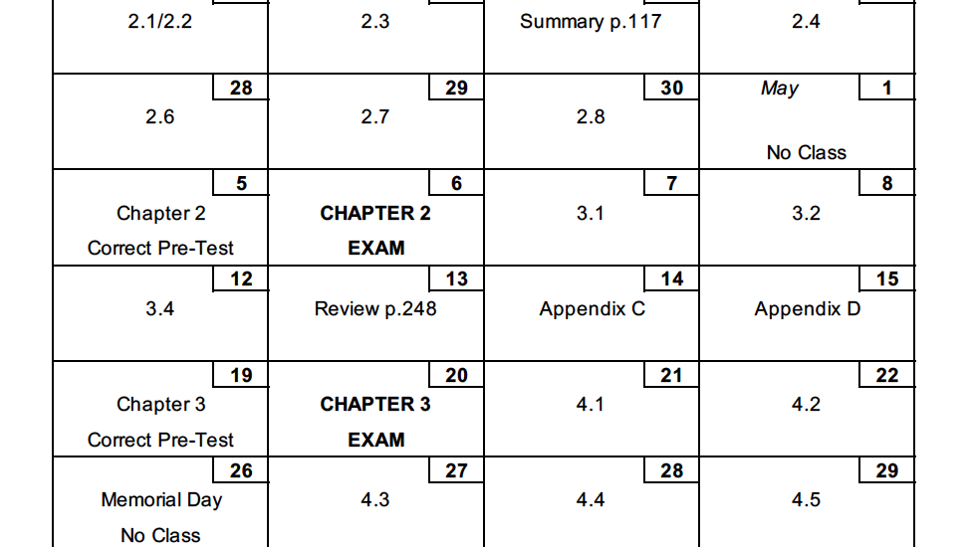

Slide 6
Good teacher, and...
Limited rather than empowered by my materials
Text equaled curriculum
Struggled to integrate promising practices

Slide 7
Understanding by Design
By Wiggins and McTighe

Slide 9
MEC
The Mathematics Education Collaborative

Slide 10
MEC’s Instructional Approach
Student Agency
immersed in a classroom culture
kindle mathematical agency
meaningful mathematical inquiry and student-to-student discourse
sense-making
mathematically convincing arguments
questioning that seeks to understand, rather than change, the thinking of others
Big Mathematical Ideas
experience robust units of study
confront and investigate ‘big’ mathematical ideas
expandable tasks
collaborative and independent problem solving
student choice
equitable differentiated instruction without labeling learners
Mindset
value and encourage divergent thinking
recognize cognitive dissonance as necessary to learning
embrace mistakes as sites for new understandings

Slide 11
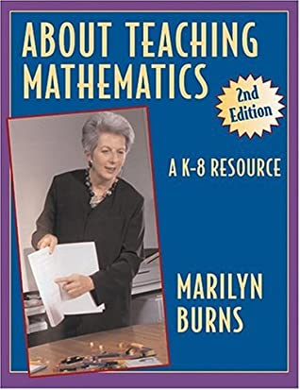
About Teaching Mathematics by Marilyn Burns
A problem-solving curriculum, however, requires a different role from the teacher. Rather than directing a lesson, the teacher needs to provide time for students to grapple with problems, search for strategies and solutions on their own, and learn to evaluate their own results. Although the teacher needs to be very much present, the primary focus in the class needs to be on the students’ thinking processes.

Slide 12
“Teaching Chapters Not Lessons”
Phil Daro
Notes:
Phil Daro is one of the principles writers of the Common Core State Standards for Mathematics and at some point I came across this video of him. You might recognize that the title is pretty on point!
I’m going to share about 6 minutes of this video to let him help me make my case...
https://vimeo.com/79909978
Stop at 6:35
So, in addition to what we as teachers and students can gain from unit-size planning, Dr. Daro also makes the important point that administrators are key partners in this type of work.

Slide 13
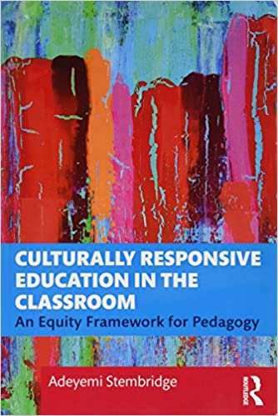
Culturally Responsive Education in the Classroom By Adeyemi Stembridge
...the question ’What do I want students to feel?’ compels us to consider our students in more dynamic and multidimensional contexts than we might otherwise. I think of this as the height of emotional intelligence in teaching. When asking this question in my planning, I think deliberately about the emotional journey on which the learning experience takes students (which is why I find the unit, and not the individual lesson, to be the most effective level at which to plan).

Slide 14
Talking about it vs. doing it

Slide 15
Experience as a learner
Lesson grain-size
No path forward
Fundamental expectations about tasks and time
“Illusions of learning”

Slide 16
My process
Proportional Reasoning and Percents Unit
Math for Elementary Education
Winter 2019

Slide 17
Backward planning to layout the landscape
A new kind of calendar
Collecting good tasks
Deciding where tasks best fit
Being sure we’re hitting what matters
Being flexible and enjoying the unit with my students
Taking good notes and tinkering

Slide 18
Backward planning from Understanding by Design
Sort objectives/outcomes
Enduring understandings
Important to know and do
Worth being familiar with
Evidence
What will it look like when students understand?
Assessment
How can I assess for this evidence?
Learning plan
What experiences do students need to build these understandings?

Slide 19
Enduring Understandings

Slide 20
Important to know and do

Slide 21
Worth being familiar with
Many course outcomes
Which rise to “Important to know and do?”

Slide 22
Evidence, Assessment, Learning Plan MEC

Slide 23
Unit parts & types of tasks
Choosing tasks and deciding where they belong

Slide 24
Types of tasks
Menu tasks
Group tasks
Whole class tasks
Homework
On-demand tasks
Pre- and post-assessment tasks
Number Talks

Slide 25
Menu Tasks
Collection will surround students with the big ideas of the content
Facilitate students running into the big ideas over and over and from various perspectives
Low floor, high ceiling
Worthy of sustained attention and sustained attention is needed
Choosing which of these to require and process as a class is a core of our learning together.

Slide 26
Group Tasks
Benefit from group effort
Clear norms about working together
Facilitate exploration of at least one big idea
Synthesize ideas that are being explored in unit work
Clarify big ideas, important definitions and methods
Name ideas that are identified/clarified

Slide 28
Whole Class Tasks
Synthesize ideas coming from individuals/groups
Introduce new ideas/methods
Clarify big ideas, important definitions and methods
Name ideas that are identified/clarified

Slide 30
Homework Tasks
Purposeful
Minimal
Always processed or feedback is provided
Always connected to class work: extension/continuation or something to think about in preparation for our next class
Never busywork

Slide 32
On-Demand Tasks
Periodic assessment of key ideas
Reflect what’s been experienced in class
Reasonably completed in class time
Formative
Feedback opportunity
Inform which menu tasks to process and when

Slide 34
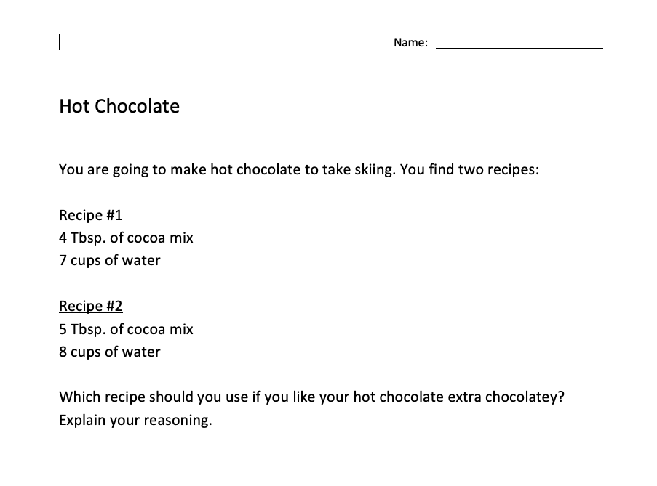

Slide 35
Pre- and Post-Assessments
Capture big ideas
Reasonably completed in class time
Pre-assessment is a subset of post-assessment (only those that are easily accessed without unit experience, these tend toward target big ideas)

Slide 37
Number Talks
10-15 minute mostly mental math exercise
Essential maintenance to the foundation of their mathematical understandings
Communicate class culture
More important to make connections to each other’s thinking and develop confidence/flexibility than to tie to content of the day

Slide 38
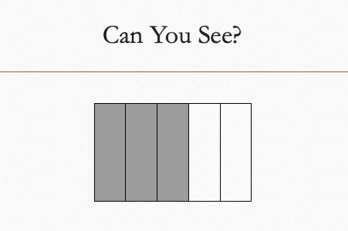
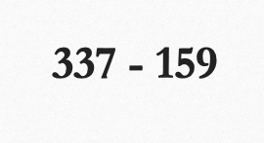
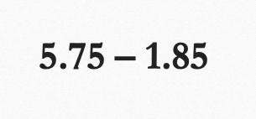
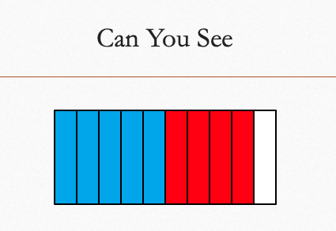
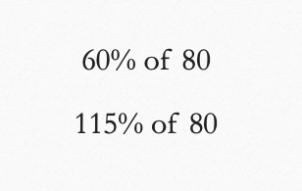
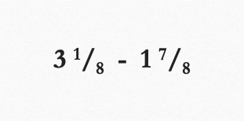

Slide 40
So that’s it

Slide 41
Challenges
More time at the front end
Risky, especially in isolation
Trust and autonomy required
Can’t avoid or gloss-over areas own shallow understandings
Forced to think more carefully about what I’m teaching and why

Slide 42
Successes
More thoughtful and reflective planning
Easier to adjust
Vet and integrate new insights without starting over
Not beholden to a certain text
Teaching is more fun and organic.
Meaningfully meet students’ needs

Slide 43
Successes
Know each other as mathematicians
Broader issues clearly connected to my daily work
Students thrive, engage, and develop positive dispositions
Can’t avoid or gloss-over areas own shallow understandings
Forced to think more carefully about what I’m teaching and why

Slide 44
Lessons Learned
Rethink department policies
Do this collaboratively whenever possible

Slide 45
The art of teaching

Slide 46
Resources
Burns, Marilyn. About Teaching Mathematics. Math Solutions, 2000.
“Phil Daro - Teaching Chapters, Not Lessons on Vimeo.” Vimeo, 20 Nov. 2013, https://vimeo.com/79909978.
Stembridge, Adeyemi. Culturally Responsive Education in the Classroom. Routledge, 2019.
Walle, John A. Van. Teaching Student-Centered Mathematics, Vol. 3. 2006.
Wiggins, Grant P., and Jay McTighe. Understanding by Design. ASCD, 2005.
MEC | Mathematics Education Collaborative, http://www.mec-math.org.

Slide 47
Thank you Questions?
debbieo@mec-math.org

