Slide 1
Using math to evaluate the world
AMATYC 2020
Charlotte Mortimer
Valencia College

Slide 2
My story: course
MGF 1106 College Mathematics – liberal arts math course
COLLEGE MATHEMATICS Prerequisite: Minimum grade of C in MAT 0018C or higher or appropriate score on an approved assessment. Topics include systematic counting, probability, statistics, geometry, sets, logic, and the history of mathematics. Gordon Rule course. Minimum grade of C required if MGF 1106 is used to satisfy Gordon Rule and general education requirements.
Course Learning Outcomes
Demonstrate an understanding of mathematical topics beyond algebra: sets, logic, probability, counting methods, geometry and statistics.
Implement the fundamental methods of each topic in various applications of mathematics.
Recognize the historical development of mathematical ideas and concepts.
ADDED OUTCOME: Compare and contrast cultural experiences

Slide 3
Overview of study abroad experience
Videos and pre-departure meetings to learn material
Traditional MyMathLab homework prior to trip
Homestays (in 2 of the 3 locations) so we have people to talk to and to save money
Trip packet completed instead of traditional tests

Slide 4
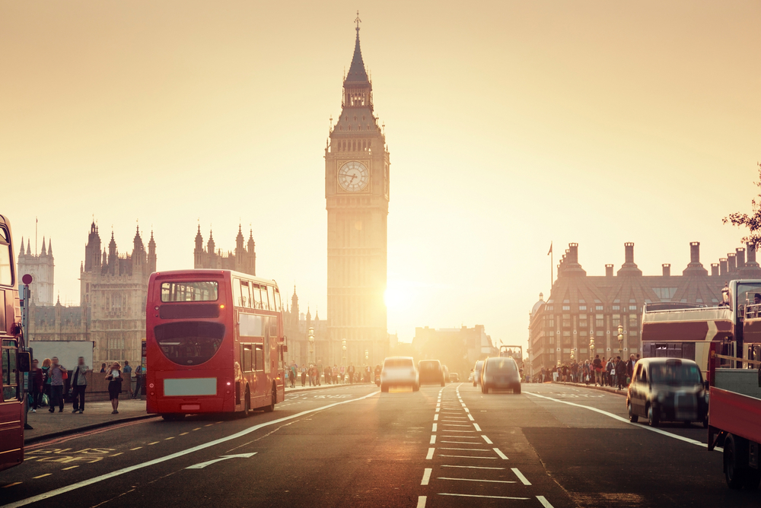
My story: my trip
UK for 15 days
Edinburgh, Scotland
Kent, England
London, England
Home stays in Edinburgh and Kent
Gilman scholarship eligible
Fun/touristy activities that we can analyze, categorize, and do computations

Slide 5
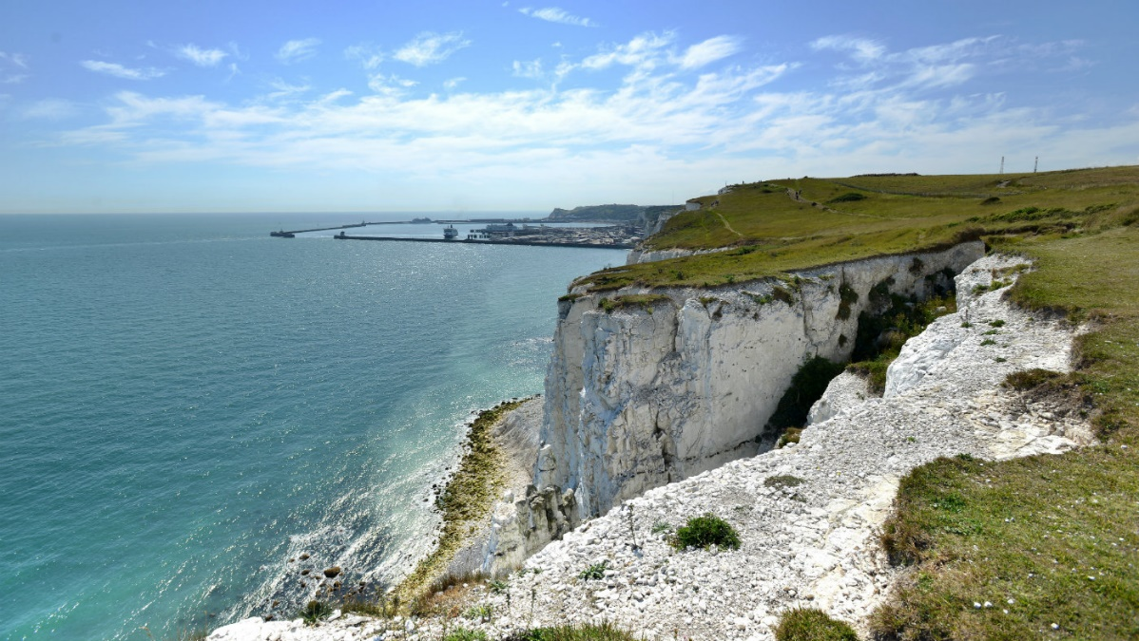
My story: itinerary
Day 1, Wed, May 16: Fly to U.K.
Day 2, Thurs, May 17: Bus to Edinburgh, free time in Edinburgh Historic City Centre, go to family
Day 3, Fri, May 18: Edinburgh castle, Tartan Weaving Mill, grocery store visit, Scotch Whisky Heritage Centre
Day 4, Sat, May 19: BT Murrayfield stadium rugby tour, lunch in pub, Holyrood Palace
Day 5, Sun, May 20: full day with family
Day 6, Mon, May 21: Sterling castle, Loch Katrine cruise
Day 7, Tues, May 22: Transport to London, lunch at pub in London, go to family
Day 8, Wed, May 23: Canterbury Cathedral and city centre, Discover White Cliff of Dover

Slide 6
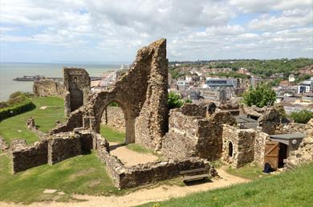
My story: itinerary
Day 9, Thurs, May 24: Eastbourne old historic town and pier, Hastings castle, Smugglers Adventure
Day 10, Fri, May 25: Leeds castle, lunch at traditional pub, grocery store visit
Day 11, Sat, May 26: Harry Potter studio tour, transport to London
Day 12, Sun, May 27: Camden Market, grocery store visit, canals on Camden Lock to Little Venice through regent park
Day 13, Mon, May 28: Hop on, hop off of London, tour of Queen Elizabeth Stadium (Olympic stadium)
Day 14, Tues, May 29: Changing of Guard (Buckingham), scavenger hunt in Hyde park, visit Houses of Parliament and Westminster Abbey, group dinner
Day 15, Wed, May 30: Winton Gallery and additional time at Science Museum of London, Knightsbridge, Kensington, etc.
Day 16, Thurs, May 31: fly to Orlando

Slide 7
The Course work

Slide 8
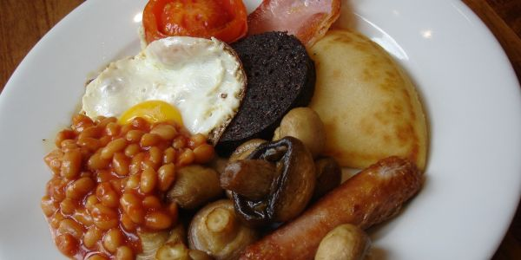
sets
Types of beverages in house
Components and features of castles
Key elements to a full breakfast
Choice comparison
Sports

Slide 9
Sets - types of beverages in house
Types of beverages available in the house
Set A contains the beverages that are available in your house
A =
Set B contains the types of beverages that are available in the house you stay at in Edinburgh, Scotland
B =
Set C contains the types of beverages that are available in the house you stay at in Kent, England
C =
Draw the Venn Diagram below putting all the items from sets A, B, and C into the Venn Diagram
Find $A∩B∩C$
Describe this region in words

Slide 10
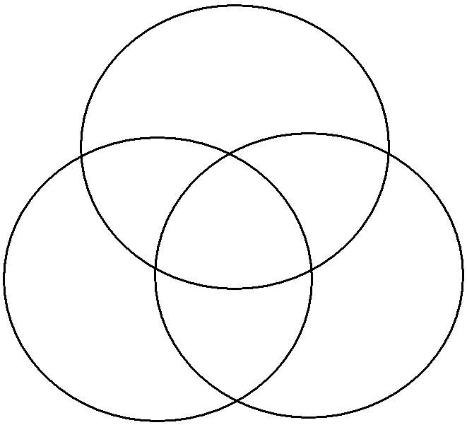
Sets – components and features of castles
Choose 3 of the castles we visit to compare: Edinburgh Castle, Holyrood Palace, Sterling Castle, Leeds Castle, Hastings Castle
Label each circle as a specific castle. Fill in the Venn diagram with at least 1 item per region. Don’t forget to put something on the outside of the circles (this would be something you expected, but wasn’t at any of the 3 castles). Then below identify the elements in each set using roster form.

Slide 11
Sets – key elements to a full breakfast
Key elements to a “full breakfast”
Ask each family you stay with what they believe are the key elements to a full breakfast
Set A contains the food and drink that make up a full breakfast in Scotland
A =
Set B contains the food and drink that make up a full breakfast in England
B =
Draw the Venn Diagram below putting all the items from sets A and B into the Venn Diagram
$A∩B$ =

Slide 12
Sets – choice comparison
Decide on something you’d like to compare from one household to another that we have not yet looked at as a class. This thing can be something tangible (candies or sweets available in the house, colors of paint on the walls, etc.), it can be something that you discuss with your families, (gender roles, feelings on Americans, etc.) or it can be something you choose to observe about the family (words of appreciation spoken to each other, etc.). Have set A consist of the items that fit your criteria in Edinburgh and set B contain the items that fit your criteria in Kent. Then create a Venn diagram filling in all the items.
A =
B =

Slide 13
Sets - sports
Ask your family (in Edinburgh or Kent, only 1) to explain to you how their favorite sport works including all the divisions and what all the teams are. This could be a professional sport or it could be a local team that one of the children plays for. Draw a Venn diagram with as many sets as necessary and subsets inside of it showing all the teams in the league of their favorite sport.

Slide 14
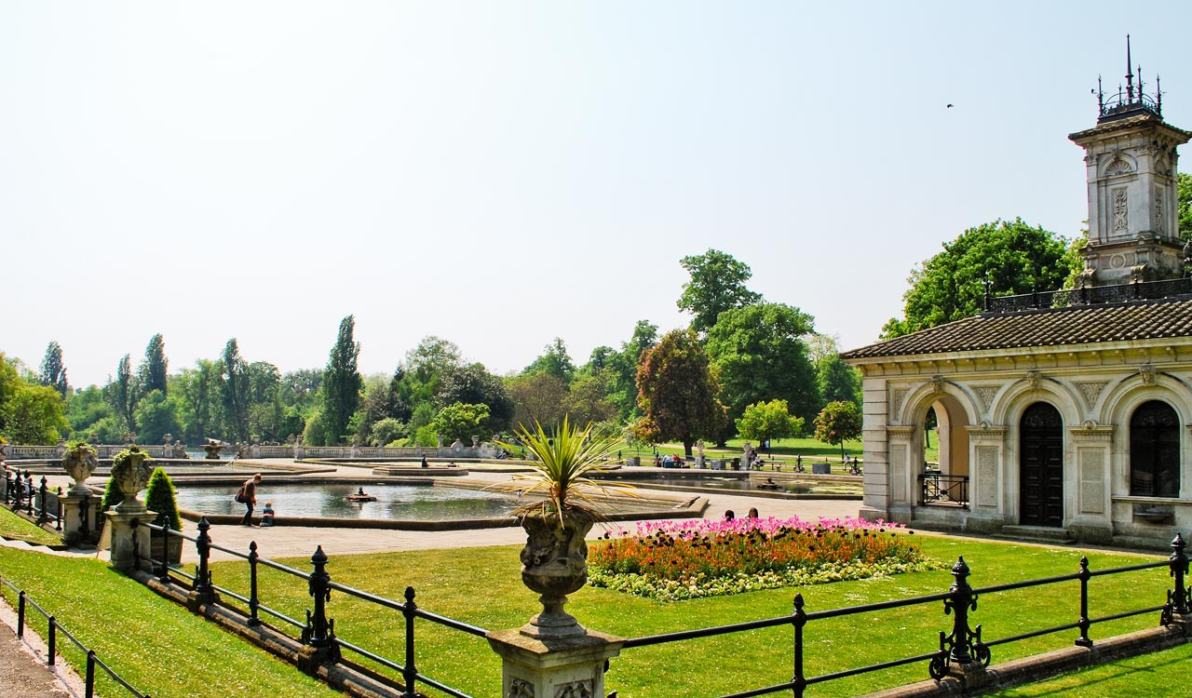
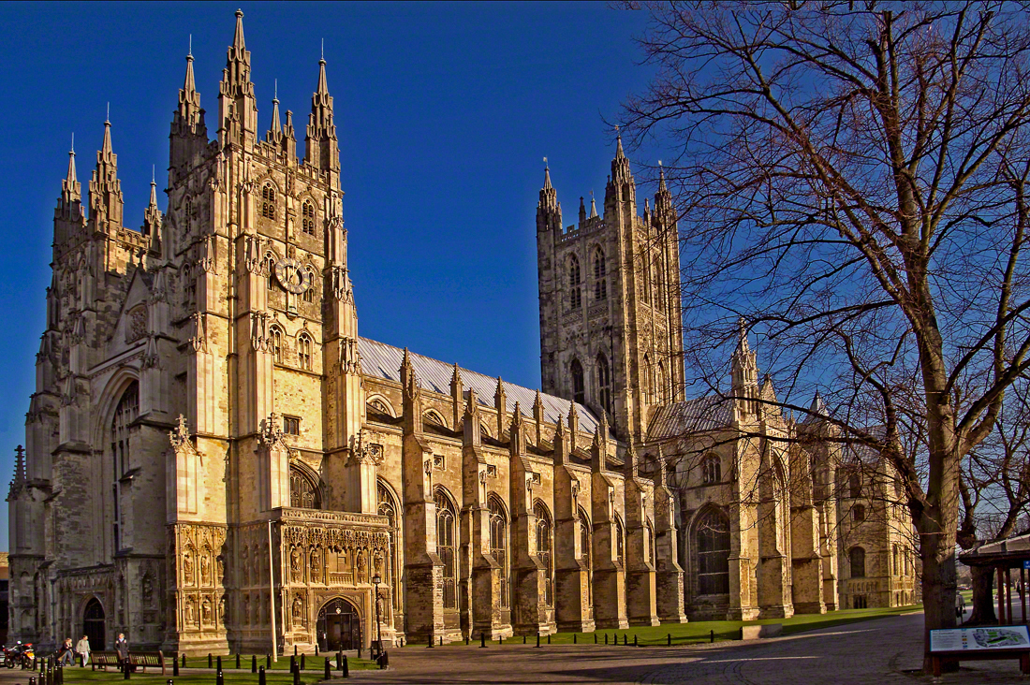
geometry
Dinner plate area
Shower volume
Area of house in each location and allocation of space
Scavenger hunt in Hyde park and Canterbury cathedral
Right, acute, obtuse, angles
Complementary, supplementary angles
Parallel lines
Triangle, quadrilateral, hexagon, etc.
2D shape with cutout for area
3D object like stairs for volume

Slide 15
Geometry – dinner plate area
Calculate the area of a standard dinner plate in your house, your house in Edinburgh, and your house in Kent, England. Round each initial measurement to the nearest inch.
USA
Edinburgh, Scotland
Kent, England
Are you surprised by the results? Why or why not?

Slide 16
Geometry -shower volume
Calculate the volume of the primary shower in cubic inches. Calculate from floor to ceiling. Round each initial measure to the nearest inch. Most showers are shaped as a rectangular solid. If it’s close to this shape, measure as if it’s a perfect rectangular solid. Some are closer to a cylinder. If this is the case, measure as if it’s a perfect cylinder.
USA
Edinburgh, Scotland
Kent, England

Slide 17
Geometry – area of house
Calculate the square footage (area) of the house that you are staying in Kent, England; Edinburgh, Scotland; and your own house in Florida. Use the American measuring system, round each initial measurement to the nearest half foot. Draw a rough sketch of the floorplan with your measurements shown. Complete the calculations below the sketch. (Suggestion: Calculate each room and/or hallway separately)
 | U.S.A. | Edinburgh, Scotland | Kent, England
Common living space square footage
 | U.S.A. | Edinburgh, Scotland | Kent, England
Kitchen and dining square footage

Slide 18
Geometry – scavenger hunt
During our time at the Canterbury Cathedral and city centre, find each of the following shapes and angles. Draw a rough sketch of the item and describe what exactly the item is. You may need to get creative for some of the items
Find a point
Find a line
Find a plane
Find a ray
Find a right angle
Find an acute angle
Find an obtuse angle
Find complementary angles
Find supplementary angles.
Find parallel lines
Find a regular polygon
Find similar figures
Find congruent figures
Find an irregular triangle
Find a regular triangle
Find a quadrilateral
Find a square
Find a pentagon
Find a trapezoid
Find a hexagon

Slide 19
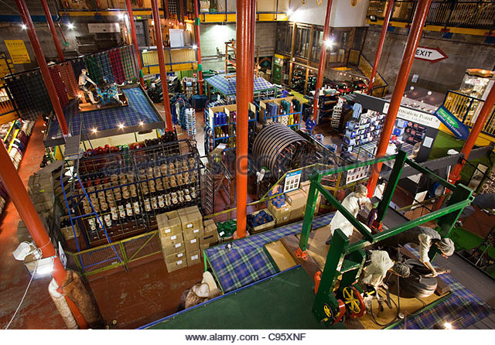
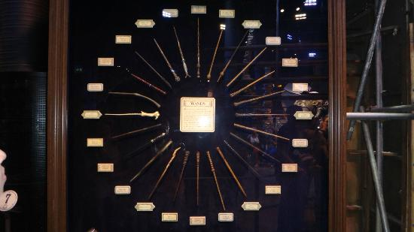
Probability
Tartan Weaving Mill
Traditional Pub
Harry Potter wand case

Slide 20
Probability – tartan weaving mill
Find one pattern at the mill and identify the colors in order to run some probabilities on the information. Find one with at least 4 colors, preferably more.
Identify all the colors in the pattern and write why you chose this pattern.
Answer the following questions about the colors you wrote down. Simplify all fractions.
If one color is chosen randomly from the colors in your pattern, what is the probability that the color is a warm color (meaning in the red, orange, and yellow family)?
If one color is chosen randomly, what is the probability that the color is red?
If one color is chosen randomly, what is the probability that the color is blue or green?
If one color is chosen randomly, what are the odds in favor and odds against the color being green?
If one color is chosen randomly, what is the probability the color is white given it’s not red?

Slide 21
Probability – harry potter wand case
You’ll find a case with 24 of the most prominent wands from the Harry Potter series. List the wand owners along with the house that the wand owner was sorted into. (Note: some wands don’t have a house affiliation that is known. For those you can write unknown). You may need to look up a few of them online. In the last column, fill in the main color associated with the house of the wand owner. If the house is unknown, write none for that color.
Example questions:
If 1 wand is chosen randomly from the case, what is the probability the wand’s owner was a Slytherin?
Find the probability of randomly selecting a wand with a Gryffindor owner followed by selecting a wand with an unknown owner if 2 wands are randomly selected without replacement.
Given the wand has a Gryffindor owner, what is the probability a randomly selected wand belongs to a member of the Weasley family.
How many different ways could you select a first, second, and third favorite wand from the case?

Slide 22
Statistics
Internet devices
Countries visited
Number of children
Grocery store visits

Slide 23
Statistics – internet devices
How many internet devices are in the average household per country? Fill in for your household in Florida and for the household you stay in in each country.
Find the mean, median, mode, and midrange for the number of internet devices in a household in the USA, in Scotland, and in England.
Which of the 5 methods was used to collect the data?
**We all shared our data**

Slide 24
Statistics – countries visited
How many countries have you visited? (answer for yourself as if you’ve completed the travel on this trip). Ask the person that is closest to your age in the household. Fill in for yourself and then for your family in each country on the line with your name. The data will be collected and then distributed to everyone for analysis.
Find the mean and standard deviation for the number of countries visited in a household in the USA, in Scotland, and in England.
**We all shared our data**

Slide 25
Statistics – number of children
Find the number of children in each household. Fill in for yourself and for the families that you stay with in each country. If you need clarification on the specifics of this, please ask.
After the data has been collected, create a frequency distribution, frequency polygon, histogram, and stem and leaf plot for Orlando, Edinburgh, and Kent. Use a class size of 1. Identify the modal class.
**We all shared our data**

Slide 26
Statistics – grocery store visits
Choose 20 items you would like to compare from grocery store to grocery store in each country. Find the price (in pounds, not dollars) of each item in country and list their cost. (Round to the nearest cent) Then find the average (mean) of the cost of each item and also the average (mean) of the cost of the total bill for the items. Only include the items you were able to find a price for it in ALL 3 LOCATIONS in your calculations.
Example questions:
What is the midrange for the average cost?
What is the median cost for the items in Edinburgh?
What is the mode cost for the items in Kent?

Slide 27
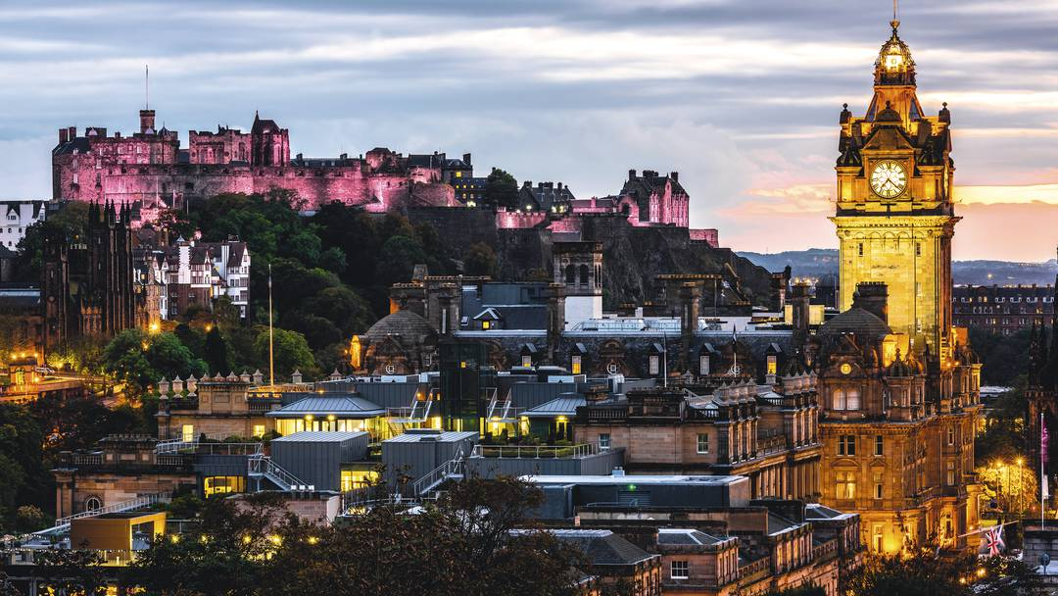
Logic
Expectations for trip
Beliefs about Edinburgh and Kent

Slide 28
Logic – expectations for the trip
Fill in the following conditional statement with what you believe will happen or you believe you’ll learn.
If I study abroad, then ________________________________
Write the converse, inverse, and contrapositive of the statement
Converse:
Inverse:
Contrapositive:
Determine via truth table if the following conclusion is valid or invalid given the premises.
If you study abroad then you will come home a better person. You flew on a plane and you studied abroad. Conclusion: You are a better person.

Slide 29
Logic – beliefs about Edinburgh and kent
Write 3 things you believe to be true about Edinburgh or the people of Edinburgh(make sure it only has one idea).
$p$:
$q$:
$r$:
Translate each of the following from symbol to words:
$\sim q$
$r⋀\sim p$
$q→r$
$\sim r↔\sim q$

Slide 30
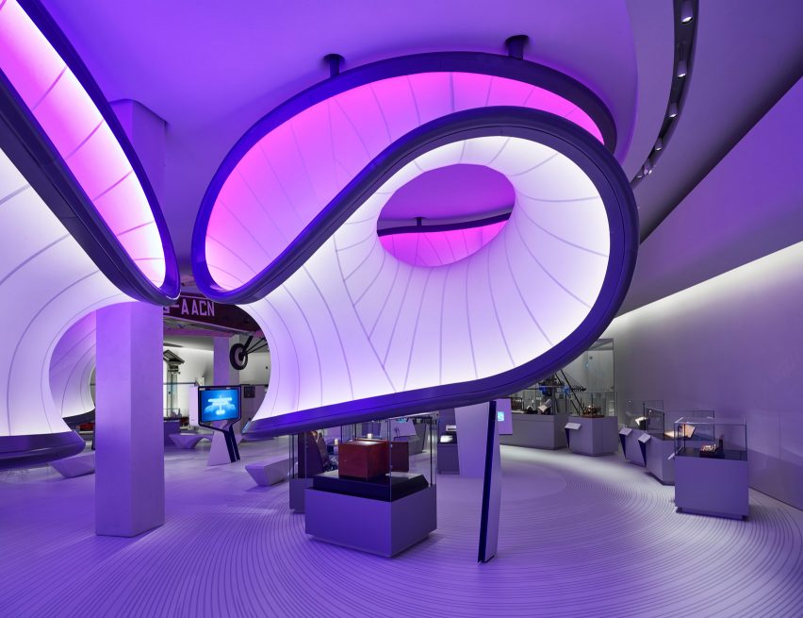
History of math
Winton Gallery in London

Slide 31
History of math – winton gallery
Find one artifact in the Winton Gallery that fascinates or interests you. Describe what the artifact is, what life was like before the artifact existed, and what life is like now that the artifact has been invented.

Slide 32
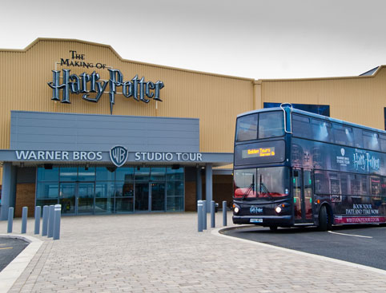
Compare/contrast (added course objective)
Sunday in USA vs Scotland
Harry Potter
Traditional Pub
Loch Katrine and Camden Lock
Olympic Stadium vs BT Murrayfield

Slide 33
Compare/contrast – traditional pubs
Write 500+ words comparing and contrasting your experience in a traditional pub in each of the locations. You can talk about anything that comes with the experience of dining in a traditional pub: food quality, food cost, time taken, friendliness, patrons, activites happening away from the tables, etc.

Slide 34
Compare/contrast – sundays and stadiums
Write 500 words comparing and contrasting different aspects of your Sunday’s. You can choose to discuss a few particular parts of the day or the entire day.
Write 500+ words comparing and contrasting your experience on each stadium. You can talk about any aspects of the stadium experiences you feel are worthy of comparing and contrasting.

Slide 35
Compare/contrast – loch Katrine and Camden lock and harry potter
Write 500+ words comparing and contrasting your experience on each boat. You can talk about any aspects of the boating experiences you feel are worthy of comparing and contrasting.
Write 500 words comparing and contrasting your experience at the two Harry Potter environments. You can choose to focus on small details, on the big picture, or on any combination of both.

Slide 36
Post trip
 | 2 | 1 | 0
Presentation length | >6 minutes | 2-6 minutes | <2 minutes
Activity summary (Activity 1) | Complete summary (What is activity and how complete it) | Partial summary (What is activity or how complete it) | No summary
How activity surprised you (Activity 1) | Detailed summary or how surprised | Minimal summary on how surprised | Not mentioned
What you learned from the experience (Activity 1) | Detailed summary of what was learned | Minimal summary of what was learned | Not mentioned
Activity summary (Activity 2) | Complete summary (What is activity and how complete it) | Partial summary (What is activity or how complete it) | No summary
How activity surprised you (Activity 2) | Detailed summary or how surprised | Minimal summary on how surprised | Not mentioned
What you learned from the experience (Activity 2) | Detailed summary of what was learned | Minimal summary of what was learned | Not mentioned
Upon return: 2 wrap up meetings
Share necessary data and ask questions
Present on two topics

Slide 37
details
Trip cost $3800
Valencia scholarship $1800
Gilman eligible
Included: flights, all daily transportation, all meals (not a common choice), entrance to all activities, medical insurance
Not included: Host family gifts, snacks, souvenirs
May 16 – May 31, 2018
Planning began in November 2016
8/10 students needed per leader
Maxed out at 12 students
Homestays (not a common choice): bedroom door can lock, may be one or two students of same sex

Slide 38
For more information
Contact Char Mortimer: cmortimer2@valenciacollege.edu
Thanks for checking out my presentation!

