Slide 1
A Study of Online Discussion Technologies in Hybrid Algebra Classes
Dr. Dona Boccio & Dr. Zeynep Akcay-Ozkan
Queensborough Community College - CUNY
AMATYC 2020 Virtual Conference

Slide 2
College Algebra at Queensborough CC
Gateway course for STEM majors
Large enrollment ~2000
Low passing rate ~45%

Slide 3
Challenges of Partially Online Courses
Student engagement
Accommodating learners with different learning styles
Availability and cost of technology

Slide 4
Interactions that Foster Student Engagement
Student - Instructor
Student - Content
Student - Student

Slide 5
Online Discussion Tools
Discussion Board (DB)
Text commenting
VoiceThread (VT)
Text, audio and video commenting

Slide 6
Online Discussion Tools: DB vs VT
Do these tools:
Help increase sense of community?
Help engage students?
Compare differences in:
Satisfaction
Participation
Success

Slide 7
Experimental Design
IRB approved
Internally funded:
2019-2020: Center for Excellence in Teaching and Learning, Queensborough Community College, CUNY
2020-2021: PSC-CUNY Research Award
PI’s: Dr. Dona Boccio & Dr. Zeynep Akcay-Ozkan

Slide 8
Experimental Design
Piloted in Fall 2019
Implemented in Spring 2020
3 instructors, each taught 2 sections
6 Sections Total:
3 Experimental (VT)
3 Control (DB)

Slide 9
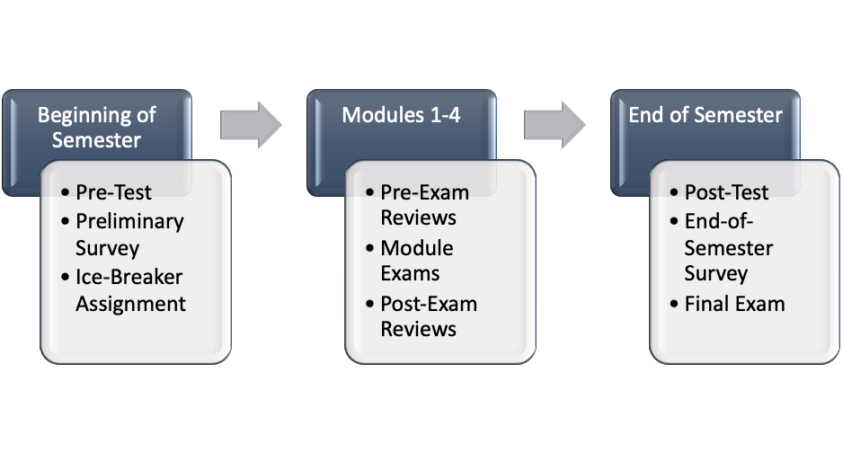
Experimental Design

Slide 10
Experimental Design: Assignments
Pre-exam: “Practice for Exam”
Designed to prepare students for exam on that module
Post-exam: “Going over Exam”
Included questions from the module exam

Slide 11
Experimental Design: Assignments
Each student is assigned a problem, and must:
Post the solution
Show and explain steps
Comment on a classmate’s post
Instructors:
Monitored interactions
Provided positive feedback for correct work
Supplied hints and helpful comments when needed

Slide 12
Previous experience with DB/VT
I have used DB before and I am familiar with how to use it
YES: 26
NO: 16
I have used VT before and I am familiar with how to use it
YES: 1
NO: 32

Slide 13
Directions to Students for DB
Log in to Blackboard
Click the link to Discussion Board
Click the link to the forum.
Click “Create Thread”.
Type a Subject. Use the problem number, for example, Problem #1.
Click in the “Message” box and type an explanation of the steps you used to solve the problem.
Upload the picture of your solution using the "Insert/Edit Image” icon.
When you are finished, click the “Submit” button on the lower right.

Slide 14
Directions to Students for VT
Log in to Blackboard
Click the ‘VoiceThread’ link on the left menu.
Click the link to the assignment, this will take you inside VoiceThread application.
Click on the assignment title within the application to open the presentation.
To add a slide:
Hit the ‘Show all the slides’ button at the bottom (with icon two boxes on top of each other).
Click the ‘+’ sign: ‘Add a slide’ and choose the middle option: ‘Upload files'
Find and choose the file you saved to the computer and upload.
If you need to delete (and re-upload) or edit the file you uploaded, you can drag it over ‘Edit’ or ‘Delete’ on the left menu
To make a comment:
Click on the ‘+’ (make a comment) sign at the bottom, choose microphone or camera and add your comment.
Use arrows to see other solution slides posted by your classmates, add your questions/comments.

Slide 15
Rubric for Scoring DB/VT Assignments
Exemplary (100 points)
Thoughtful, insightful analysis. All parts of the assignment are completed. All questions are answered thoroughly; all steps are explained clearly.
Proficient (80 points)
Most parts of the assignment are completed and/or most questions are answered adequately. Most steps are explained clearly.
Satisfactory (60 points)
Shows insight in responding to some parts of the assignment. Some steps are missing or unclear.
Unsatisfactory (30 points)
Most steps are missing, unclear, irrelevant or incorrect. Needs much improvement.
No Credit (0 points)
Irrelevant statements or does not answer any of the questions.
Extra Credit
An additional 10 – 30 points will be added to the score for students who provide substantive comments to more than one classmate.

Slide 16
Instructions to Students
“Substantive” comments include:
Correct an error
Post alternate method
Ask about missing steps
Ask about missing or unclear explanations

Slide 17
Discussion Board – Student Sample

Slide 18
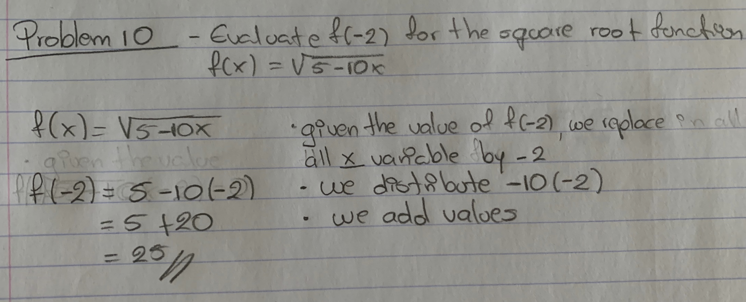
Samples

Slide 21
Transition to Fully Online
March 12, 2020 All classes fully online
Online classes taught synchronously
Assessments NOT proctored

Slide 22
Transition to Fully Online
IRB modifications needed
Online consent approved by IRB
Consent forms, surveys, pre-tests, etc. stored on campus
Permission obtained to return to campus to retrieve documents

Slide 23
Exam Results
 | Module 1 | Module 2 | Module 3 | Module 4 | Final
DB | 59 | 88 | 80 | 86 | 86
VT | 64 | 89 | 82 | 85 | 83
Module 1 Exam: In class
Module 2 - 4 Exams and Final Exam: Online, un-proctored

Slide 25
End-of-Semester Survey
11 Questions using 5-pt Likert Scale
Strongly Agree to Strongly Disagree
5 = Strongly Agree, … 1 = Strongly Disagree
1 Open-ended Question (optional)

Slide 26
End-of-Semester Survey
I completed DB/VT assignments on time.
DB/VT assignments helped me learn the material.
It was easy to view and add comments in DB/VT assignments.
I would like to use DB/VT in future math classes.

Slide 27
End-of-Semester Survey
I completed DB/VT assignments on time.
DB/VT assignments helped me learn the material.
It was easy to view and add comments in DB/VT assignments.
I would like to use DB/VT in future math classes.
Mean of responses in the DB group to questions 2, 3, and 4
significantly higher than mean of responses in the VT group at the 0.05 level
Significant difference between responses to questions on the discussion technology was not the result of the differences between the samples.

Slide 28
Mean: 4.1
Std Dev: 0.82
Mean: 3.64
Std Dev: 1.14
P-value: .0398

Slide 29
Mean: 4.42
Std Dev: 0.70
P-value: .0027
Mean: 3.72
Std Dev: 1.22

Slide 30
Mean: 4.02
Std Dev: 1.06
Mean: 2.97
Std Dev: 1.31
P-value: .0002

Slide 31
End-of-Semester Survey: Open-ended Question
Do you have any suggestions to improve the online or in-class portion of this course, or any other comments concerning VT/DB or any other component of the course?

Slide 32
End-of-Semester Survey Comments: DB
The cooperative element of the discussion boards is a great idea I hope this is included in the future
I think My Open Math videos under each question helped me a lot more than discussion board.

Slide 33
End-of-Semester Survey Comments: VT
Voice thread was a very difficult website to follow, so using a simpler website might help improve learning the material.
Improving the interface if possible. At least in my case, trying to access it mobily was virtually impossible.
I just feel like voice thread isn't really needed but, having more zoom calls would be awesome

Slide 34
End-of-Semester Survey Comments: VT
Did not enjoy voice thread, never worked for me, it’s difficult to use.
Don’t use voice thread

Slide 35
Conclusions and Next Steps
No significant difference in participation
No significant difference in exam scores
Student satisfaction lower in VoiceThread

Slide 36
Conclusions and Next Steps
Issues with VoiceThread discouraged students:
Technical difficulties using VT on mobile devices
Students were not familiar with using audio/visual discussion technology
Difficult to use VT; many steps needed to post; icons not intuitive
Suitability of home environment for voice/video recording

Slide 37
Conclusions and Next Steps
Implement with a larger sample
Incorporate voice in DB
Redesign assignments to promote collaboration

Slide 38
Selected References
Borba, M. C., Askar, P., Engelbrecht, J., Gadanidis, G., Llinares, S., & Aguilar, M. S. (2016). Blended learning, e-learning and mobile learning in mathematics education. ZDM - Mathematics Education, 48(5), 589–610. https://doi.org/10.1007/s11858-016-0798-4
Dean, C., & Goodson-Espy, T. (2019). The Role of VoiceThread in Supporting Effective Mathematical Discussions Online. https://doi.org/10.4018/978-1-7998-1476-4.ch003
Delmas, P. M. (2017). Using VoiceThread to Create Community in Online Learning. TechTrends, 61(6), 595–602. https://doi.org/10.1007/s11528-017-0195-z
Hew, K. F., & Cheung, W. S. (2012). Students’ use of asynchronous voice discussion in a blended-learning environment: A study of two undergraduate classes. Electronic Journal of E-Learning.
Hong, K., & Jacob, S. M. (2012). Critical Thinking and Socratic Questioning in Asynchronous Mathematics Discussion Forums. Malaysian Journal of Educational Technology, 12(3), 17–26.
Jacob, S. M., & Sam, H. K. (2008). Measuring Critical thinking in Problem Solving through Online Discussion Forums in First Year University Mathematics. Lecture Notes in Engineering and Computer Science, I, 19–21.
Marriott, P., & Hiscock, J. (2002). Voice vs text-based discussion forums: An implementation of Wimba voice boards. In Proceedings of world conference on e-learning in corporate, government, healthcare, and higher education 2002.
Mccormack, V. (2010). Increasing Teacher Candidate Responses through the Application of VoiceThread. International Journal of Arts and Sciences.
Moore, M. G. (1989). Editorial: Three Types of Interaction. In American Journal of Distance Education. https://doi.org/10.1080/08923648909526659
Orlando, J. (2016). A Comparison of Text, Voice, and Screencasting Feedback to Online Students. American Journal of Distance Education. https://doi.org/10.1080/08923647.2016.1187472
Weigel, C. (2019). A Comparison Between VoiceThread and Text-Only Discussions in an Online Course. Radiologic Science & Education, 24(1).

Slide 39
Contact Info
Feel free to contact me with questions!
dboccio@qcc.cuny.edu

Slide 40
Thank You!
Funded by Center of Excellence in Teaching and Learning, Queensborough – CUNY

