Slide 1
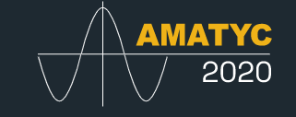
How to add reflection to your online math class
Prepared and presented by Crystine Chipman

Slide 2
Hello!
I am an Educational Specialist student at Utah State University.
I have taught math online since 2005.
I have added Big Ideas to my classes since 2015. Reflection came March 2019.

Slide 3
Note to the wise: I am presenting six strategies. Do not try more than one.
Small Teaching Online: Applying Learning Science in Online Classes
by Flower Darby and James M. Lang | May 15, 2019
This Photo by Unknown Author is licensed under CC BY-NC-ND

Slide 4
Frank ‘Trey’ Cox at
Chandler-Gilbert Community College
2015
“Always be yourself.
Unless you can be Batmen.
In that case, be Batman.”

Slide 5
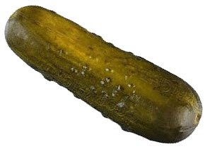
A 2015 student example
37 page PowerPoint
Honors scholarship!
This Photo by Unknown Author is licensed under CC BY-NC-ND

Slide 6
Reflection?
March 2019, Learning Theories class

Slide 7
In 1984, David Kolb proposed a model of experiential learning
fake
Concrete experience
active experimentation
Math
Reflection on experiences
abstract conceptualization

Slide 8
Reflection is easy to add
Beginning of unit
Middle of unit
End of unit
😉

Slide 9
In the beginning…

Slide 10
1. Student-set learning goals
Hours of study
Which day?
Review time
Seeking help
This Photo by Unknown Author is licensed under CC BY-SA

Slide 11
2. Introduction + quiz for unit

Slide 12
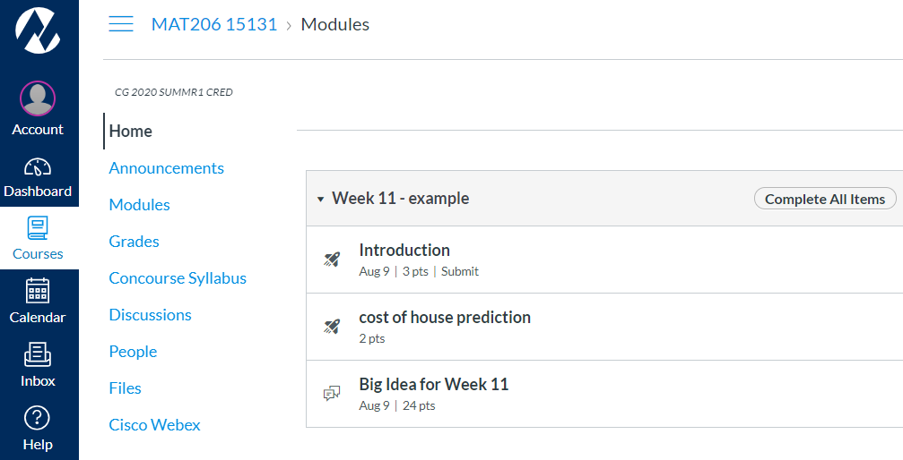

Slide 13
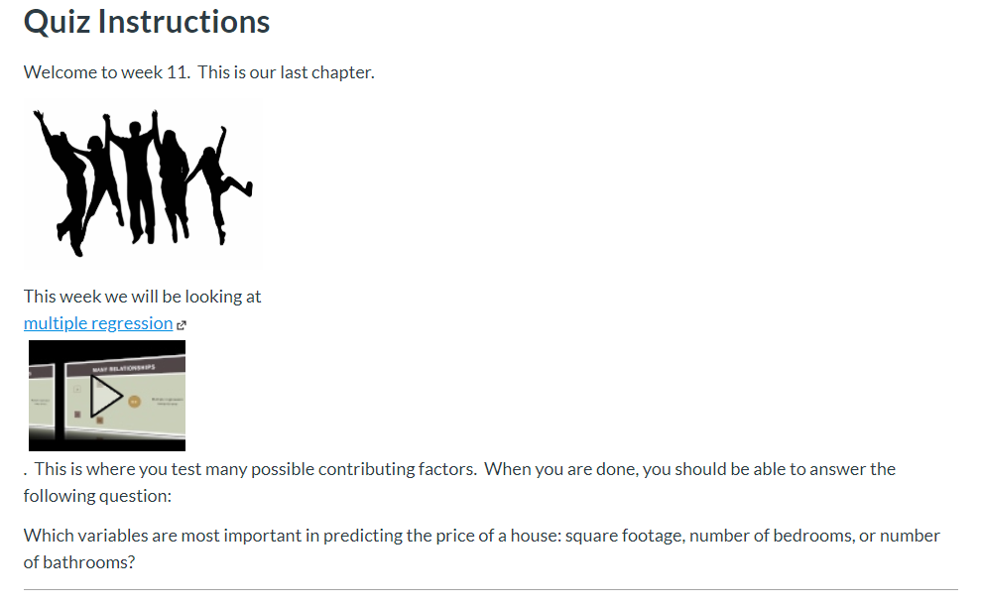
introductory quiz
topic
video
question from the end of the chapter
Notes:
Go to canvas

Slide 14
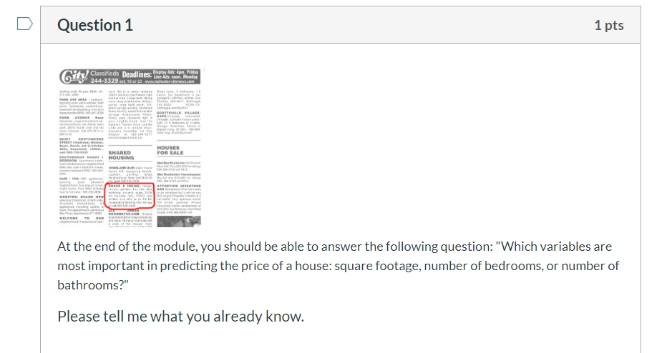
introductory quiz Q1
Question from the end of the chapter
Already know?
Notes:
Go to canvas

Slide 15
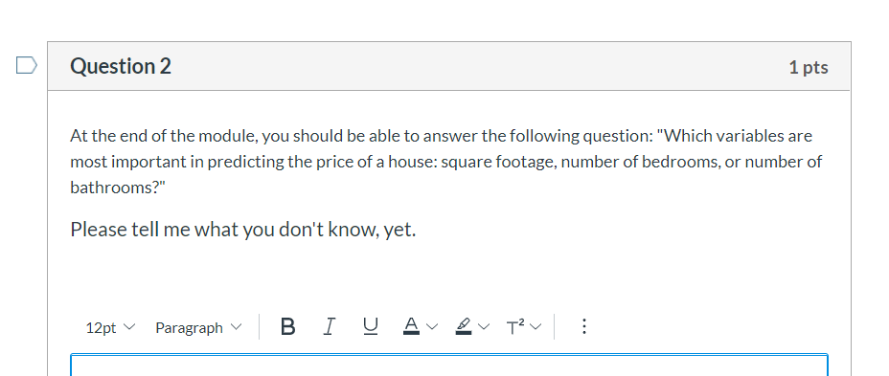
introductory quiz Q2
Don’t know?
Notes:
Go to canvas

Slide 16
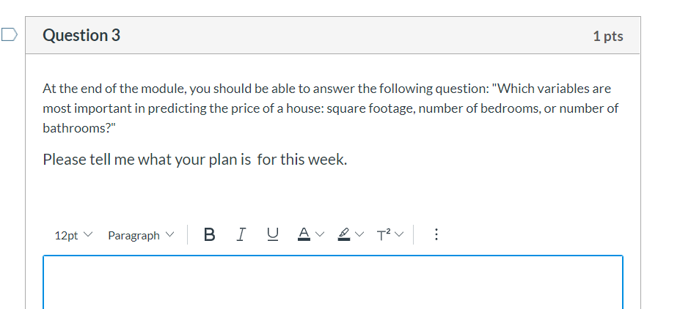
introductory quiz Q3
How are you going to know?
Notes:
Go to canvas

Slide 17
student
A personalized learning plan!
(PLN)
I own my learning

Slide 18
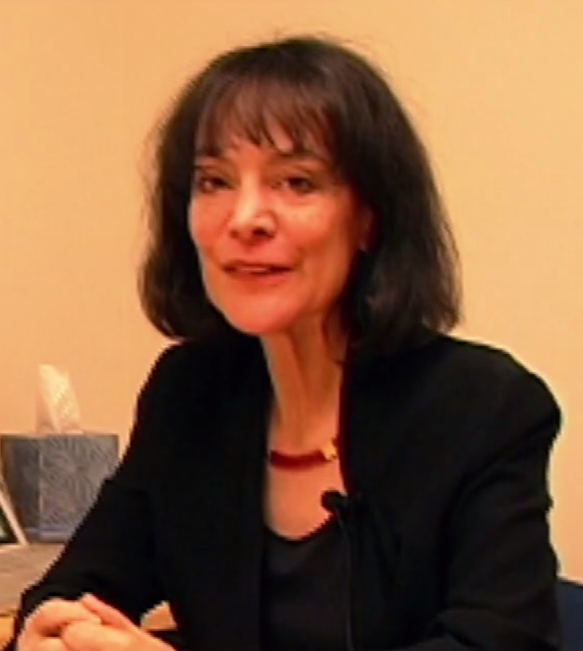
Destigmatize failure -Joshua Eyler, How Humans Learn
Growth mindset
-Carol Dweck, Mindset, the new psychology of success
This Photo by Unknown Author is licensed under CC BY-NC

Slide 19
…and in the middle …
This Photo by Unknown Author is licensed under CC BY

Slide 20
3. Ask for personal experiences.
Saundra McGuire said, “We can just throw a concept out there, like a ball, and ask, ‘What does this remind you of that you’ve encountered in your everyday life?’

Slide 21
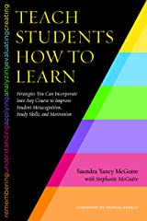
“When students hit the ball back
they come up with the most wonderful examples and ideas ….” Saundra McGuire, in Teach Students How to Learn (2015, p. 26).

Slide 22
Student examples:
“Derivatives made me think of brewing beer…”
“I went to IKEA and tried to buy a picture frame …”
“I went to flush the toilet…” (Scott Adamson)

Slide 23
4. Ask students for resources
Online calculators
Study groups
Online videos
Concept maps
LaTex tutorials
Desmos

Slide 24
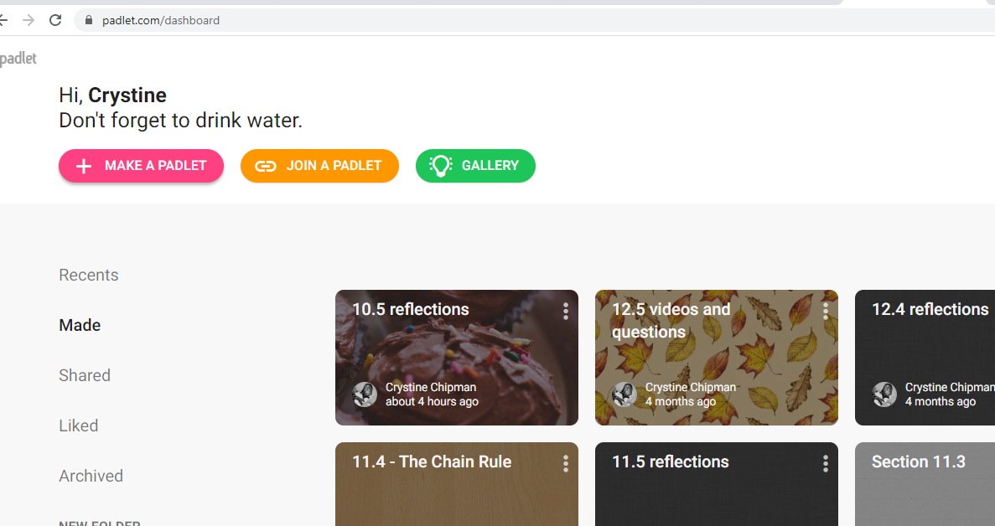
Padlet.com
Product Rule
Quotient Rule
Notes:
Go to Padlets screen

Slide 25
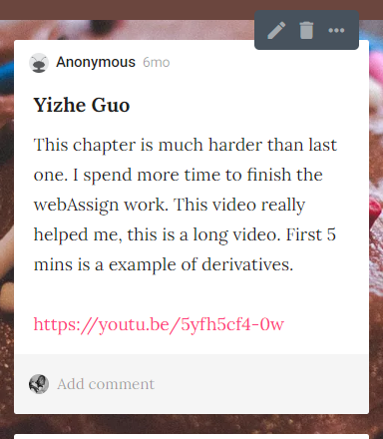
Anonymous?
name

Slide 26
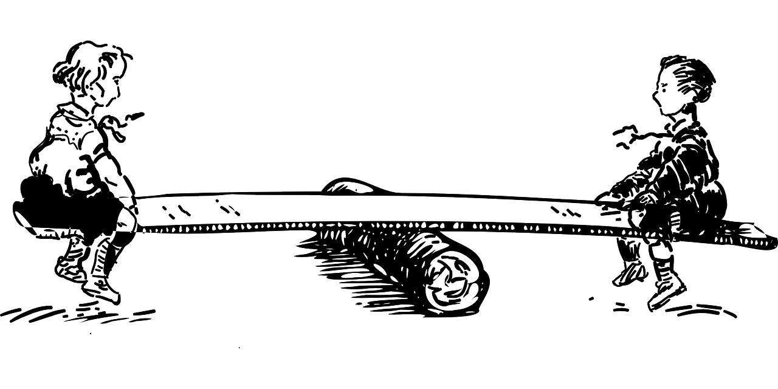
5. Don’t forget your beginning!
End of the beginning?
Beginning of the end?

Slide 27
5a. Student goals
Follow up!
This Photo by Unknown Author is licensed under CC BY-SA

Slide 28
5b. Intro quiz

Slide 29
6. At the end, what was the Big idea?
This one is my favorite

Slide 30
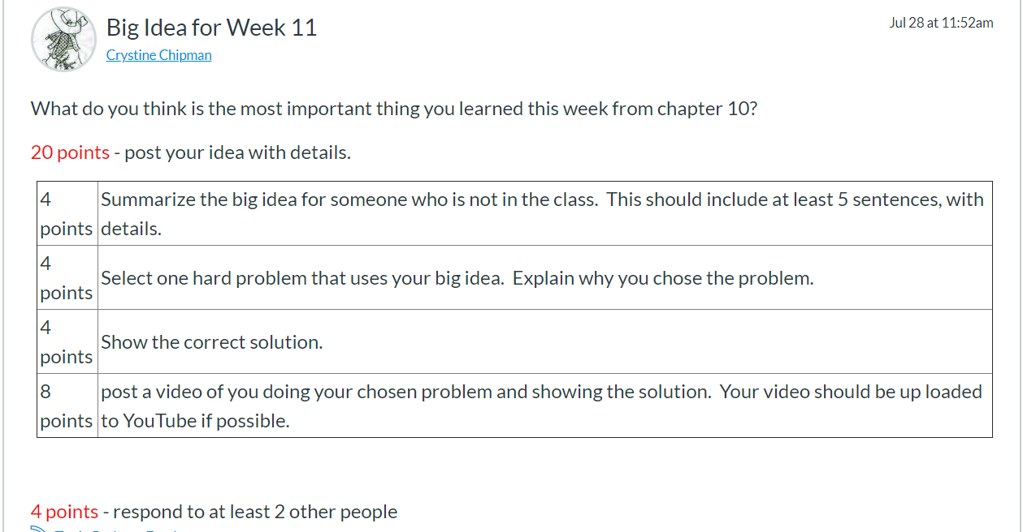

Slide 31
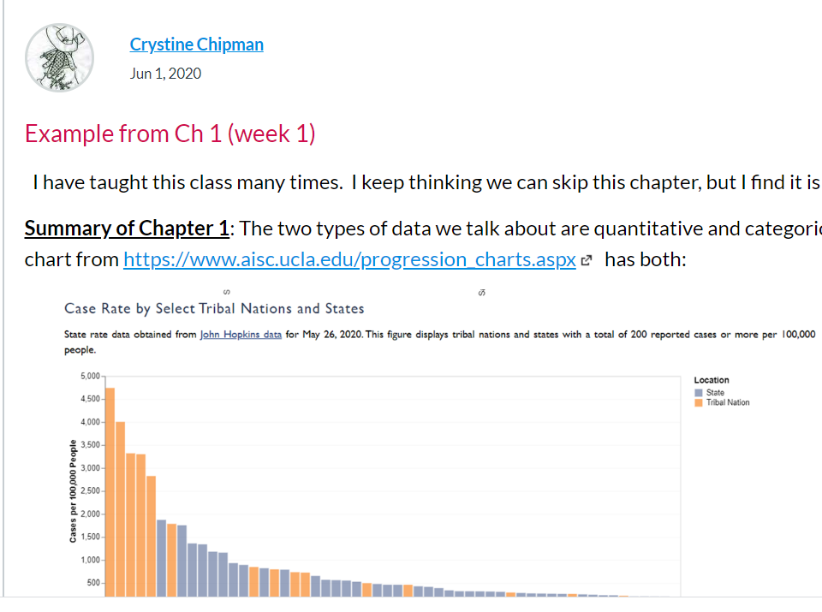
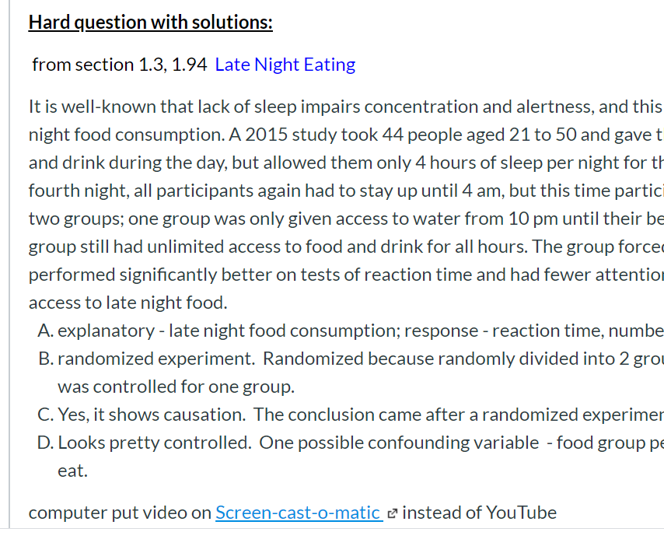
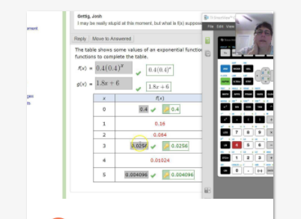
My example of a Big Idea
Hard problem
Screen-cast-o-matic
Summary of big idea – quantitative vs. qualitative
solution

Slide 32
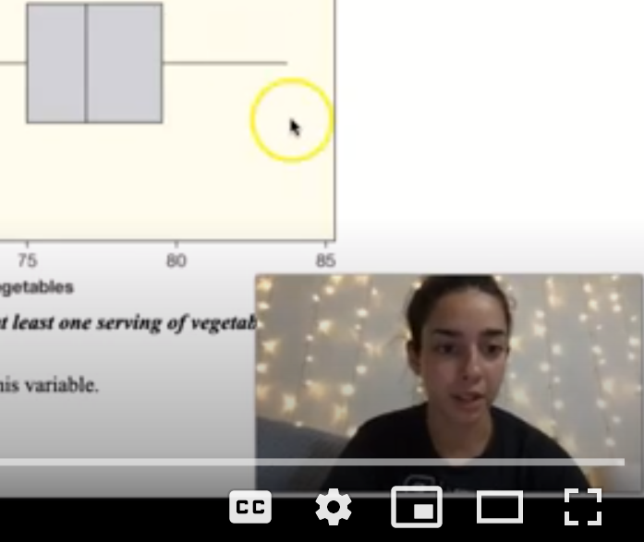
Screencast-o-matic
Can show a face!

Slide 33
Camera phone
Recent example

Slide 34
Record your paper and talk

Slide 35
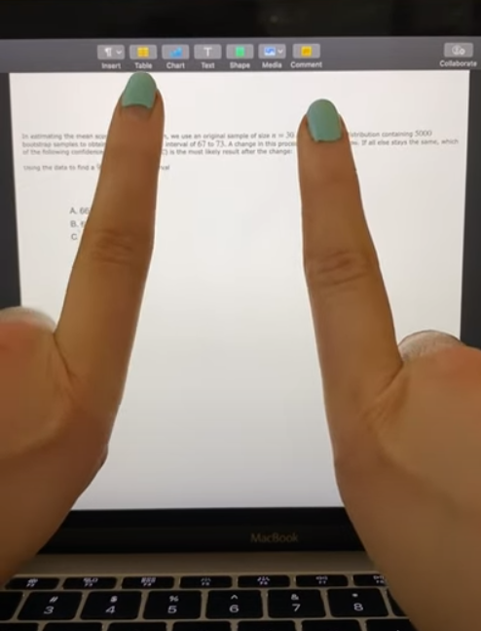
Body language and fingers!
90% interval vs. 95% interval

Slide 36
Hold up a calculator

Slide 37
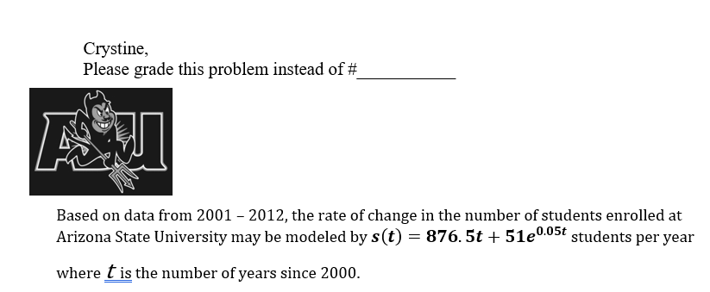
A few more ideas
Hard problem for the final
Error analysis: WHY?
Test and quiz analysis
Notes for the final

Slide 38
Thanks!
Any questions? Other ideas?
You can find me at:
Crystine.Chipman@usu.edu
This Photo by Unknown Author is licensed under CC BY-SA

Slide 39
Credits
Special thanks to all the people who made and released these awesome resources for free:
Presentation template by SlidesCarnival
Photographs by Unsplash
Teeter-totter by needpix.
Batman by Pixabay

